Slide 3
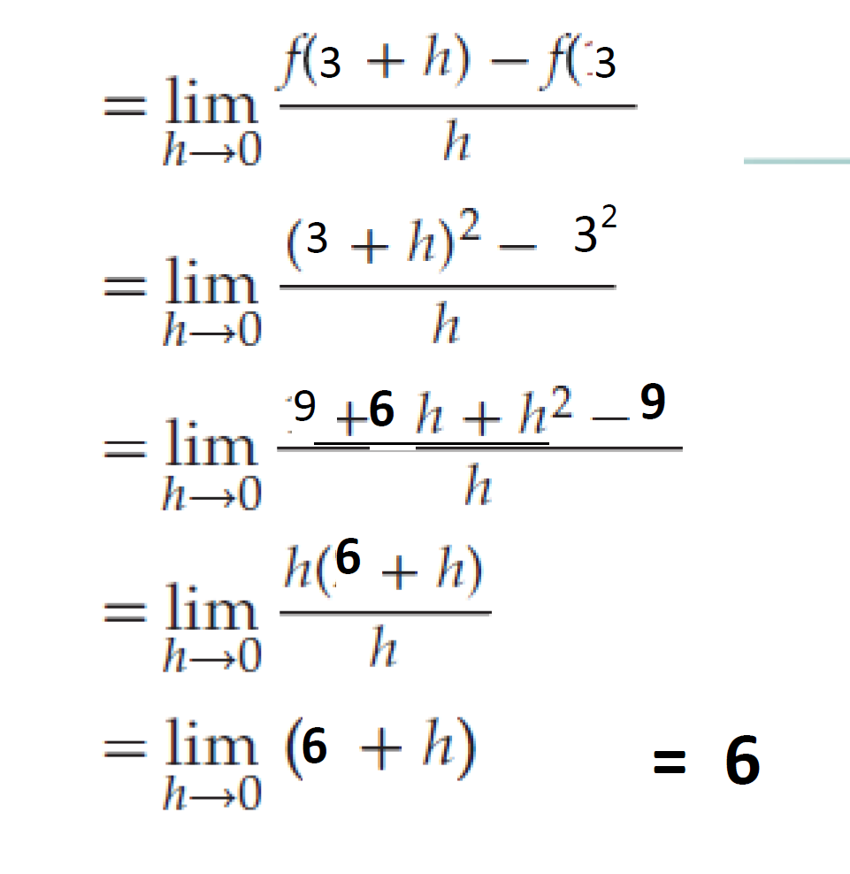
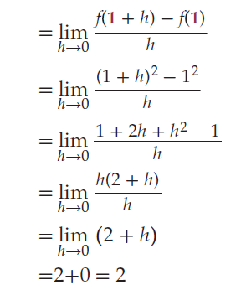
3
3
3
3²
9
6
9
6
6
= 6

Slide 7
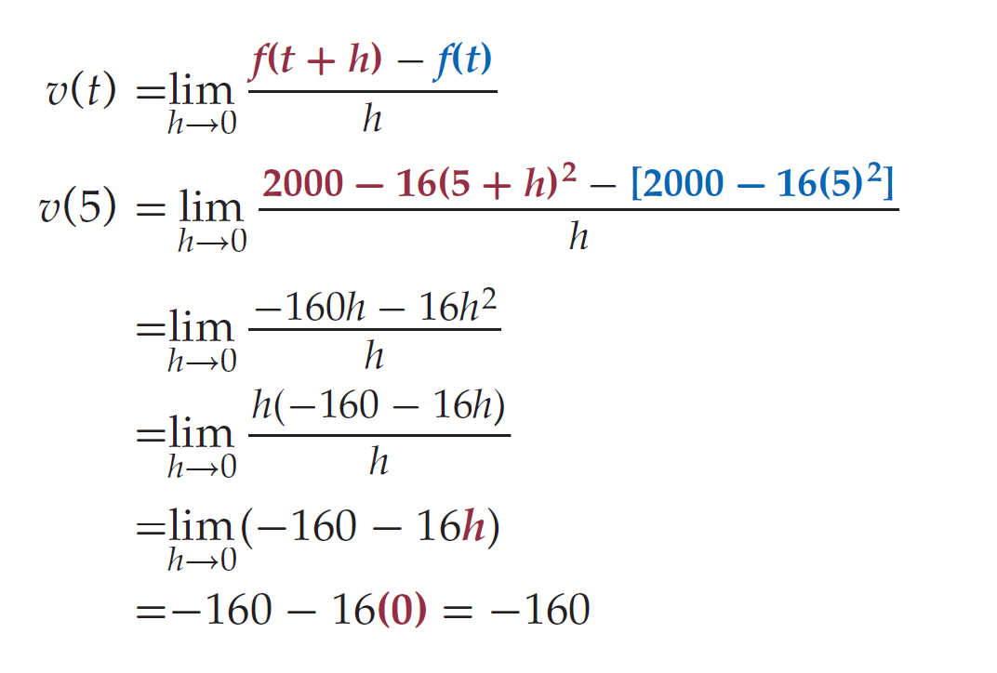
1400
7
1400
7

