Slide 5
Indiana University
Intensive English Program

Slide 6
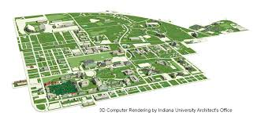
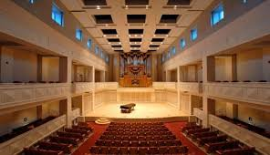
The University
Indiana University was founded in 1820 and is one of
the oldest and largest state-sponsored universities
in the United States. It is internationally known for
the excellence and variety of its programmes. The
University has over 100 academic departments and a
full-time faculty of over 1,500, including members of
many academic societies.

Slide 7
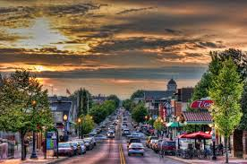
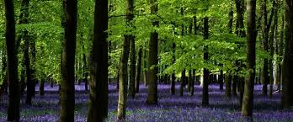
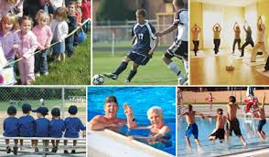
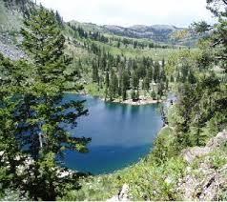
It is located in Bloomington, the cultural and recreational centre of southern Indiana in the midwestern
US.
Bloomington, a dynamic, safe and
culturally-sophisticated town, has a population of
65,000 inhabitants (not including university students).
It is surrounded by hills, green woodlands and lovely
lakes.

Slide 8
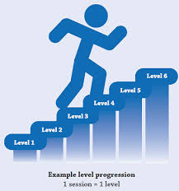
IEP
The goal of the Indiana University Intensive English
Program (IEP) is to increase the English language
skills of non-native English speakers to the level
needed for study at a college or university in the
United States. We encourage students to reach this
goal as quickly as possible. Teachers in the IEP are
qualified to teach English as a second language and
have taught in the United States and abroad.

Slide 9
Requirements for Admission
All students admitted to the programme must have
earned at least a high school diploma and must show
that they or their sponsors are able to pay for their
living expenses and tuition while in the United States.
Our application materials will tell you how much
money is needed for each session

Slide 10
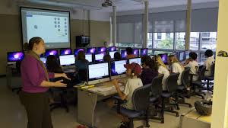
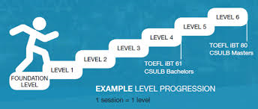
Curriculum
There are seven levels in the IEP. All levels meet
for 20-24 classroom hours each week. Levels One
through Five use audio-visual materials, as well as
campus computer and language laboratory resources.
These levels concentrate on listening, speaking,
writing and grammar.

Slide 11
Level Six is a high intermediate academic reading and
writing class, which focuses mainly on writing. After
completing Level Six, most students are ready to begin
academic work at a college or university. However,
some additional English may be recommended to help
them adjust to their new environment.

Slide 12
In Level Seven students focus on written analysis
of authentic texts. This gives them a clear idea of
the kind of work which is required by American
universities. At levels Six and Seven, students also
select from a variety of courses in advanced grammar,
advanced pronunciation, business, computer skills,
communication, literature, test preparation and the
World Wide Web to meet their particular needs and
interests.

Slide 13
College and University Placement
Graduates of the Center for English Language
Training have gone on to pursue careers in such
areas as physics, art, chemistry, business, education
and even teaching English as a foreign language.
We offer careers guidance to qualified students
who want to apply either to Indiana University or to
other colleges or universities in the United States.
Admission, however, to the Intensive English Program
does not guarantee admission to specific academic
programmes at Indiana University.

Slide 14
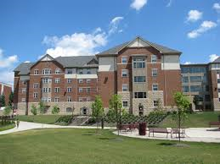
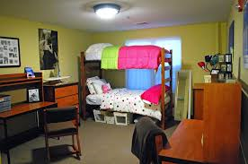
Housing
There is a wide variety of housing available in
Bloomington for both married and single students:
on-campus housing is arranged through the IU Halls
of Residence. After receiving your application form,
we will send you a campus housing application.
Campus apartments are all within walking distance
of classes and are on the University bus routes. Many
off-campus apartments are located near campus
or near city bus routes. Off-campus housing is best
arranged after your arrival in Bloomington, but you
can begin by browsing the electronic classified ads in
the Bloomington Herald Times.

Slide 15
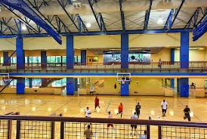
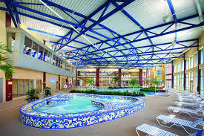
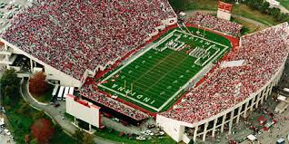
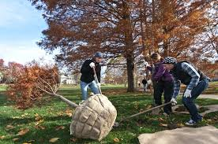
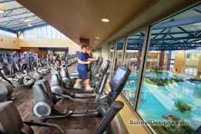
Extracurricular Activities
Bloomington and Indiana University offer a large
variety of recreational activities and social events
going on all year round. To begin with, soccer,
swimming, boating, tennis, racquetball, skiing and
many other forms of exercise and relaxation are
readily available. We have also combined education
and enjoyment with trips to nearby zoos, art festivals,
museums and nature centres.

Slide 16
E.3 ( 1-6 ) p.8
E.4 p.8

