Slide 1
Unit 2
Lesson 1

Slide 2
The
Best of the
past

Slide 3
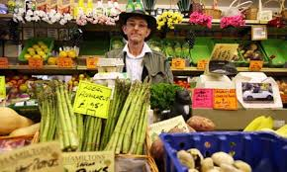
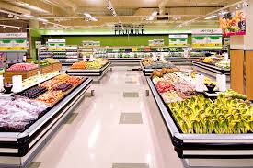
Local shop versus supermarket
vs

Slide 4
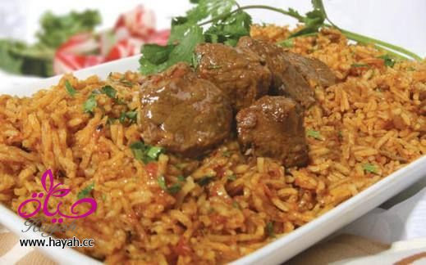

Slide 6
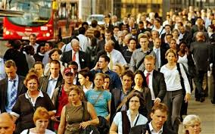
Urban dwellers

Slide 7
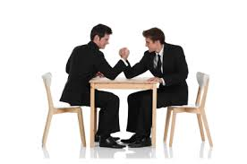
rivalry

Slide 8
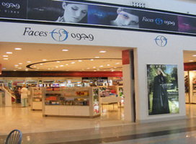
retail

Slide 9
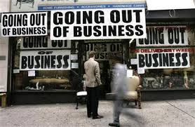
Gone out of business

Slide 10
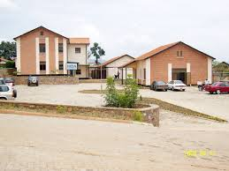
premises

Slide 11
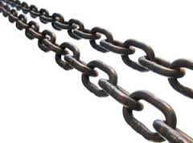
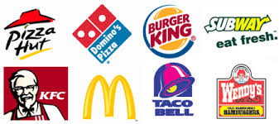
chains
Fast food chains

Slide 12
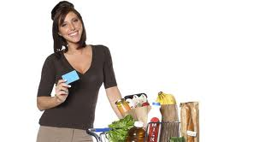
consumer

Slide 13
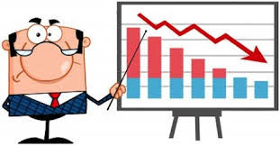
decline

Slide 14
1-Do young urban dwellers know the meaning of local shop ?
2-with whom did the local shop face rivalry ?
3-How many shops are closing in UK every year?
4-Who should help to stop the decline of the local shops ?

