Slide 1

Comparatives and superlatives
Unit :6
Grammar
E.T Nada El-Alfy

Slide 2

Comparatives and Superlatives are special forms of adjectives.
They are used to compare two or more things.
Generally, comparatives are formed using -er and superlatives are formed using -est.

Slide 3

Forming comparatives and superlatives
How these forms are created depends on how many syllables there are in the adjective.
Syllables are like “sound beats”. For instance, “sing” contains one syllable, but “singing” contains two — sing and ing. Here are the rules:

Slide 4

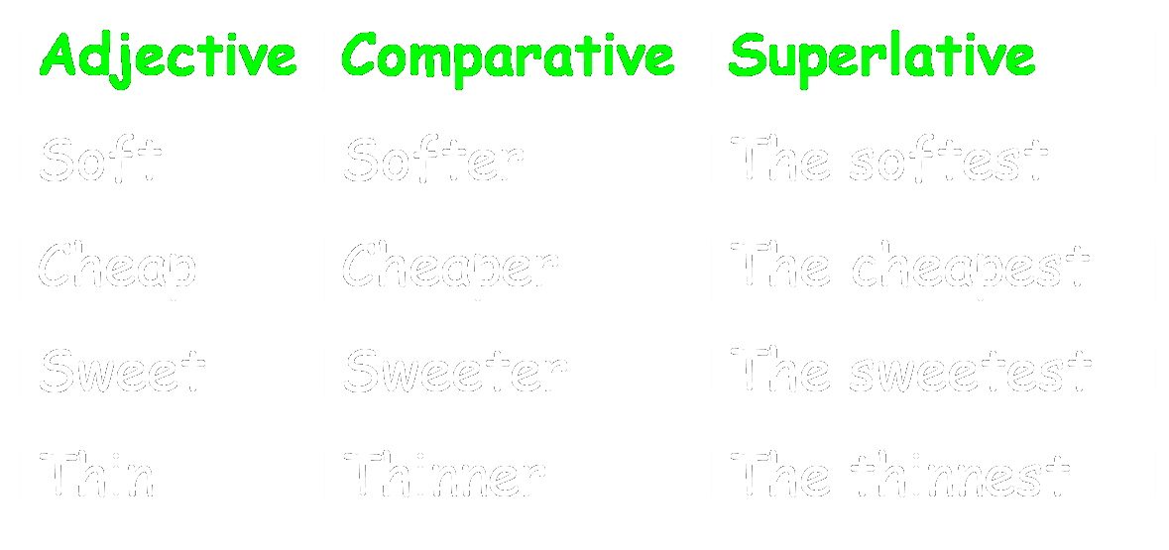
One syllable adjectives
One syllable adjectives generally form the comparative by adding -er and the superlative by adding -est, e.g.:

Slide 5

SPELLING RULES
Note that if a one syllable adjective ends in a single vowel letter followed by a single consonant letter, the consonant letter is doubled, e.g.: thin → thinner, big → biggest.
If an adjective ends in -e, this is removed when adding -er/-est, e.g.: wide → wider/widest.
If an adjective ends in a consonant followed by -y, -y is replaced by -i when adding -er/-est, e.g.: dry → drier/driest.

Slide 6

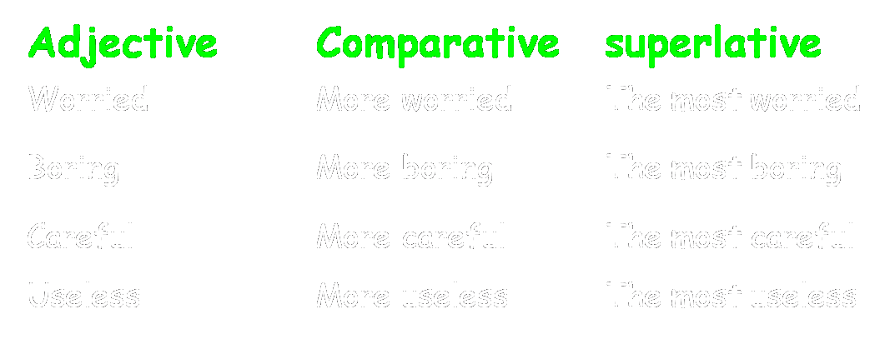
TWO SYLLABLE ADJECTIVES
two syllable adjectives ending in -ed, -ing, -ful, or -less always form the comparative with more and the superlative with the most, e.g.:

Slide 7
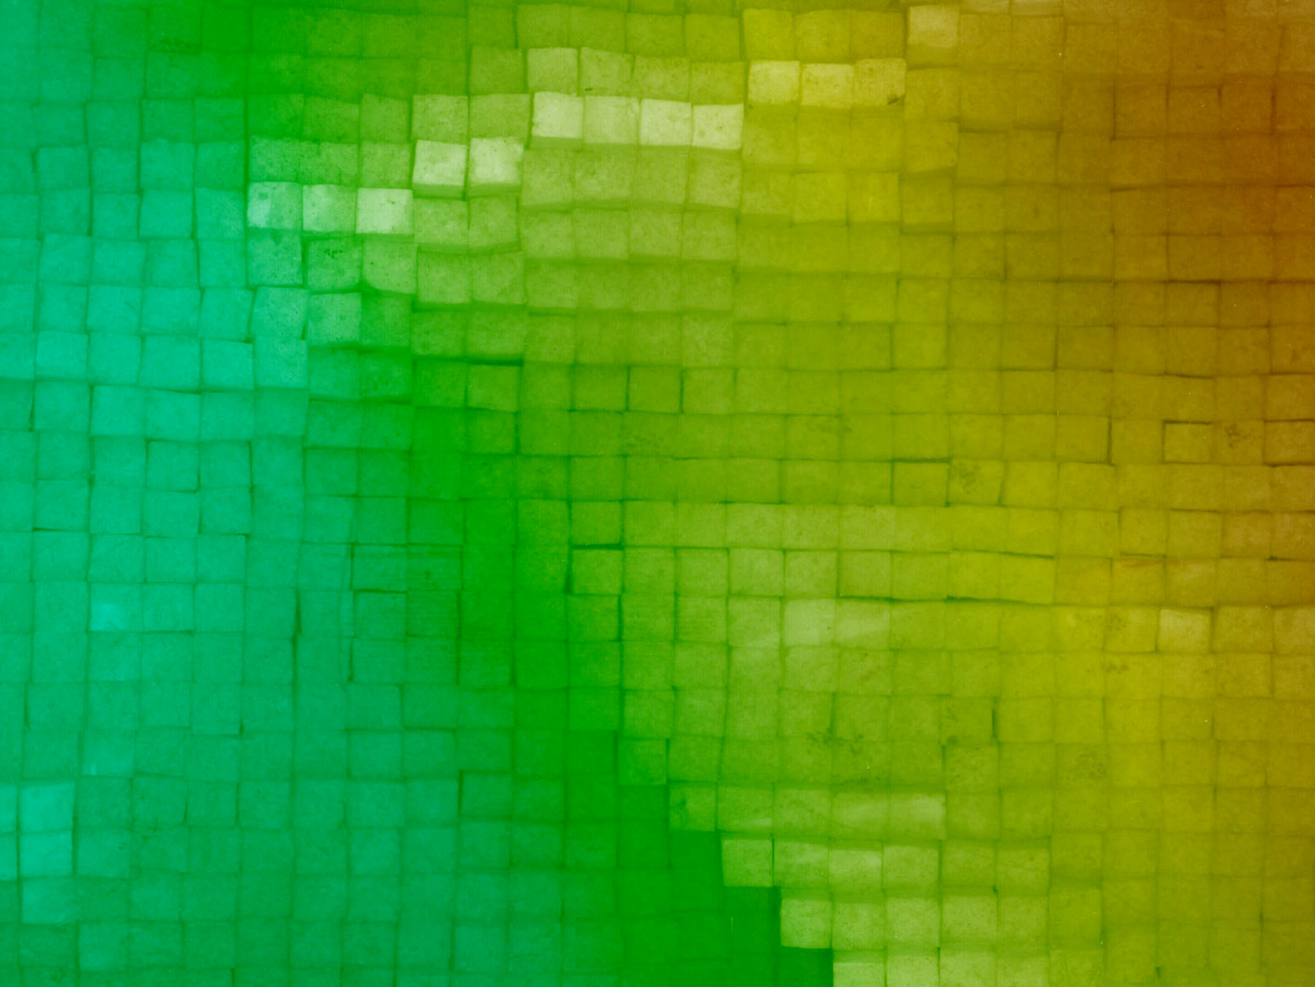
two syllable adjectives ending in -ed, -ing, -ful, or -less always form the comparative with more and the superlative with the most, e.g.:

Slide 8

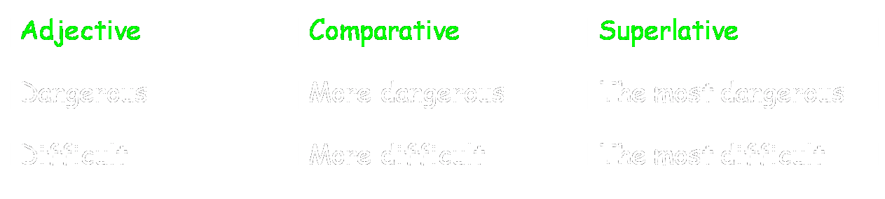
Three or more syllables
Adjectives which have three or more syllables always form the comparative and superlative with MORE and THE MOST

Slide 9

What is the superlative of "small"?
  smallier
  smaller
  smalliest
  smallest
What is the superlative of "deep"?
  deeper
  deepper
  deepest
  deeppest
What is the comparative of "heat"?
  heater
  heatter
  heatier
  hetter
  none of these

Slide 10

What is the superlative of "unpleasant"?
  unpleasant
  most unpleasant
  more unpleasant
  unpleasantest
What is the superlative of "soft"?
  softest
  softiest
  softtest
  most soft
What is the comparative of "destructive"?
  destructiver
  more destructive
  destructivier
  more destructiver

Slide 12
