Slide 1
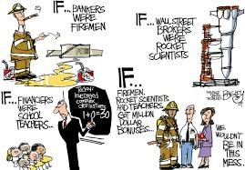
CONDITIONAL IF by Nada El-Alfy

Slide 2
i
There are four basic types of conditional sentence:
Zero conditional
First conditional
Second conditional
Third conditional

Slide 3
Conditional Sentences
Structure :
A conditional sentence is composed of 2 parts :
If-clause
+
Main Clause
Example :
If it rains tomorrow, we will not come.
If-clause
Main Clause

Slide 4
Conditional Sentences
Types :
The order of the two clauses is flexible, it’s not
important.
But if the if-clause comes first, it must be followed by
a comma.
If it rains, I’ll stay at home
There are 4 types of conditional sentences.
They are classified according to the degree of
probability that they express.
Each type of conditional sentences uses different
tenses to show the difference in the degree of
probability.

Slide 5
Conditional Sentences
Zero Conditional: If /when + present tense ….. / modal
Water boils if it reaches 100º
First Conditional: If/unless + present,….. Future
If I study, I’ll pass
Second Conditional: If + past, ……would +inf.
If I studied, I would pass
Third Conditional: If + past perfect ….. would have + pp
If I had studied, I would have passed

Slide 6
Zero Conditionals
Tense :
Present tense in both clauses
Example :
Present Tense
Present Tense
If you heat water to 100°C, it boils.
If you pour oil into water, it floats.

Slide 7
Zero Conditionals
Use :
Talk about universal truth.
If you heat ice, it turns to water
To talk about habits
If I see a spider, I get very scared!

Slide 8
First Conditionals
Tense :
If-clause ~ Present Tense
Main Clause ~ Future Tense
Present Tense
Future Tense
If I feel sick tomorrow, I will not go to school.
If it rains, the match will be cancelled.

Slide 9
First Conditionals
Use :
To speak about possible or probable future events.
If the weather is as sunny tomorrow as it was today, we will go surfing.
To make promises or warnings
If you forget my birthday, I’ll never speak to you again.
To give commands
If you are tired, go to bed!
In this case the verb in the main clause is an Imperative

Slide 10
Exercise One. First Conditionals
do not come
If you ___________________ (not come),
You ________________ (miss ) the show.
will miss
will buy
John __________________ (buy)a car if he
_____________ (get) a job.
gets
will get
Mary ________________(get) a toothache if
she_________________ (eat) too many sweets.
eats

Slide 11
Second Conditionals
Tense :
If-clause ~ Past Tense
Main Clause ~ would + an infinitive
Example :
Past Tense
Would + infinitive
If he were a bird, he would fly across the harbour.
If I had $200,000 now, I would buy a car.

Slide 12
Second Conditionals
Use :
To speak about present and future
situations which are unlikely to happen.
If I had any money I would lend it to you.
If I were you I wouldn't do this.
MIND
Were is often used instead of was in the 1st and 3rd person singular

Slide 13
Third Conditionals
Tense :
If-clause ~ Past Perfect Tense
Main Clause ~ Would Have + Past Participle
Past Perfect Tense
Would have+ Past Participle
If I had had enough money, I would have bought the camera yesterday.
If I had come home earlier, I would not have missed the programme.

Slide 14
Third Conditionals
Use :
To speak about impossible past events
If they’d gone by bus, they would have arrived much later.
(They didn’t go by bus)
He would have travelled around the world if he had had more money.
(Impossible to change, because he didn’t have the money)

Slide 15
Exercise Two
were
If I ________________ (be) four years old, I
________________ (learn) to play the piano.
would learn
had not failed
If I ________________ (not fail) in the
examination, my mother_______________ (buy)
me a new computer.
would have bought
would have finished
3. We ________________________ (finish) if we
________________ (have) better preparation.
had had

Slide 16
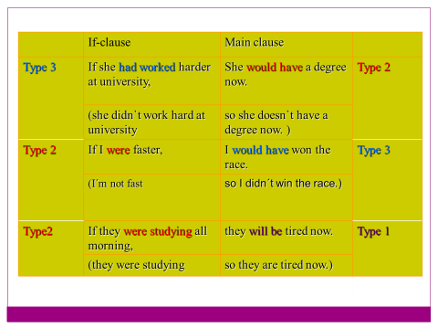

Slide 17
Words other than if

Slide 18
Conditional Sentences
Other connectors:
Type 1 : UNLESS
If you don’t phone John, he’ll get very angry.
Unless you phone John, he’ll get very angry.
Unless can replace If in negative conditionals

Slide 19
Conditional Sentences
Other connectors:
PROVIDED / PROVIDING (THAT)/ WITH THE CONDITION THAT/ AS LONG AS
You can stay with the condition that you
sleep on the couch.
I will go to the party as long as you go there too
IMAGINE / SUPPOSE /SUPPOSING THAT
Imagine that you won a million pounds, what would you do?

Slide 20
Conditional Sentences
Other connectors:
EVEN IF
I won’t go to the party even if they beg me
IN CASE
Take an umbrella in case it rains

Slide 21
Exercises
Identifying conditionals
I. Choose the correct answer.
1 - If I drink tea in the morning, it makes me feel sick.
Zero Conditional
First Conditional
Second Conditional
Third Conditional
✓

Slide 22
Exercises
2 - I'll tell her if she comes.
Zero Conditional
First Conditional
Second Conditional
Third Conditional
✓
3 - If I were you, I'd buy it as soon as possible.
Zero Conditional
First Conditional
Second Conditional
Third Conditional
✓

Slide 23
Exercises
4 - If I had the time, I’d help you
Zero Conditional
First Conditional
Second Conditional
Third Conditional
✓
5 – I would have done things differently if I had been the manager.
Zero Conditional
First Conditional
Second Conditional
Third Conditional
✓

Slide 24
Exercises
II. Choose the correct answer.
1 - If I ...... you, I would tell him straightaway
were
am
✓
2 - If you ...... yellow and blue, you get green
will mix
mix
✓
3 - If I .........., I would never have done it
knew
had known
✓
4 - Unless you ....... drinking, you'll have serious health problems.
stop
will stop
✓

Slide 25
Exercises
5 - I ......... there if I'd known about it
would never have gone
would never go
✓
6 - If you see him, ......... him to call me?
will you ask
would you have asked
✓
7 - If I ........., I'd have done it myself
were there
had been there
✓
8 - What would you do if the police ......... you?
arrested
had arrested
✓

Slide 26
Exercises
Finish these sentences using the correct verbal tense.
If they had listened, they.............................. (understand)
If he hadn’t worn the helmet, he.......................... (Be) injured.
If he........................... (Speak) clearly, people would understand him.
If we miss this train, we.................................. (Be) late for the interview.
The bank............................................. (not / call) if we pay the bill.
If you................................... (meet ) Tom, you wouldn’t like him.
If I found 100 in the street, I …………………….......... (Keep) it.
If I ……………... (Know) her number, I would phone her.
If he gets late, I ………….. (be) angry.
I …………………….. (Not/buy) that coat if I were you..
If I ……………….. (Know) that you were ill last week, I'd have gone to see you.
If it stops raining, we …………………. (Go) on a trip.
would have understood
Would have been
spoke
Will be
Won’t call
met
Would keep
knew
Will be
won’t buy
had known
will go

Slide 27
Exercises
Choose the correct answer
1 If Teresa………more sensible, she wouldn’t get into trouble so often.
a) will be b) were c) had been
2 ……… me some ice cream if you go to the supermarket.
a) Got b) Get c) Have got
3 If I……...late, will you wait for me?
a) be b) am c) will be
4 If Vanessa had……..me the truth, I would not have been so angry.
a) told b) tells c) tell
5 If you listen to her, you’ll………in trouble.
a) been b) being c) be
6 If you had listen to her, you……….have been in trouble.
a) shouldn’t b) wouldn’t c) couldn’t
7 Nobody would……the secret if Danny hadn’t revealed it.
a) have known b) knew c) known
8 Will you be all right by yourself if I………. out tonight?
a) go b) will go c) would go
9 If I knew how to run my own business, I………..a rich man.
a) am b) will be c) would be
10 If anyone………., say I’ll be back about 7.30.
a) will phone b) phone c) phones
B
B
B
A
C
B
A
A
C
C

Slide 28
Mixed exercises
What would you do in these situations
You are alone in the forest at night without a phone.
You met the genie.
If I met the genie, I would ask him for my three wishes.
If I were alone in the forest I would try to use the stars.

Slide 29
Mixed exercises
What would you do in these situations
One day you read in a newspaper an article about you. The article was telling about your private life.
Your favourite singer wrote a song for you.
If I read an article about my private life, I’d look for a lawyer.
If my fauvorite singer wrote a song for me, I’d be excited.

Slide 30
Mixed exercises
What would you do in these situations
You enter the classroom and suddenly realize that you’ve forgotten to dress your trousers.
You are going to a date. But suddenly a bird made your jacket dirty.
If a bird made my jacket dirty, I’d run to buy other.
If I forgot to dress my trousers, I’d try to invent some explanation.

Slide 31
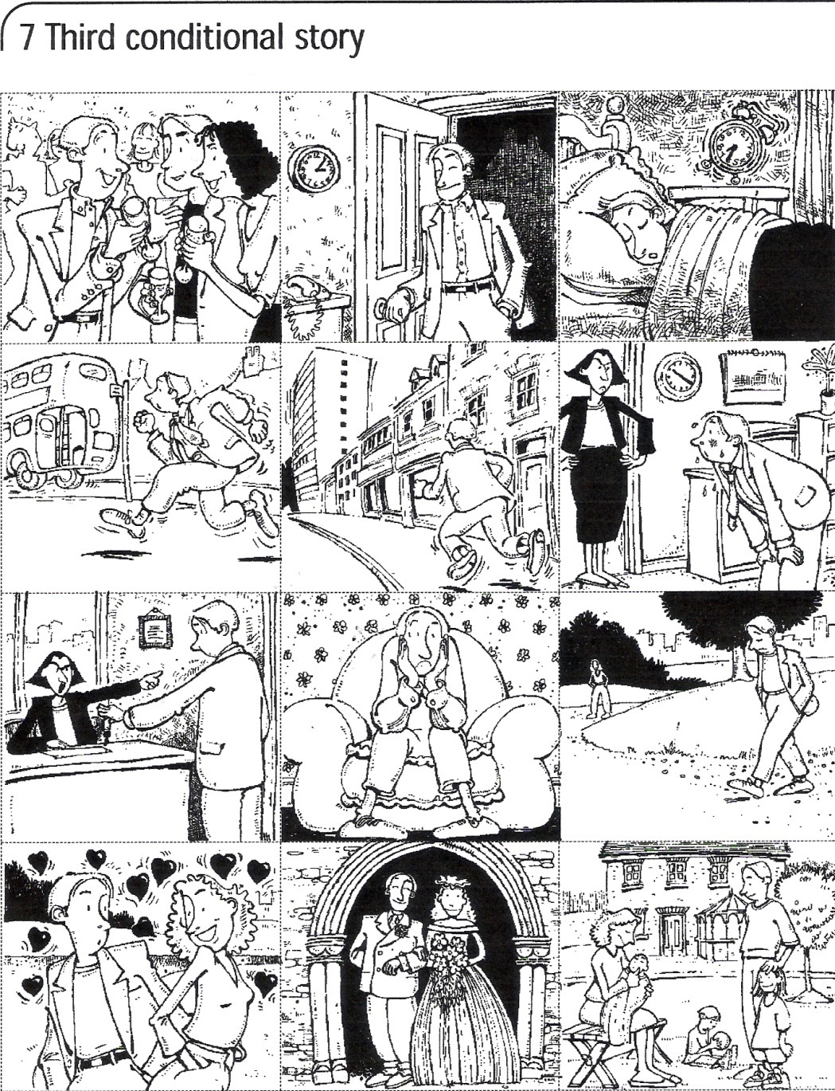
Third Conditional story
Look at this photo story.

Slide 32
Third Conditional story
Write what happened in each picture.
He went to a party
He overslept.
He arrived home very late.

Slide 33
Third Conditional story
Write what happened in each picture.
He missed the bus
He was late for work and his boss was very angry.

Slide 34
Third Conditional story
Write what happened in each picture.
His boss was angry and he was dismissed
He went for a walk.

Slide 35
Third Conditional story
Write what happened in each picture.
He met a girl and they fell in love.
Now they have three children.
They got married.

Slide 36
Third Conditional story
Write what would have happened if….
If he hadn’t gone to a party…..
he wouldn’t have arrived home late.
If he hadn’t arrived home very late…..
he wouldn’t have overslept.

Slide 37
Third Conditional story
Write what would have happened if….
If he hadn’t overslept…..
he wouldn’t have missed the bus.
If he hadn’t missed the bus…..
he wouldn’t have been late for work.

Slide 38
Third Conditional story
Write what would have happened if….
If he hadn’t been late for work,……
his boss wouldn’t have got angry.
If he hadn’t been dismissed…..
he wouldn’t have gone to the park.

Slide 39
Third Conditional story
Write what would have happened if….
If he hadn’t gone to the park,…..
he wouldn’t have met a girl.
he wouldn’t have got married and wouldn’t have had three children.
If he hadn’t met the girl…..

Slide 40
Third Conditional story
Therefore ….
If he hadn’t gone to the party,…..
he wouldn’t have got married.

Slide 41
Web pages
Note: For more practice use you you can click:
http://www.isabelperez.com/conditionals1.htm
http://www.miguelmllop.com/practice/intermediate/grammar/conditionals8.htm
http://www.better-english.com/grammar/condit23.htm
http://www.miguelmllop.com/practice/intermediate/grammar/conditionals7.htm
http://www.ego4u.com/en/cram-up/grammar/conditional-sentences/type-1/exercises?02
http://www.geocities.com/athens/olympus/7583/condprac1.html
http://a4esl.org/q/h/vm/if-clauses.html

Slide 42
Any questions?

Slide 43
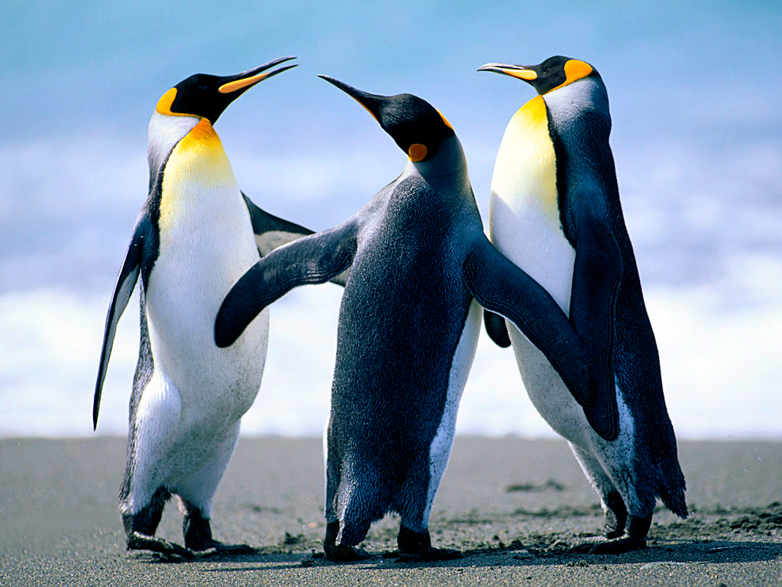
THANK YOU FOR YOUR ATTENTION
HAVE A WONDERFUL DAY!

