Slide 1
WELCOME TO..
UNIT: 3
Lesson: 3

Slide 2
New words….
achieve : (r-reg)-
do something successfully.
belief :( n)-
1-Something that is believed.
2- opinion.

Slide 3
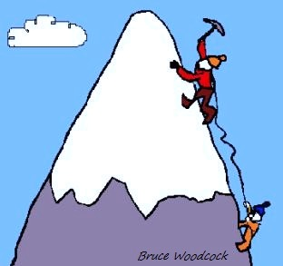
example- Keep calm and achieve your goals

Slide 4
Compete :(v-reg)
Try to beat others.
Competitor: (n)
a person who competes .
Harvest :(n) –
The collection by farmers of cereals, fruits and vegetables .

Slide 5
example
This award is given to only
one high school speech team competitor in the state

Slide 6
one another :(pronoun) –
each other .
Performancee :(n)
The way someone does his work.
Perform :(v-reg) –
do one’s work .

Slide 7
record :(n)-
the best result in an event .
Represent:(v-reg) –
Stand in the place of ;speak for .

Slide 8
Responsible :(adj)- A man who is responsible for doing a job must do it .
Selection :(n) –
1- choosing some one from different
possible choices.
2- choice .
Select : (v-reg)-
Choose .

Slide 9
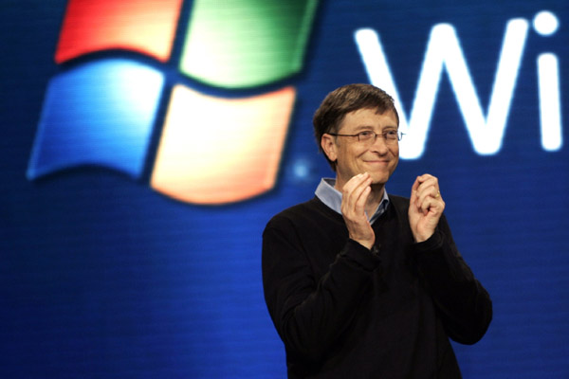
example
-
bill gates is responsible
for Microsoft Company.

Slide 10
example
Suzan thinking which shoe should be select brown one or gray ?

Slide 11
Silk : (n)-
A thread which is made by a kind of insect .
Would rather : (v) –
Would like to do one thing more
than another thing .

Slide 12
example
my red dress made from silk thread.

Slide 13
١/٢ علمي
جميلة محمد وارث
أسماء أحمد
باهيثم
إيناس حسن
أحمد
أمل أحمد مبارك

