Slide 1
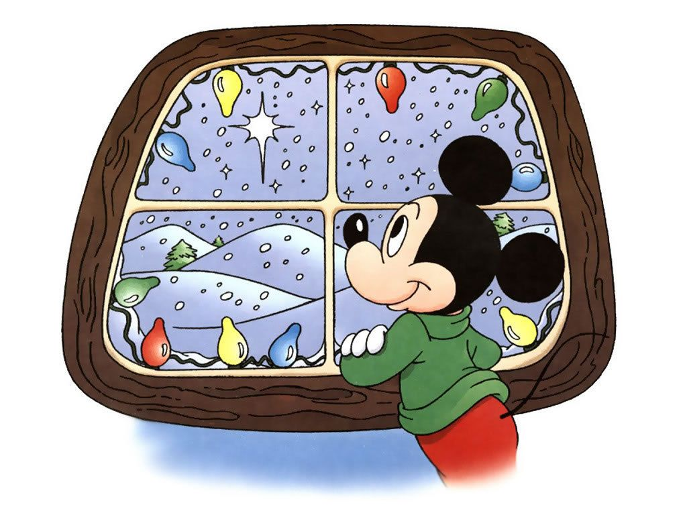

Slide 2
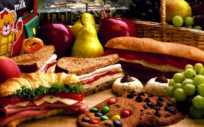
What did we study in module 2 ?
Adjectives
ending with
( Ed ) and ( Ing )
Adjectives
Describing ( food )
Activities
Vocab
?

Slide 3
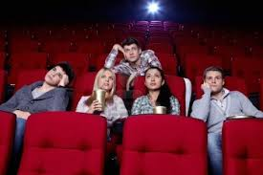
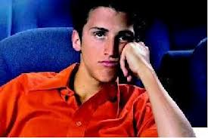
boring – bored
boring
The movie is ……………
bored
I am ……………

Slide 4
Your turn now
1- Group work

Slide 5
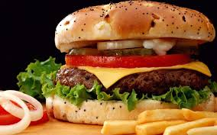
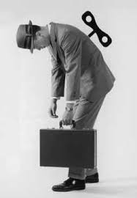
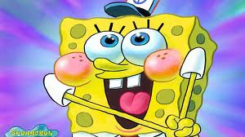
Put these pictures in sentences + adj
1
2
3
6
4
5

Slide 6
What did we study in module 2 ?
Adjectives
ending with
(Ed ) and ( Ing )
Vocab
Adjectives
Describing ( food )
Activities
?

Slide 7
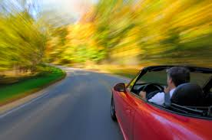
quickly
He drives the car ………….. .

Slide 8
What did we study in module 2 ?
Adjectives
ending with
(Ed ) and ( Ing )
Adjectives
Describing ( food )
Activities
Vocab
?
adverbs

Slide 9
What did we study in module 2 ?
While + When +
as soon a
Past Progressive
Past Simple
grammar

Slide 10
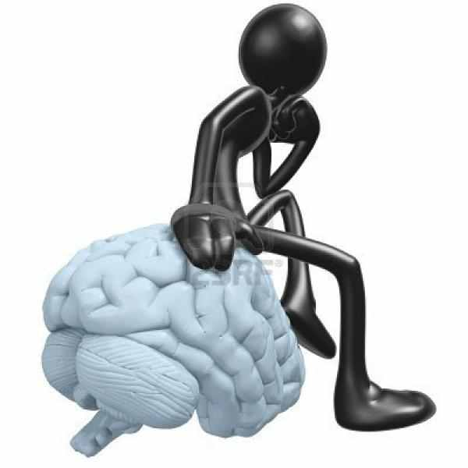
How do
We learn
English
?
Think .
How can connect between them ?
We learn it as second language .

Slide 11
While
When

Slide 12
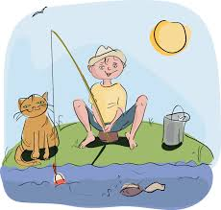
Was fishing
While John ……….……. ( fish) , he ………..……..( see)
a bear .
saw
While

Slide 13
John …………( see ) a bear while he
……………… ( fish )
saw
Was fishing

Slide 14
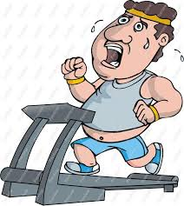
He …………... ( do ) some exercise
When he ……..……..( feel)
a pain in his chest .
Was doing
felt
When

Slide 15
When he ……..……..( feel)
a pain in his chest , he ……………( do )
some exercise
felt
Was doing
When

