Slide 1
UNIT 7
LESSON 1

Slide 2
My School

Slide 3
office

Slide 4
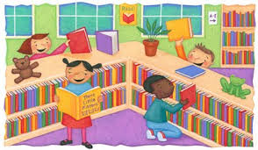
library

Slide 5
calssroom

Slide 6
PUPIL
Teacher

Slide 7
whiteboard

Slide 8
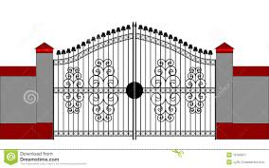
Gate

Slide 9
Listen and Say
Aa Bb Cc Dd Ee Ff Gg Hh Ii Jj Kk Ll Mm Nn

Slide 10
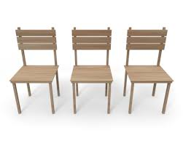
How many ….. ?

Slide 11
Homework
83 - 84

