Slide 1
Good morning
Module: 2
Lesson: 2a

Slide 2
Discussion and Reading

Slide 3
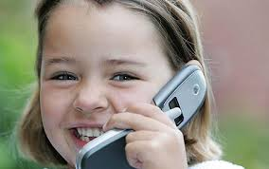
Talk about that day :
When did you get your first mobile phone ?

Slide 4
What am I doing ?
I get me first phone when I was ……….
It was a gift from my elder brother .
At the beginning it wasn’t easy to use
It was ……….day and unforgettable experience I passed through .

Slide 5
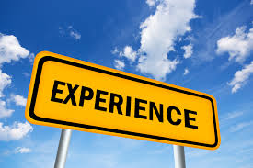
What an Experience ?
Past tense
When we ask this question ?
To talk about an activity or event took place in the past .

Slide 7
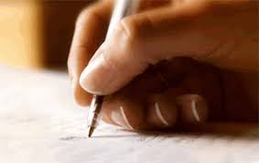
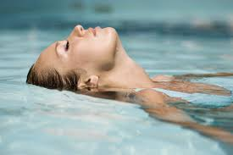
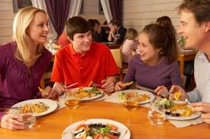
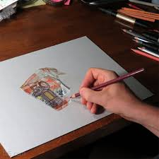
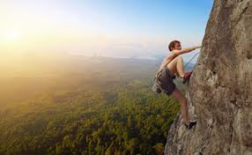

Slide 8
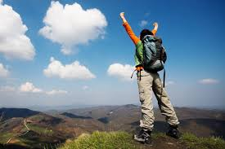
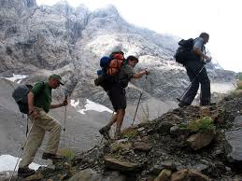
hiking

Slide 9
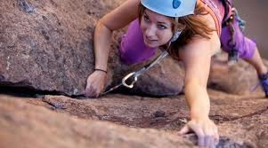
Rock climbing

Slide 10
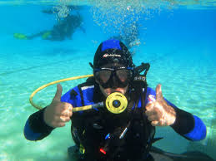
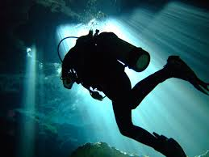
Scuba diving

Slide 11
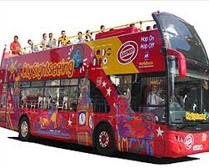
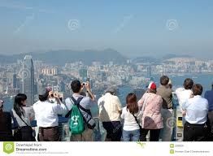
sightseeing

Slide 12
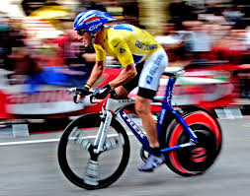
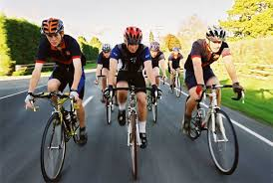
cycling

Slide 13
Shopping

Slide 14
Dialogue

Slide 15
Adjectives ending in (ed and ing )

Slide 16
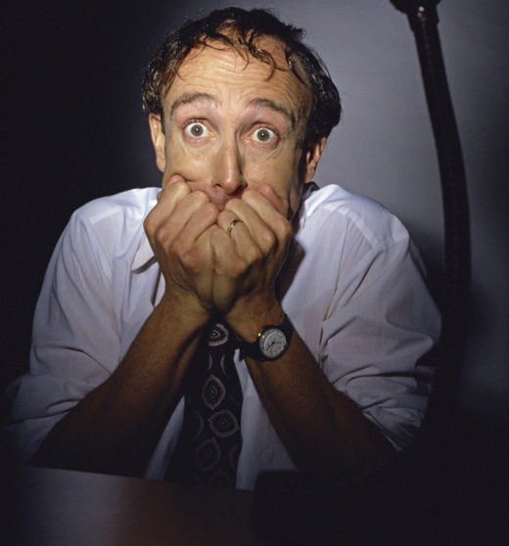
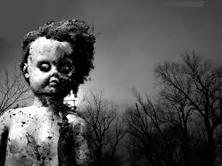
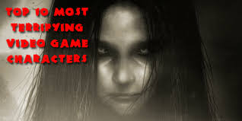
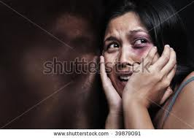
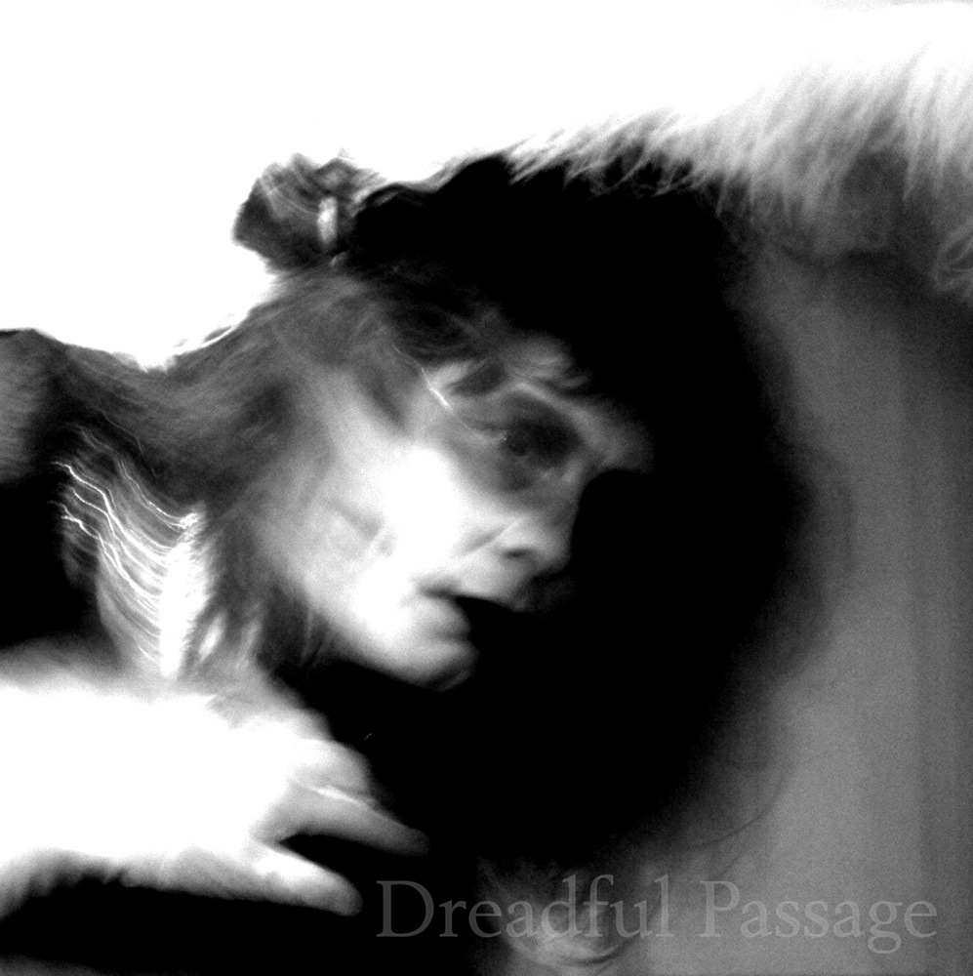
terrified or terrifying
terrifying
terrified
These are terrifying pictures
She / He is terrified

Slide 17
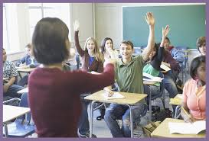
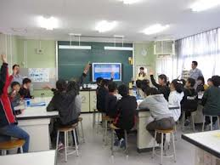
interested - interesting
interesting
It is an ………………. lesson
interested
They are………….…… students

Slide 18
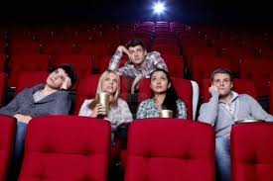
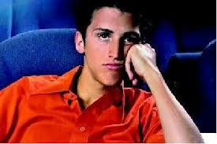
boring – bored
boring
The movie is ……………
bored
I am ……………

Slide 19
Group work :
1-Choose a number .
2- give a sentences.

Slide 20
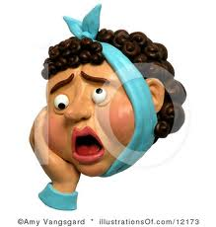
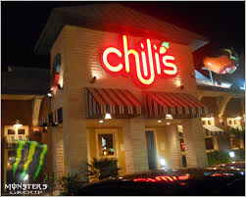
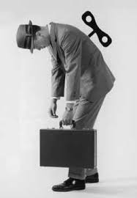
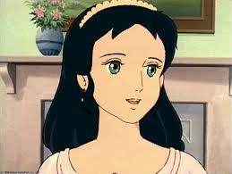
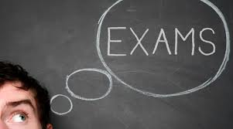
Put these pictures in sentences + adj
1
2
3
5
6
4

Slide 21
Open your book at P.

Slide 22
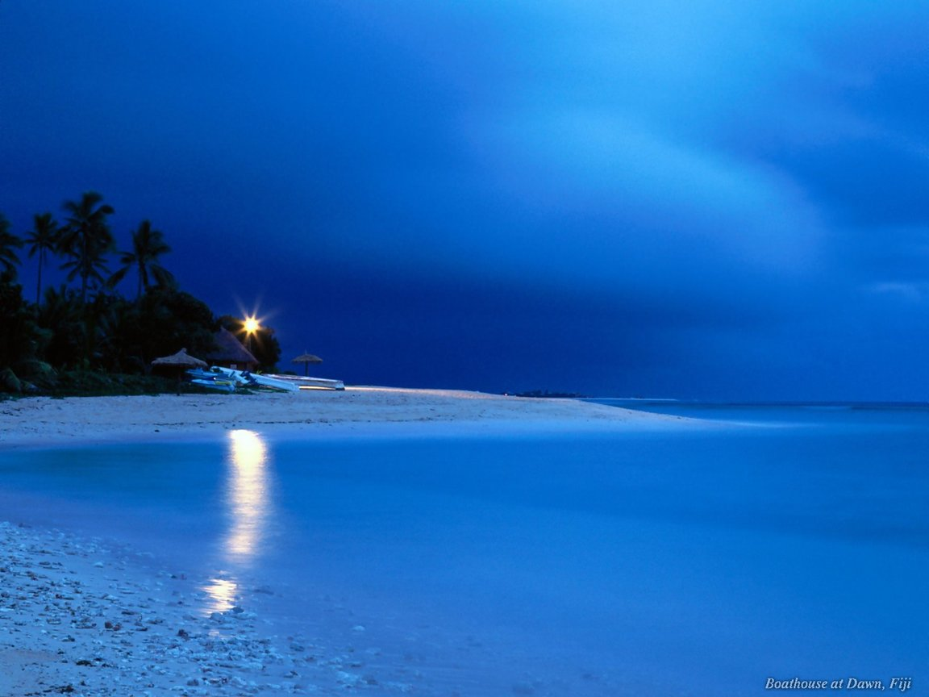
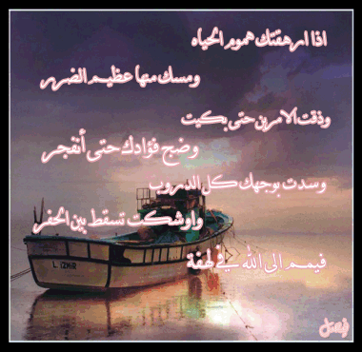
أ \ فاتن فهد النحاس

