Slide 1
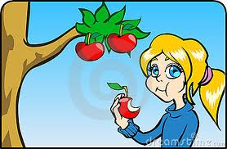
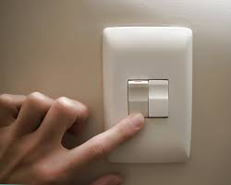
I spy
some thing starts with ….
b- Y – n
Choose:
*she eats an apple by her …………(mouth - ear).
*he smells flowers by his …….……(hair - nose).
-I turn the light to switch on by my ……........ (leg - finger).

Slide 2
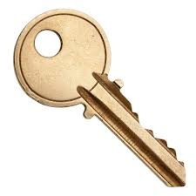
Write the letters:
ke……. …..en …..outh
Colorful fan

Slide 3
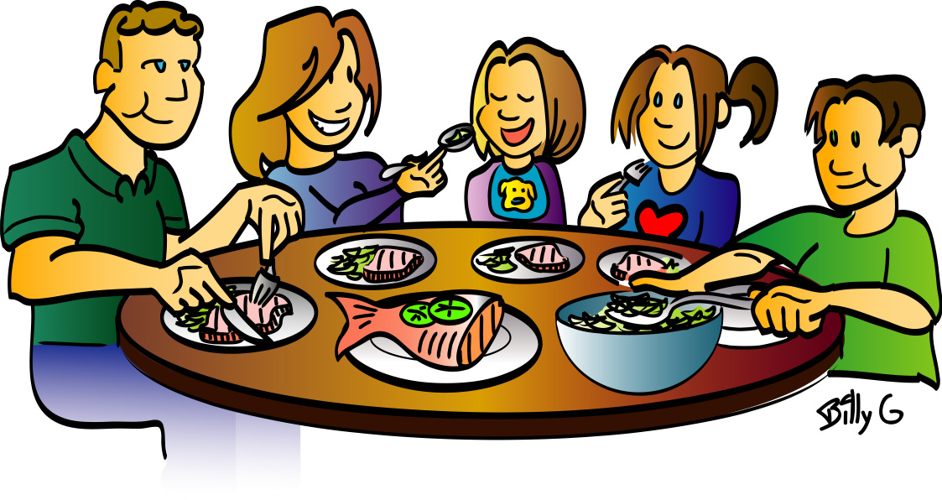
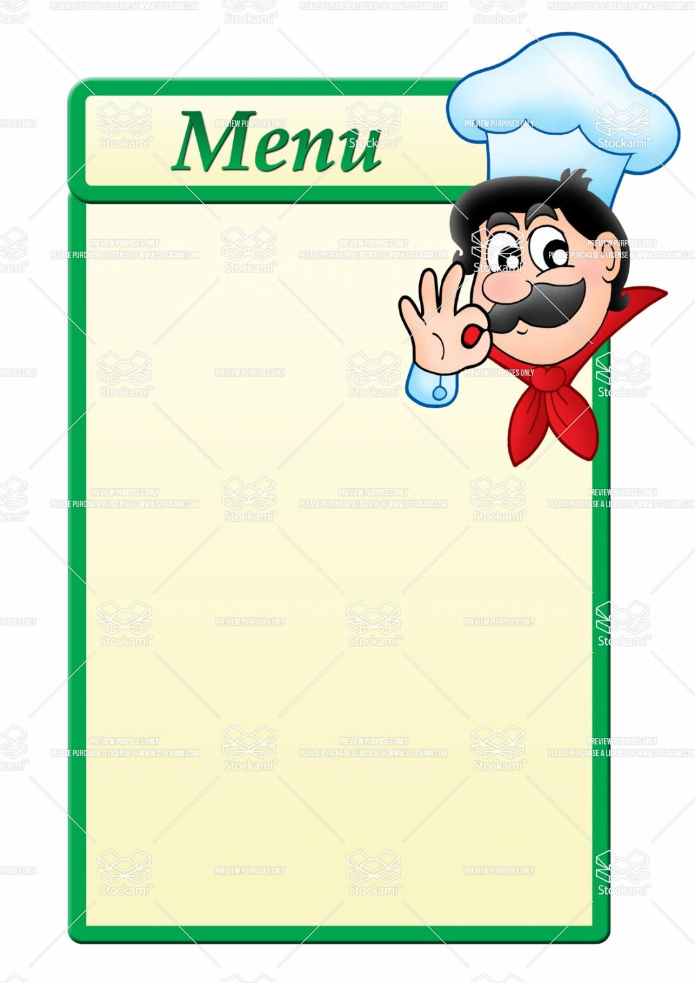
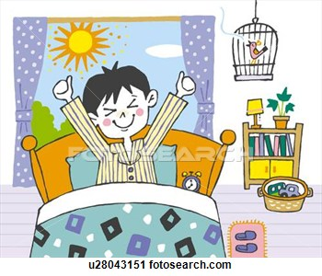
Breakfast

Slide 4
Unit: 4
Lesson: 1

Slide 5
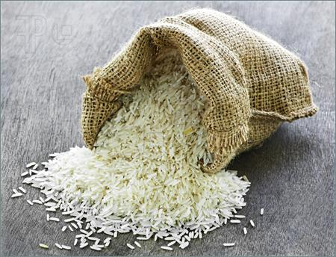
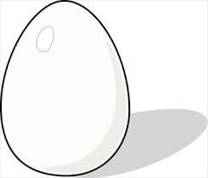
apple
orange
rice
egg
juice

Slide 6
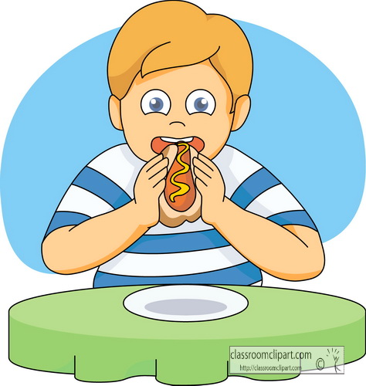
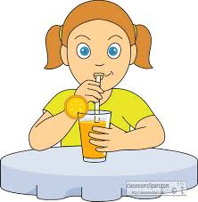
drink
eat

Slide 7
Drink
or
Eat
And read

Slide 8
How many …….… ?

Slide 9
In one minute:
Make question & answer by using clothes line.

Slide 10
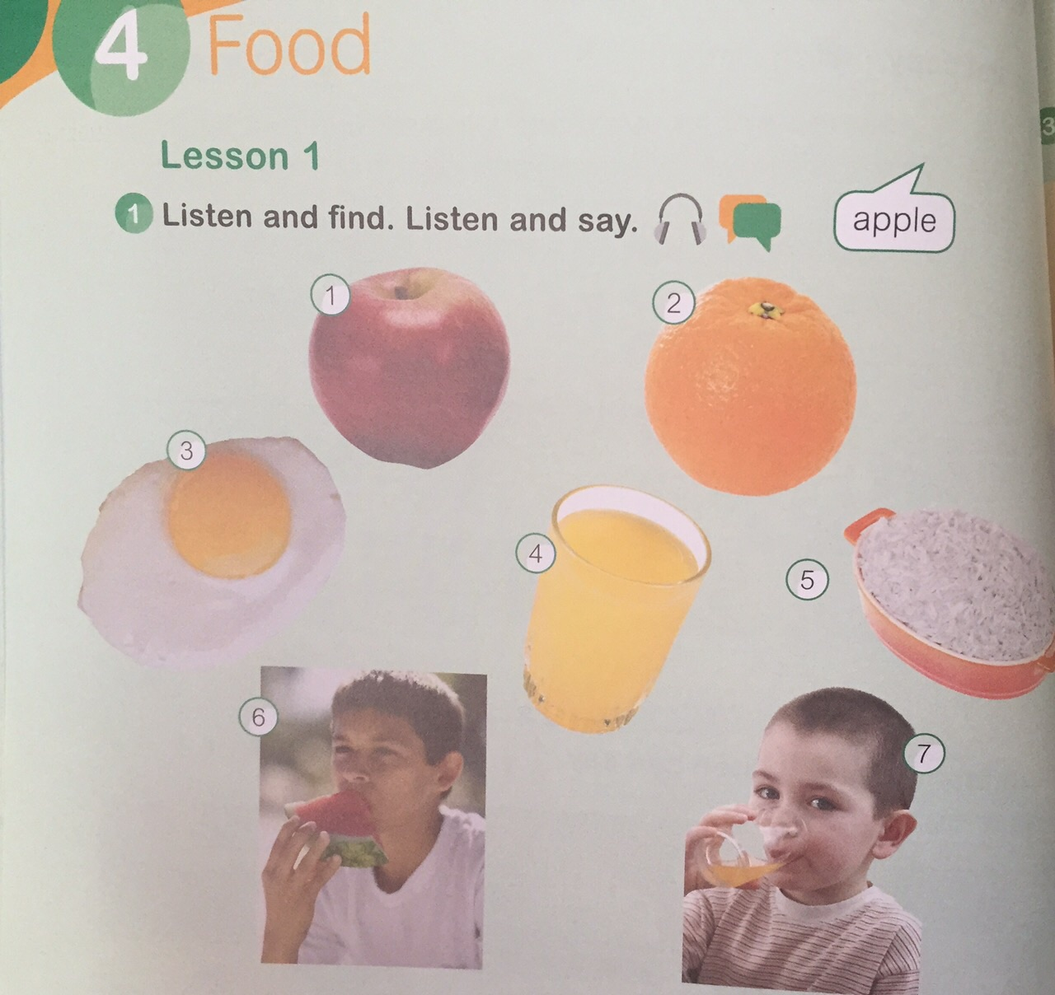

Slide 11
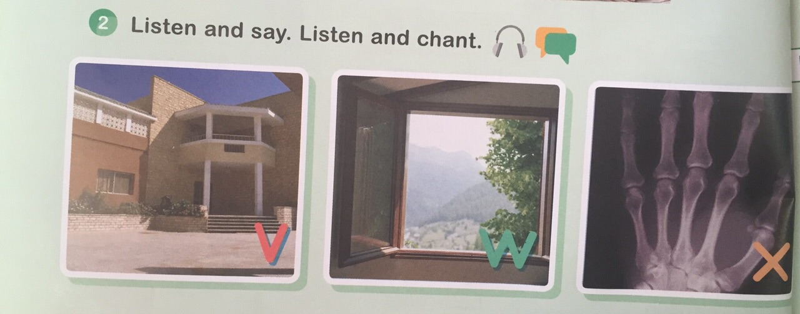

Slide 12
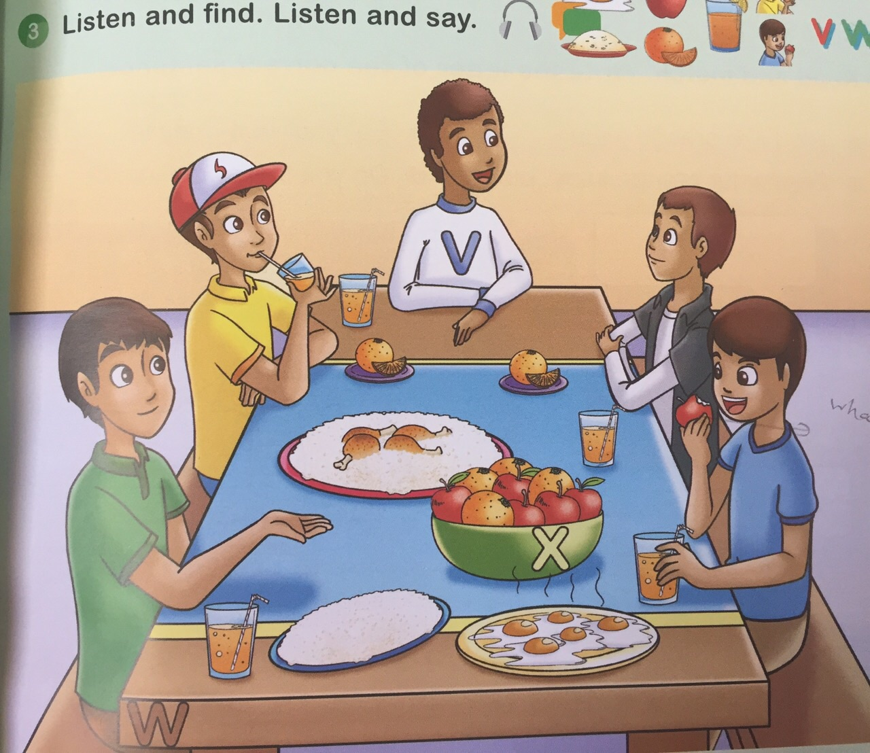
How many boys ?
How many apples?

Slide 13
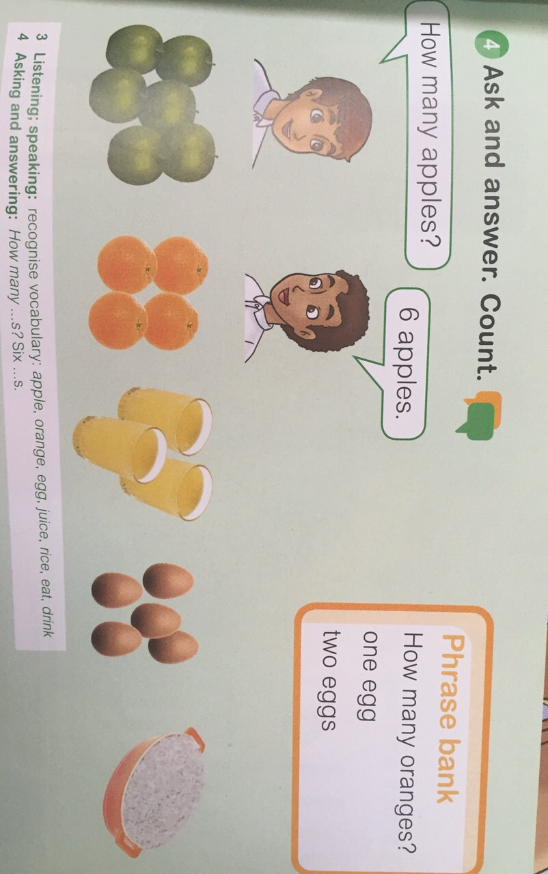

Slide 14
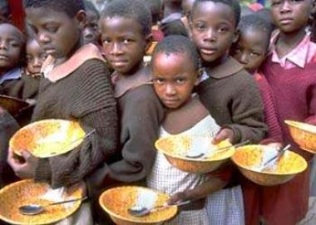
قال تعالى «وإن تعدوا نعمة الله لا تحصوها»
H.W
P. 70, 71 & 72

Slide 15
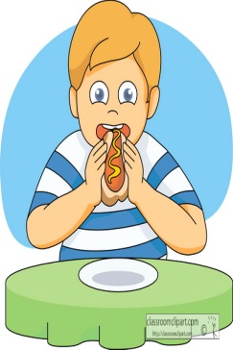
Choose:
1-He (eats - drinks) a sandwich .
2-She (eats- drinks) some juice.
Make question & answer by using clothes line.

Slide 16
Write the letters:
…….indow li…ing room bo…..
Match:
egg
rice
juice

Slide 17
