Slide 2
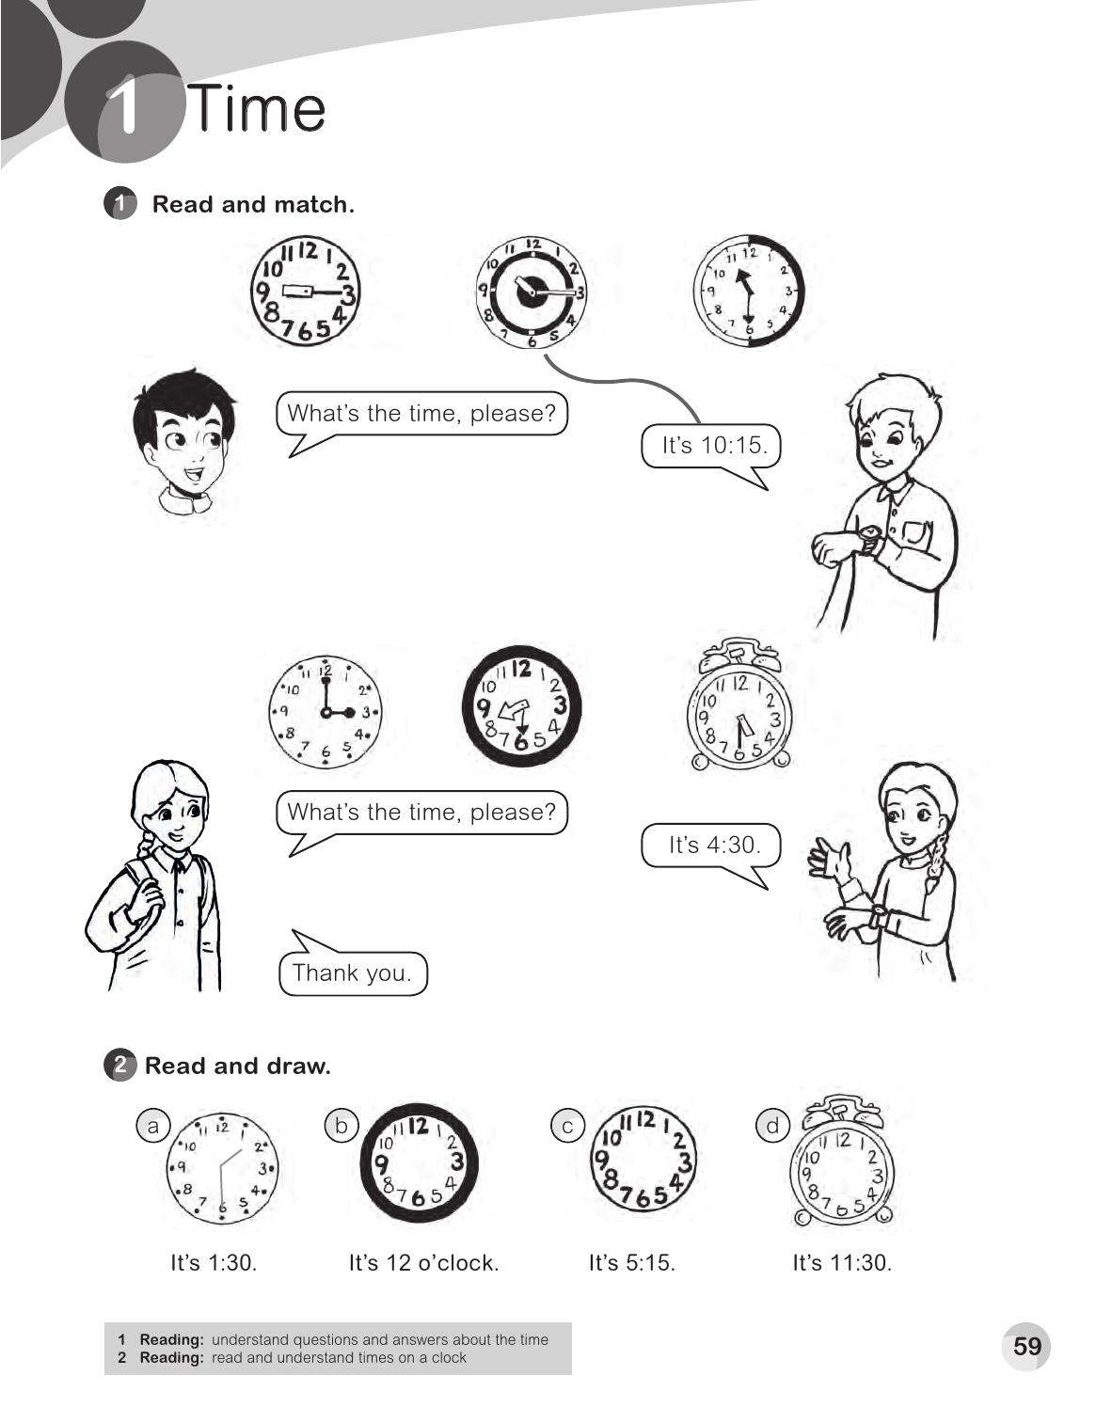

Slide 3
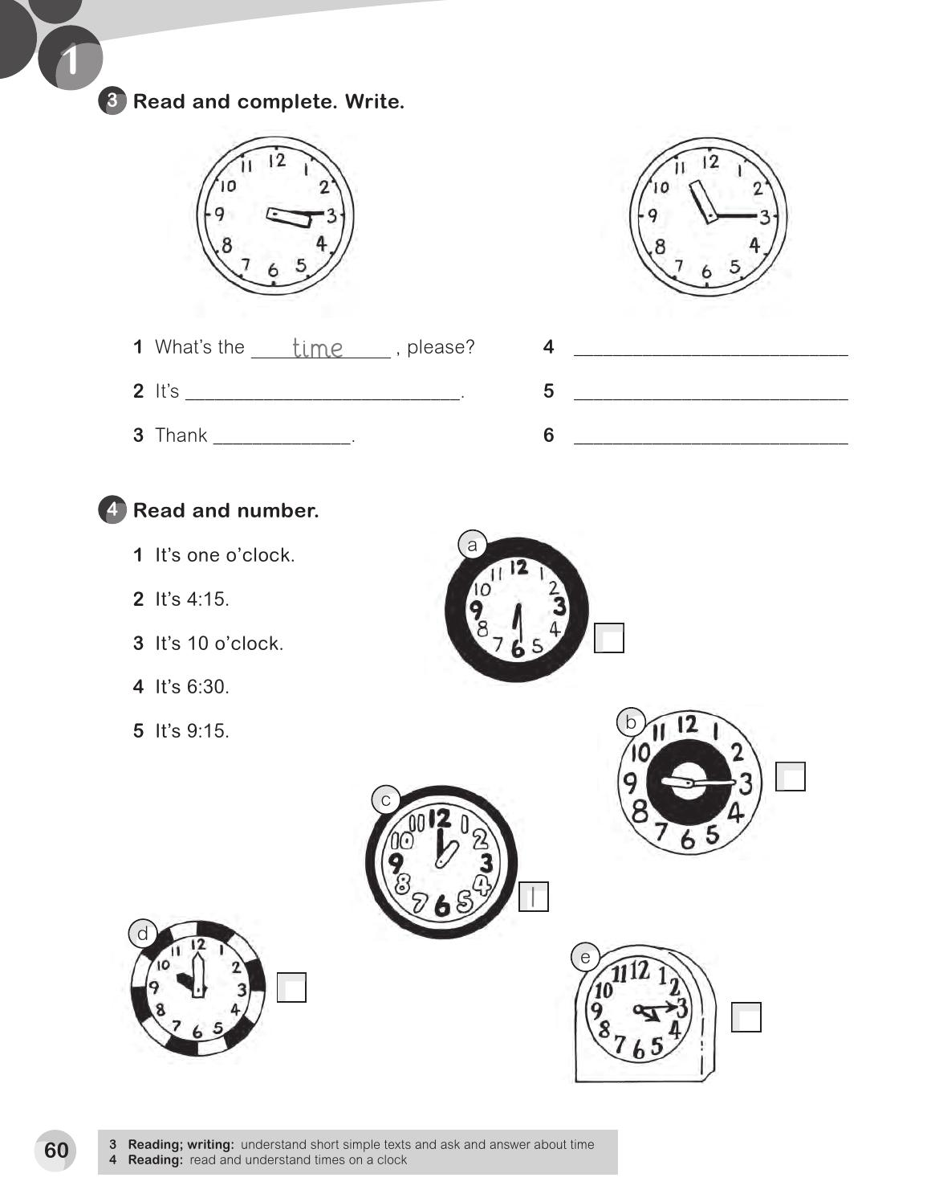
What`s the time , please?
3 : 15
It`s 11 : 15
you
Thank you .
4
5
3
2

Slide 4
two
o'clock
sorry
late
You`re
ealy

Slide 5
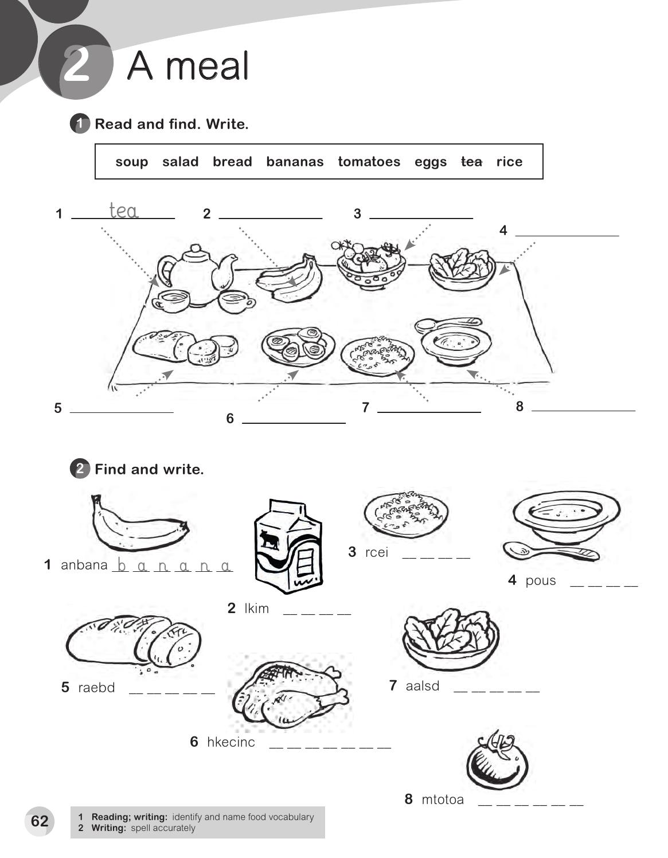
bananas
tomatoes
salad
bread
rice
soup
eggs
r i c e
s o u p
m i l k
b r e a d
s a l a d
c h i c k e n
t o m a t o

Slide 6
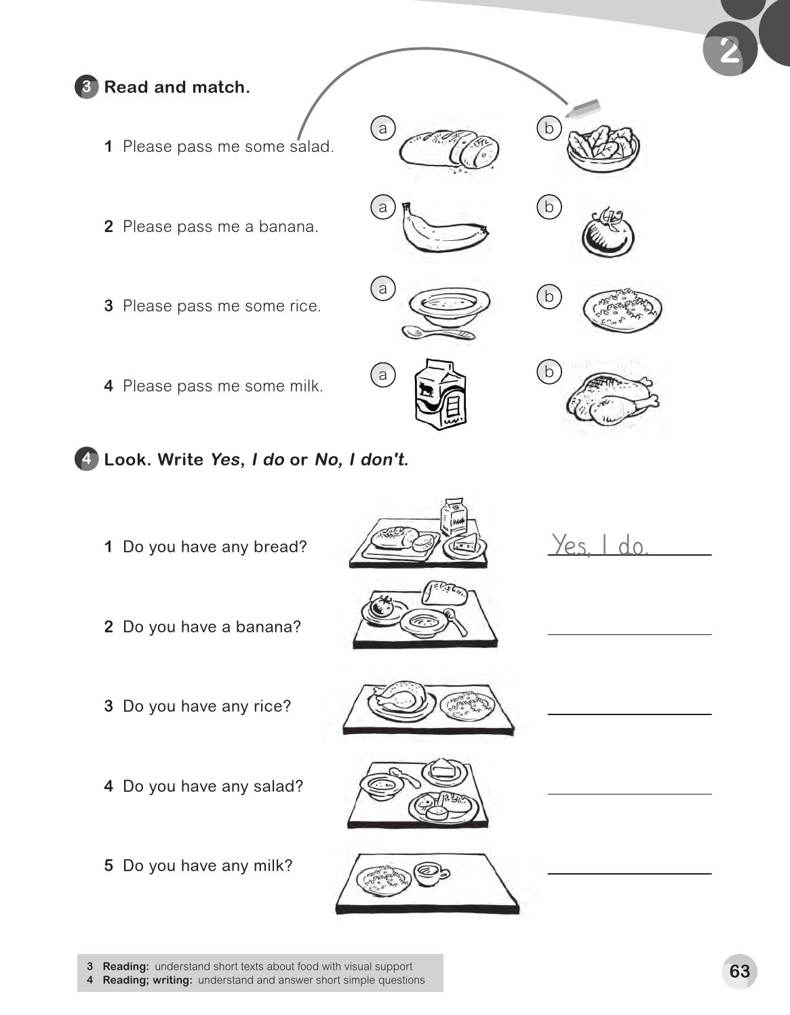
No , I don`t
Yes , I do
No , I don`t
No , I don`t

Slide 7
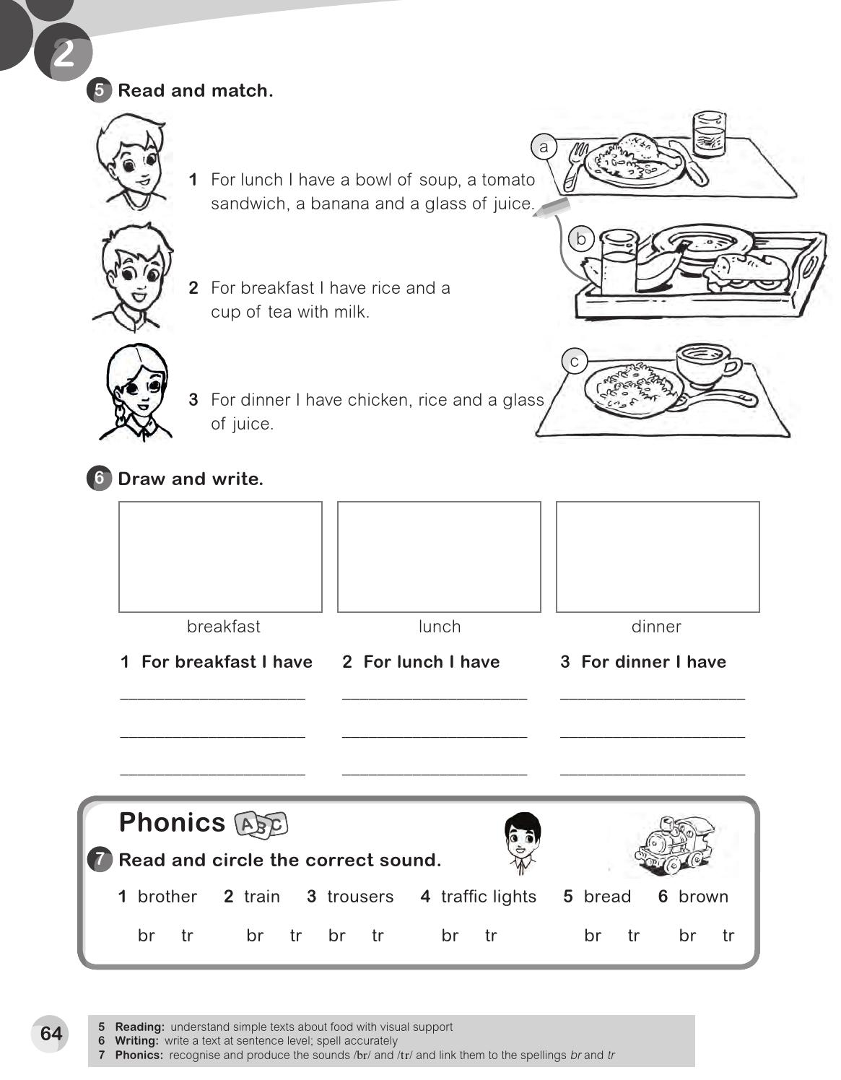
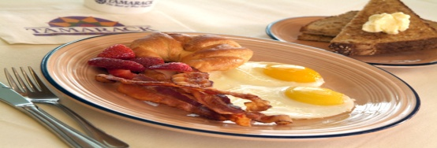
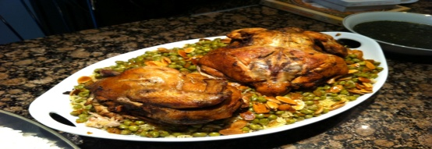
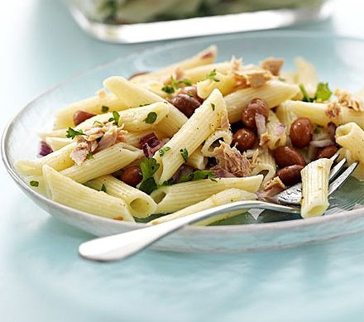
For breakfast I have a bread and Egg dish .
For lunch I have a rice and chicken .
Pasta dish . For dinner I have a

Slide 8
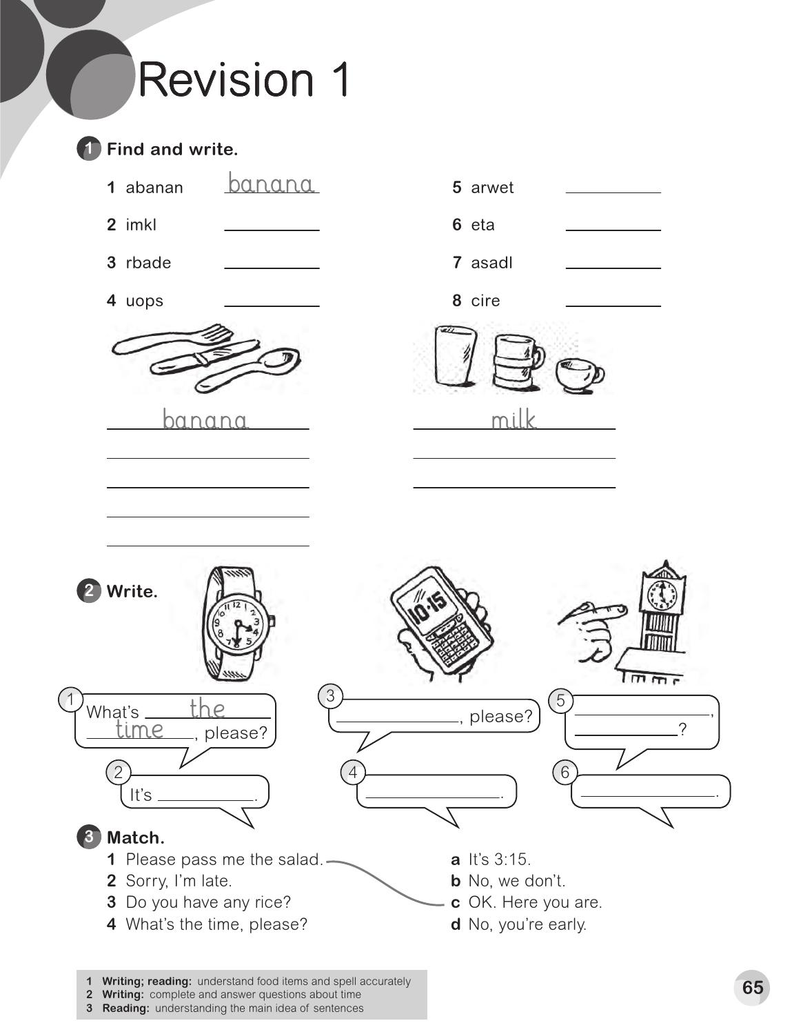
water
milk
tea
bread
salad
soup
rice
bread
water
rice
tea
salad
soup
What`s the time
What`s the time please ?
4 : 30
10: 15
5 o`clock

Slide 9
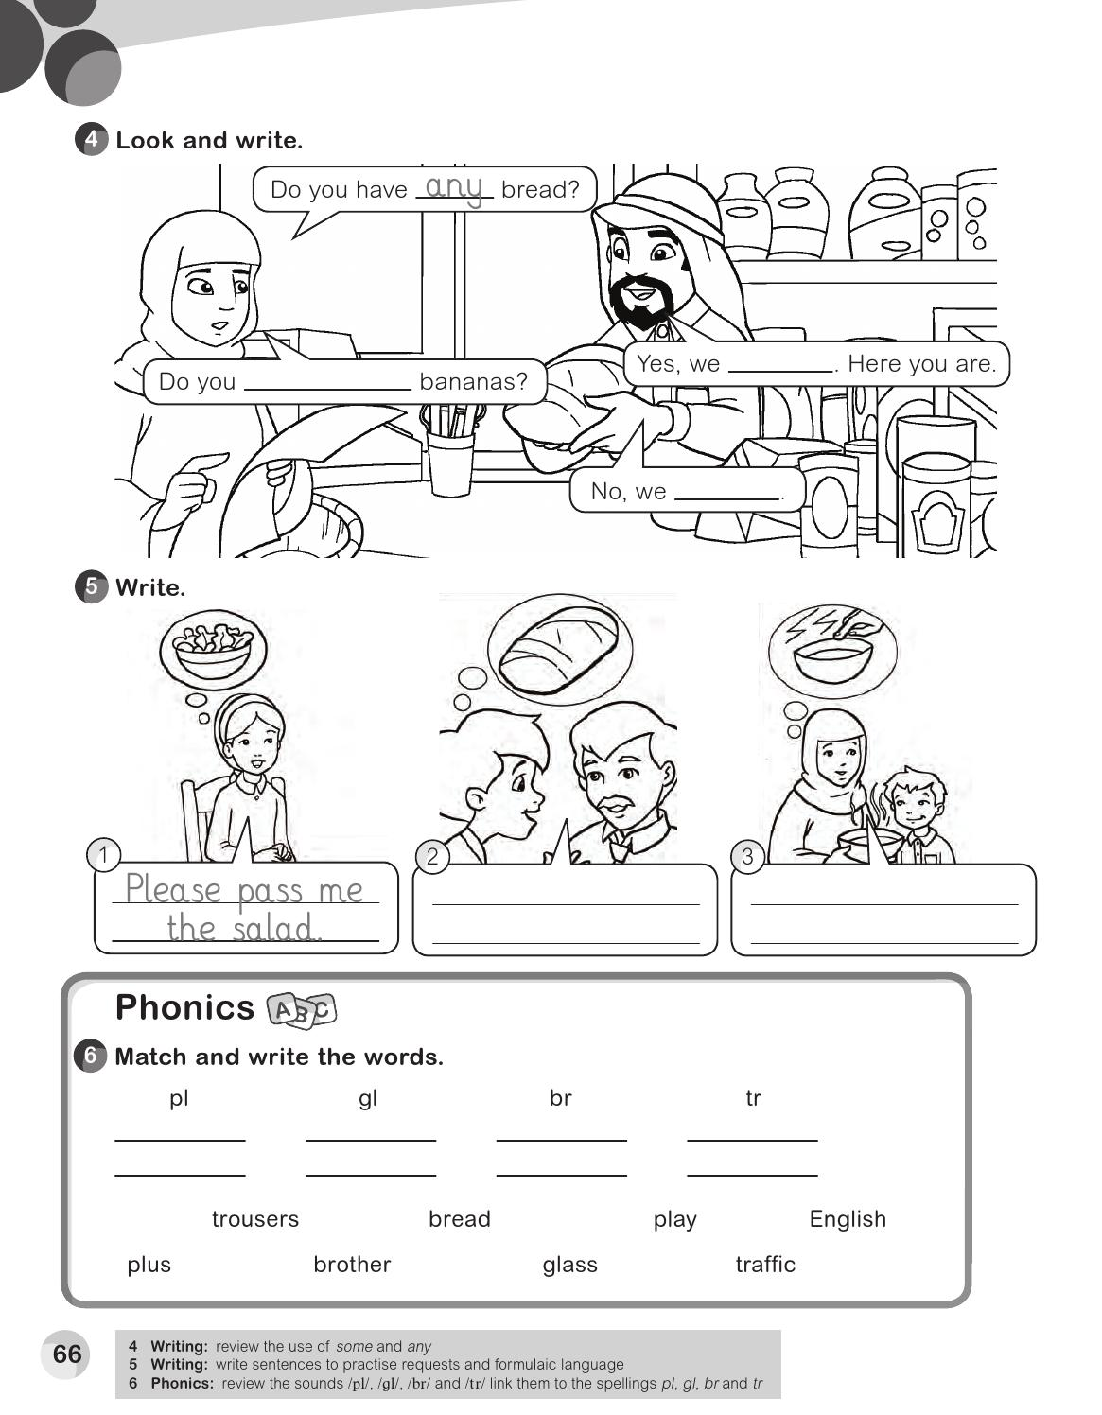
do
have any
don`t
Please pass me some bread
Be careful. It`s hot .
play
English
bread
trousers
plus
glass
brother
traffic

