Slide 1
UNIT 4
FOOD

Slide 2
Today is Tuesday
19 / 5 / 1436

Slide 3
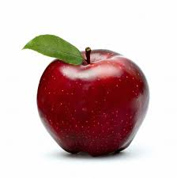
Apple

Slide 4
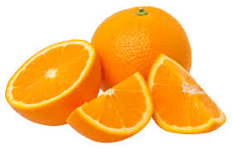
Orange

Slide 5
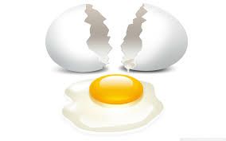
Egg

Slide 6
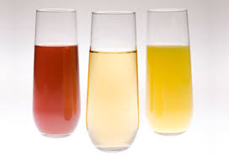
Juice

Slide 7
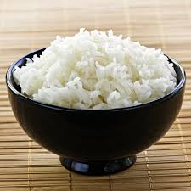
Rice

Slide 8
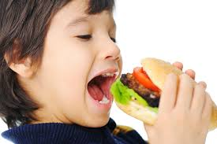
eat

Slide 9
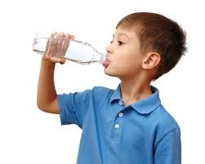
drink

Slide 10
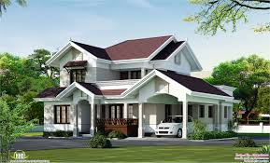
Villa

Slide 11
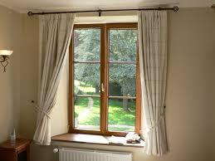
WINDOW

Slide 12
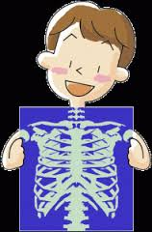
X-ray

Slide 13
How many apples ?

Slide 14
HOMEWORK
Page 70 - 71

