Slide 2
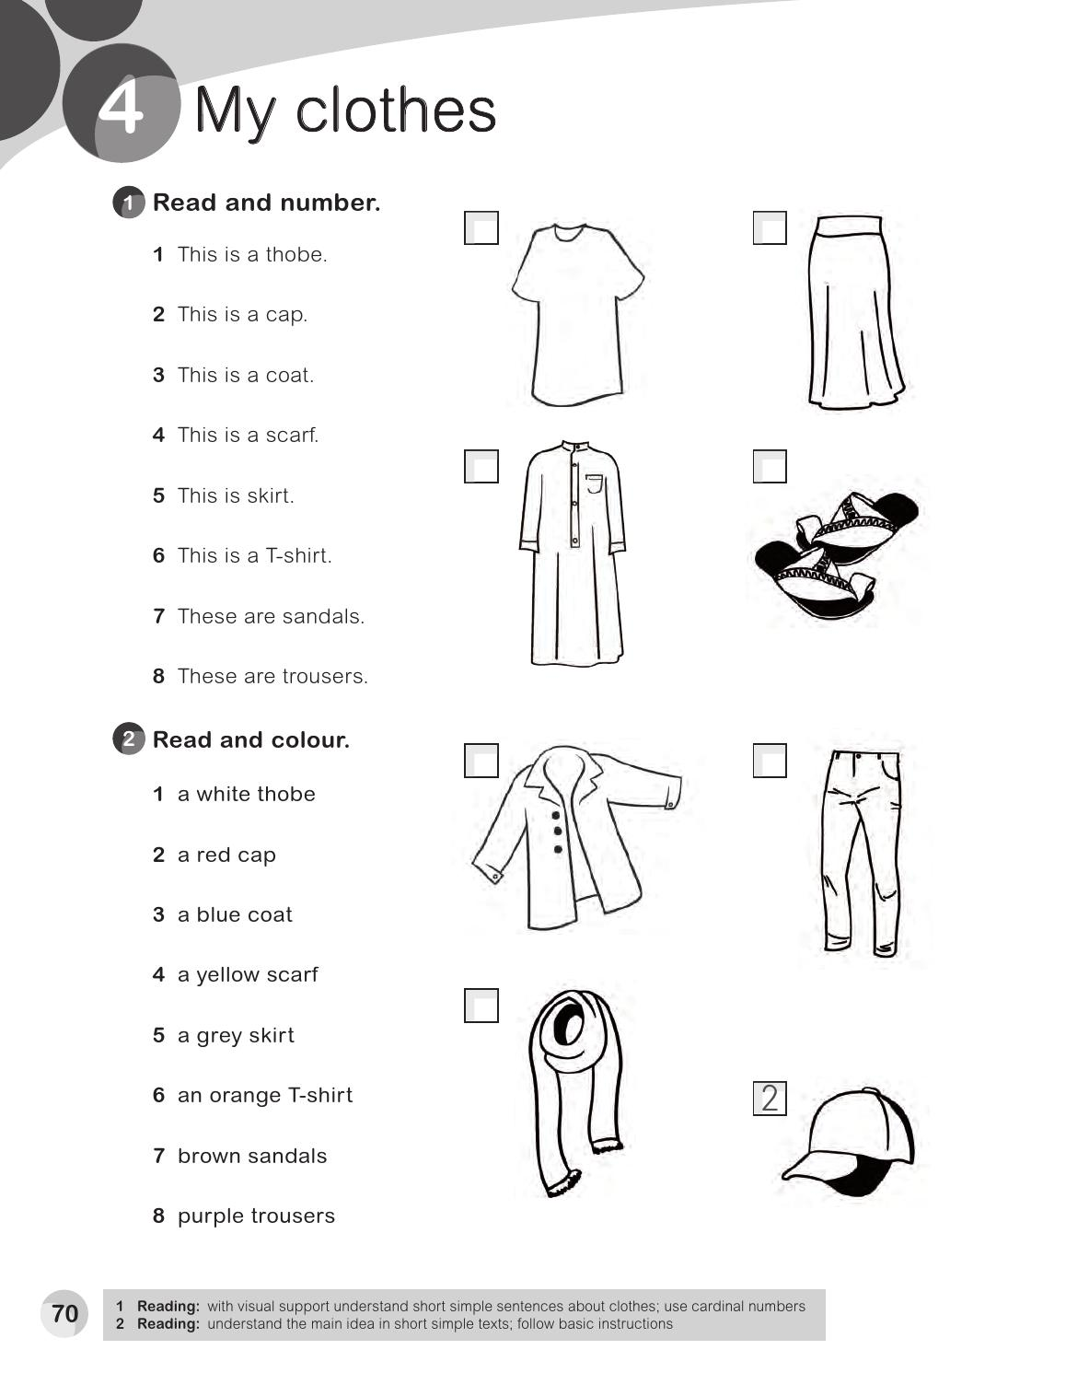
6
5
1
7
3
8
4

Slide 3
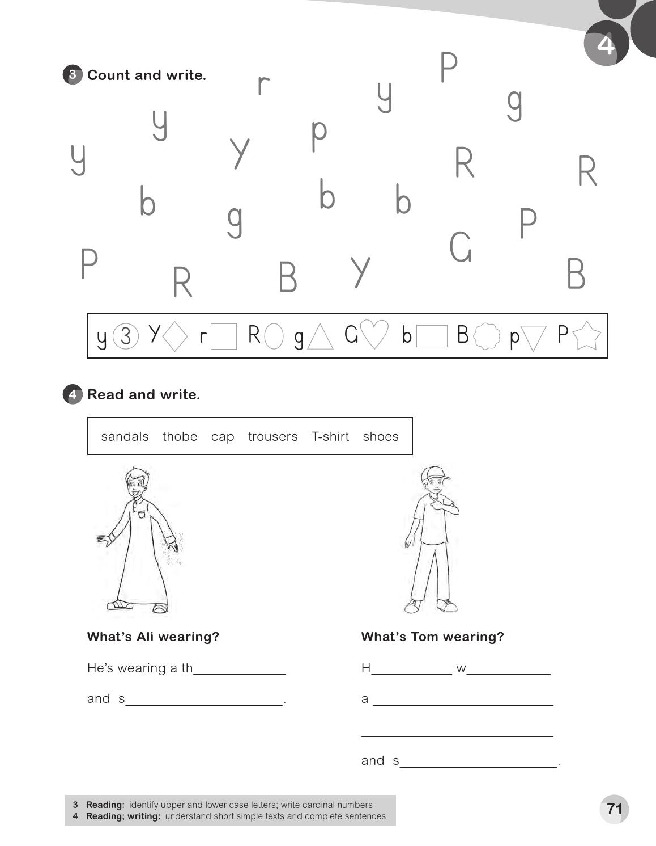
2
1
3
2
1
3
2
1
3
obe
e’s
earing
andals
trousers , T – shirt , a cap
hoes

Slide 4
G
g
Y
y
P
p
R
r

Slide 5
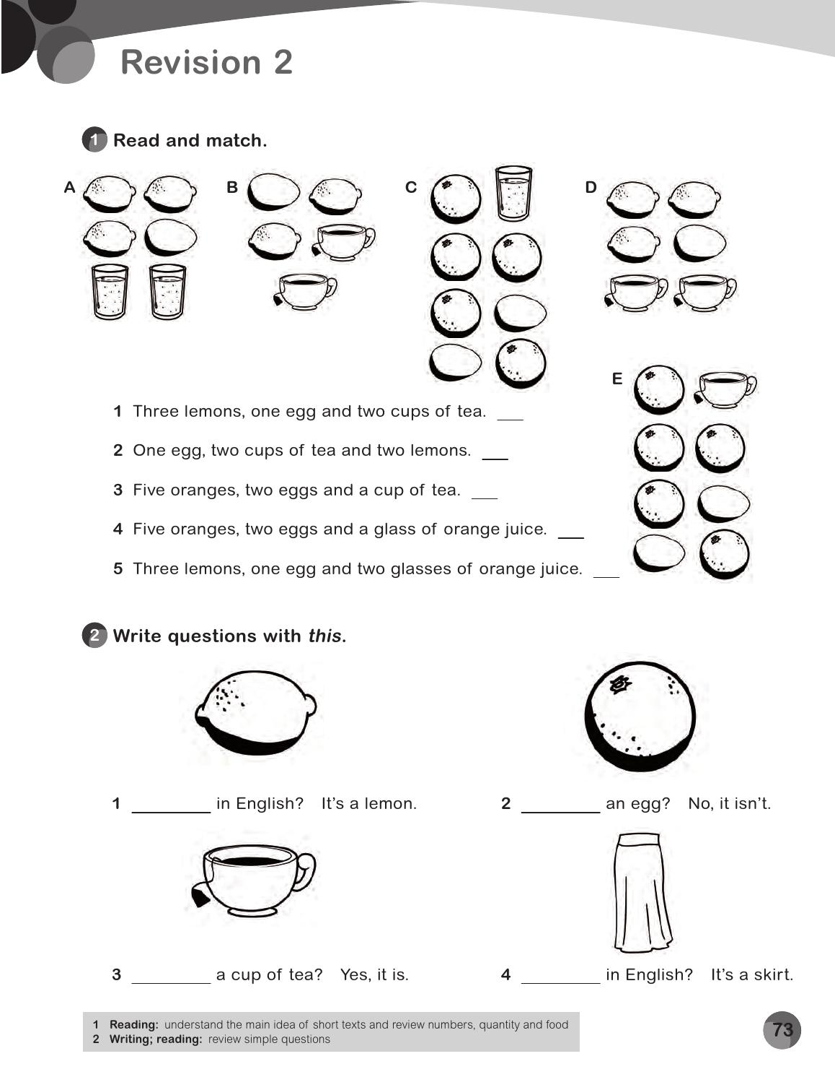
D
B
E
C
A
What’s
It’s
It’s
What’s

Slide 6
is
This ‘s an orange .
are
These are a three lemons .
this
This ‘s orange .
these
These are yellow .

