Slide 1
The World of Money
Unit: 5

Slide 2
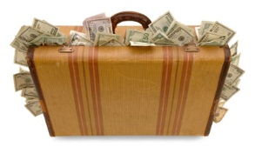
Saving Money
Lesson: 1

Slide 3
How often do you save money?
Always ?
Sometime ?
Never ?

Slide 4
Why is it important to save MONEY?

Slide 5
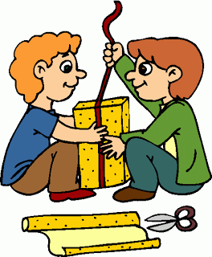
Why is it important to save MONEY?

Slide 6
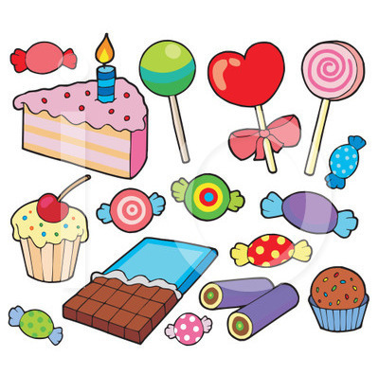
Why is it important to save MONEY?

Slide 7
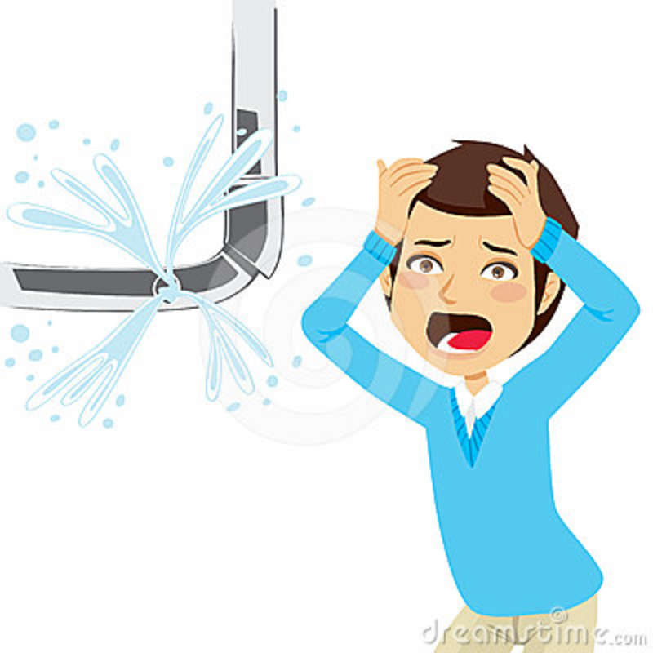
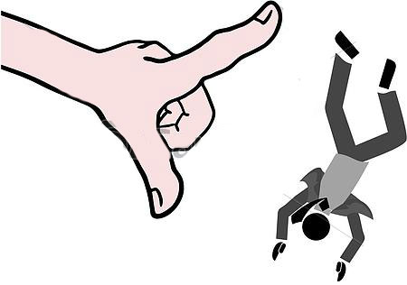
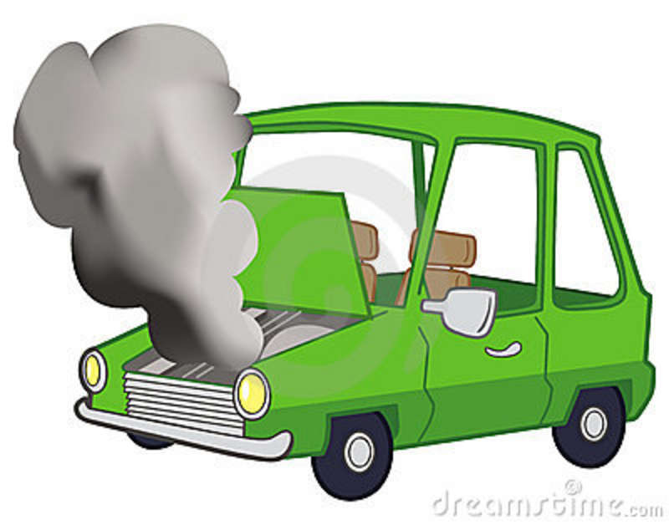
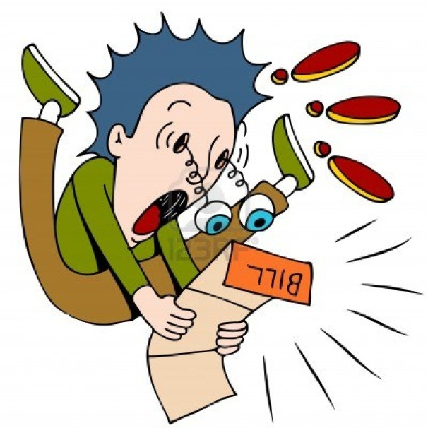
Why is it important to save MONEY?

Slide 8
How to save money?

Slide 10
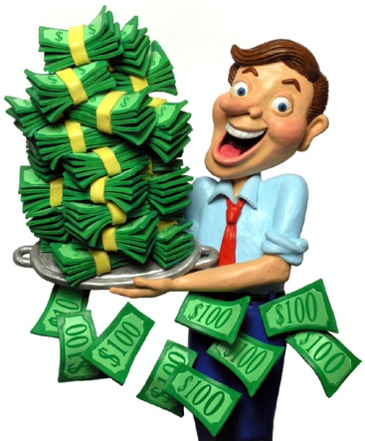
New word
● saving money
● earn
● gain
● miss
● waste
● good value
● discount
● mortgage

Slide 11
Have a nice day

