Slide 2
How are you ?

Slide 3
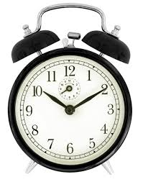
Answer the following Qs. :
Numbered heads
2 Min.
1- What is the title of last unit ?
2-Name four jobs .
3- What is the best job in the world and where is it ?
4- Tell me about your old Habits .
5- What do you think the best job ?Why?

Slide 4
Group work
1Min .
Warmer:
Write 5 words Start with letter ( D )
Then write one of them in a sentence .

Slide 5
Now Watch the following video

Slide 7
Describe What you was see in the video .
1 minute

Slide 8
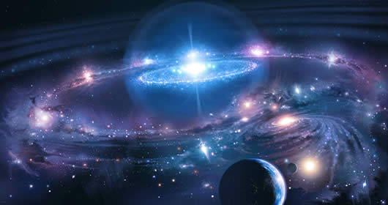
Space and Time

Slide 9
1- Do you think travelling to space waste time & money ? 2- What is the importance of space exploration? 3- Do you like travel to space ?

Slide 10
Vocabulary

Slide 11
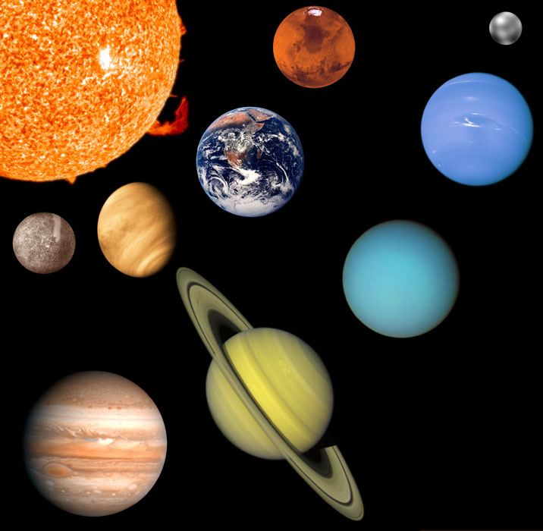
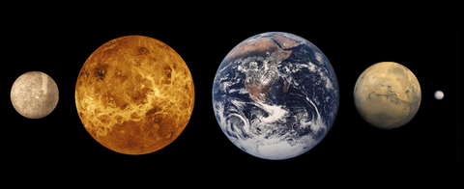
Universe
Cosmos
Planet
Planet
Asteroid

Slide 12
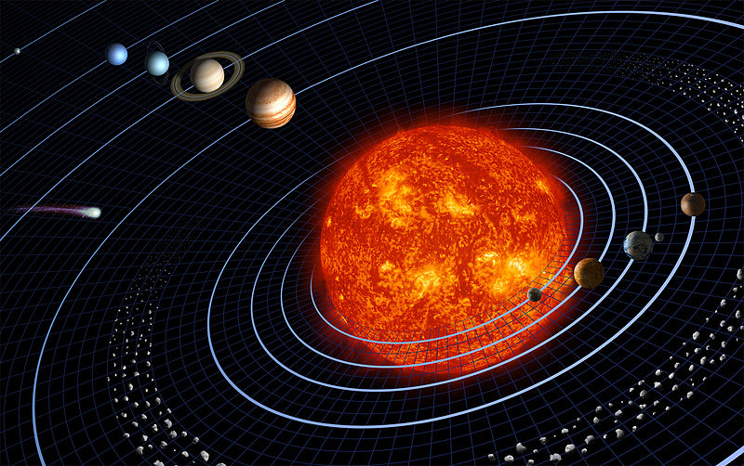
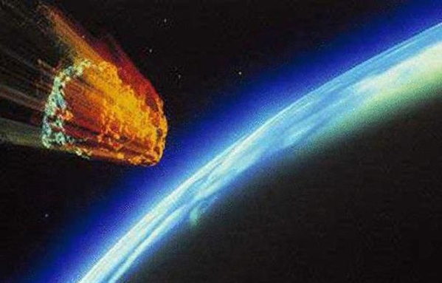
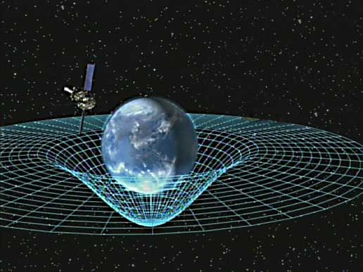
Orbit
Meteorite
Gravity

Slide 13
All of these objects are
Natural

Slide 14
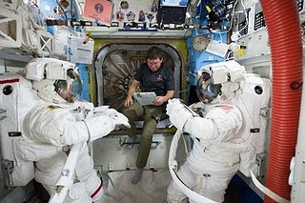
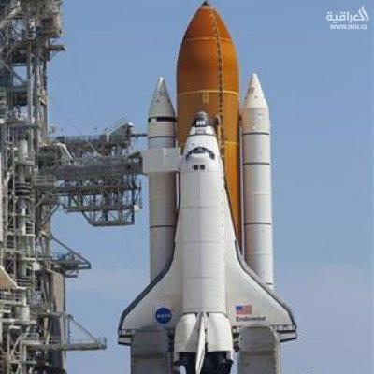
Astronomer
Space shuttle
Astronaut
crew
Mission
Spacecraft

Slide 15
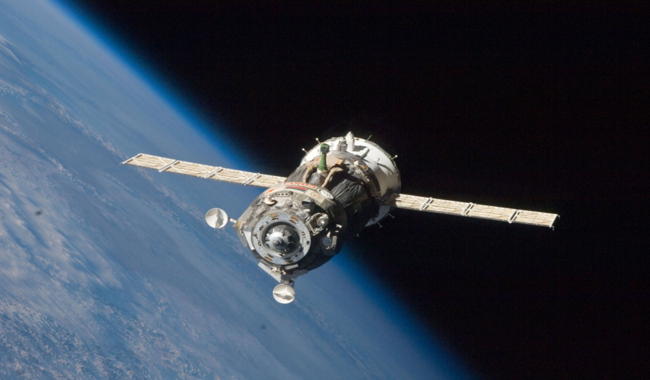
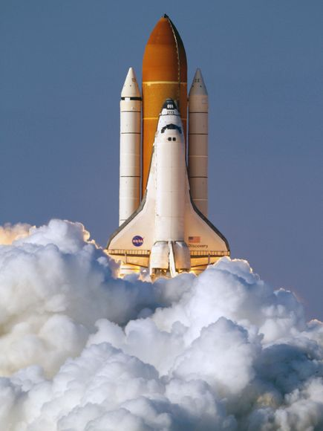
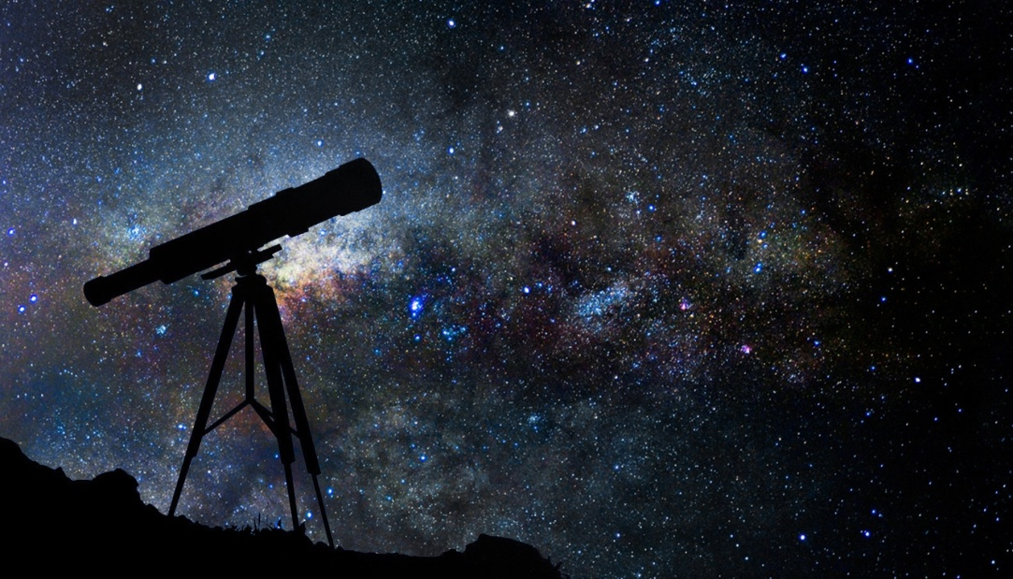
Lunch . V
Satellite
Telescope

Slide 16
All of these objects are
Man-made

Slide 17
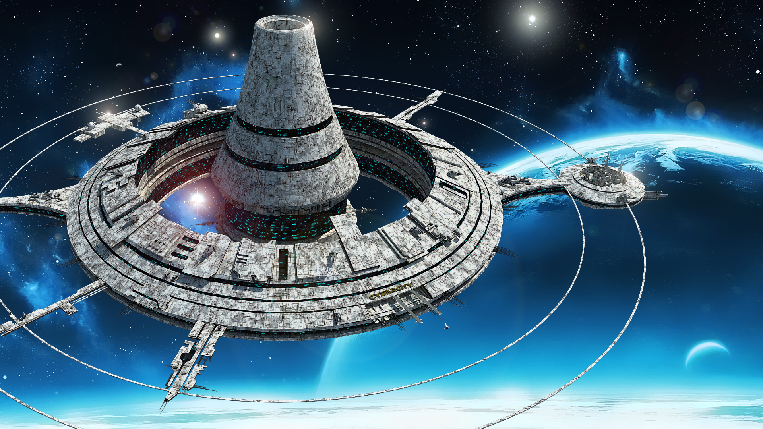
Are there any Arab astronaut ?

Slide 18
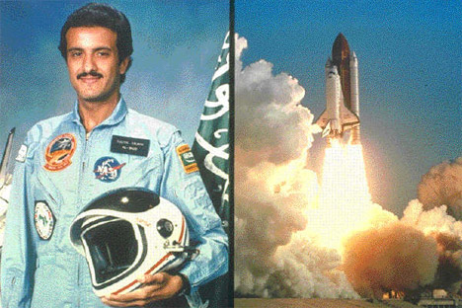
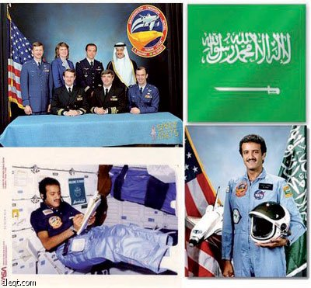
HRH prince Sultan bin Slman Al-Saud is
The first Arab, Muslim, Saudi and Royal Astronaut .

Slide 20
Open your book page 28 .. Do the quiz in group

Slide 21
Listing
Listen and answer the quiz .

Slide 22
3 – 2 – 1 Format
Write 3 natural objects in space :
Write 2 man-made objects in space :
Write a sentence about the space .

Slide 23
Thank you for attending
It is an honor for me !
Samia AlQhtani

