Slide 1
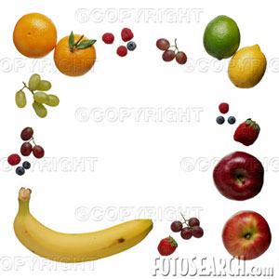
U: 4
8+L: 7
Healthy Eating

Slide 2
A-
1-C
2-a
3-D
4-C
5-B
6- C
7-B

Slide 3
8- d
9-a
10- c
11- d
D 69
1-c
2-a
3- d
4-b

Slide 4
5-c
6-a
7-b
8-d
9- a
10-d
11-c
12-a
13-b

Slide 5
What is a balanced diet? The correct mixture of food
Name 5 special substances which our bodies need ?
Protein- mineral – vitamin- carbohydrate – fats
Give the name …..
Scurvy
4-which tow kind of food ….
Camel milk and date

Slide 6
5-How many of them ….?
there are four vitamins, sugar , fat, protein , minerals
6- Name 4 countries …………..?
Australia ,
Holland
, U.S.A
, Switzerland

