Slide 1
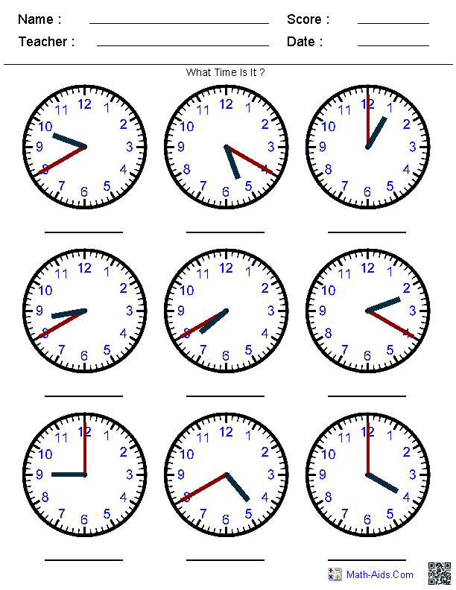
What time is it?

Slide 2
By the end of this lesson you will be able to:
* Use the adverb of frequency.
* Use time expressions.
*Use preposition (on/ at/ in )

Slide 3
First you will see the story of Cinderella
Focus on these words:
always/ usually/ sometimes/ never

Slide 4
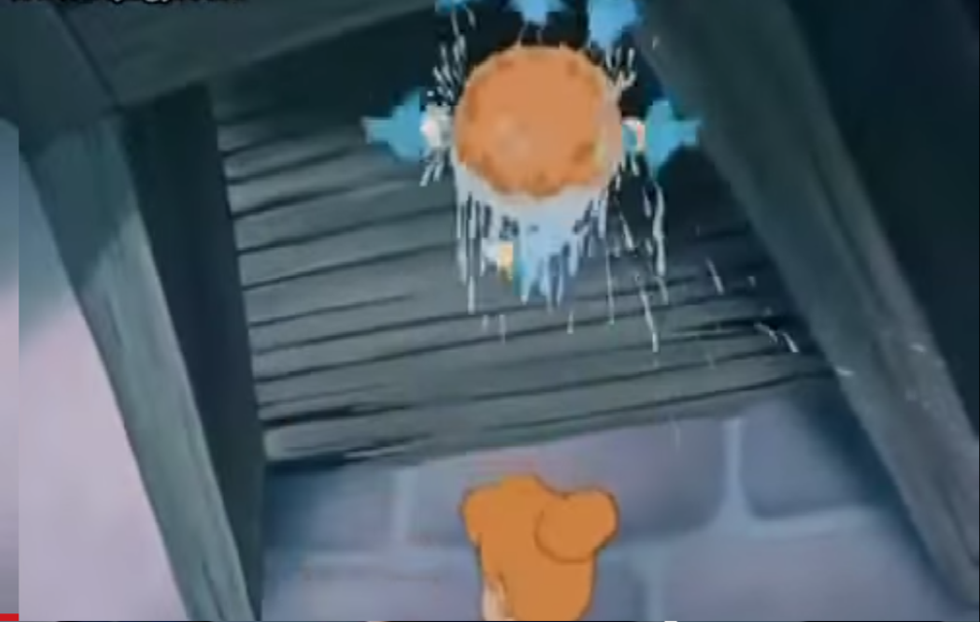
Cinderella always wakes up in the morning
Cinderella usually takes a shower in the morning

Slide 5
Cinderella always fixes the breakfast for her step mother and her sisters.

Slide 6
Cinderella never has dinner
The animals sometimes help Cinderella

Slide 7
Adverbs of Frequency: always, often, never, usually, sometimes, seldom
Saturday | Friday | Thursday | Wednesday | Tuesday | Monday
 |  |  |  |  |  | always
 |  |  |  |  |  | usually
 |  |  |  |  |  | sometimes
 |  |  |  |  |  | never

Slide 8
Using Pair and Discuss strategy Give a sentence with always
Using Pair and Discuss strategy Give a sentence with never

Slide 9
S+ Adv.+ v (s.p)+ obj.
Working with your group open your book at p.17 and do this ex.

Slide 10
S+ Adv.+ v (s.p)+ obj.

Slide 11
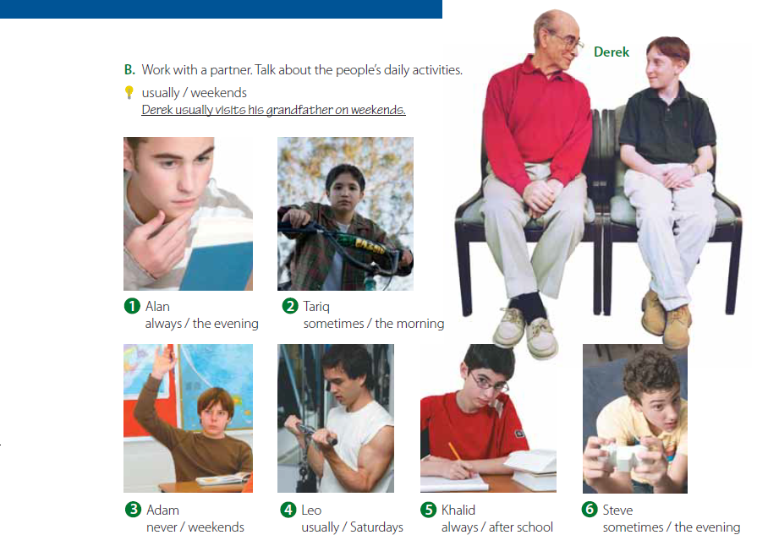
S+ Adv.+ v (s.p)+ obj.
Working with your group open your book at p.17 and do this ex.

Slide 12
Now we go to Time expressions: before/ after/ then/ everyday

Slide 14
Working with your group Give a sentence with before
Using Pair and Discuss strategy Give a sentence with then
Popsicle strategy: Form a sentence with after

Slide 15
Now we go to preposition for Time expressions: (on/ at/ in )

Slide 16
I get up at 5:45
When do you get up?
Using Pair and Practice ask the same question and answer it

Slide 17
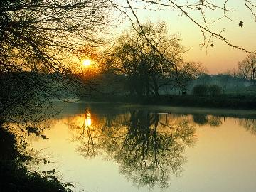
When does she pray Al-Asir prayer?
When do we go to the school?
We go to the school
in the morning
She prays in the evening

Slide 19
On Which day do you pray Al-Juma’a prayer?
I pray Al-Juma’a prayer on Fri.
* I can go to Makah on the weekend

Slide 21
Using concept map strategy:
Draw a chart { When do we use
in/ on/ at}

