Slide 1
Warm up activity: unscramble this word
yyadeesrt
yesterday

Slide 2
By the end of this lesson you’ll be able to:
*Use simple present tense tense—affirmative, third person endings.

Slide 3
S+ V (s) + obj.

Slide 4
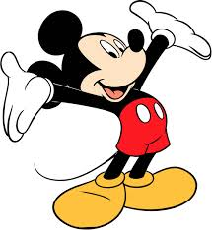
-We pray every day.
-She brushes her teeth after each meal.

Slide 5
-Teacher teaches the students.
-Doctor works at hospital.
-Nurse helps sick people.

Slide 7
Peter (He) works on his basket every day .
Children (They) like ice-cream very much

Slide 8
Any questions?

Slide 9
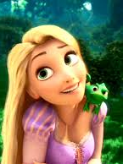
Using Thin, Pair and share strategy do this ex.
Choose the correct answer:
1-I ( eat/ eats/ is eating) cereal in the morning.
2- He (like/ likes/ is liking) green smoothies.
3- Kids (playing/ plays/ play) everywhere.

Slide 10
Time to write a paragraph
Now you will see a picture. Write a paragraph of 6 sentences describing the actions of the people in the picture.
Use simple present tense verbs
Use a topic sentence and conclusion.

Slide 11
