Slide 1
Unit:10
Back in Riyadh

Slide 2
Lesson:1
Welcome back

Slide 4
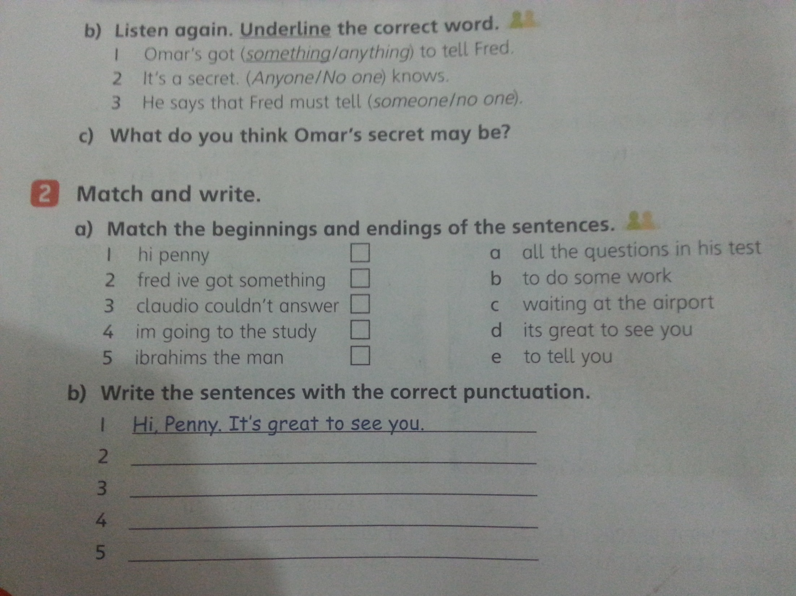
d
d
e
e
a
a
b
b
c
c
Fred, I've got some thing to tall you.
Claudio, couldn`t answer all the question in his test.
I`m going to the study to do some work.
Ibrahim's, the man is waiting the airport

Slide 5
is plaing
travels
plays
Is traveling
Is flying
stays
does
watches
Is smiling
Is walking

Slide 6
The mouse run up the tree?
He want to escape the cat

Slide 7
Workbook
124\125

