Slide 2
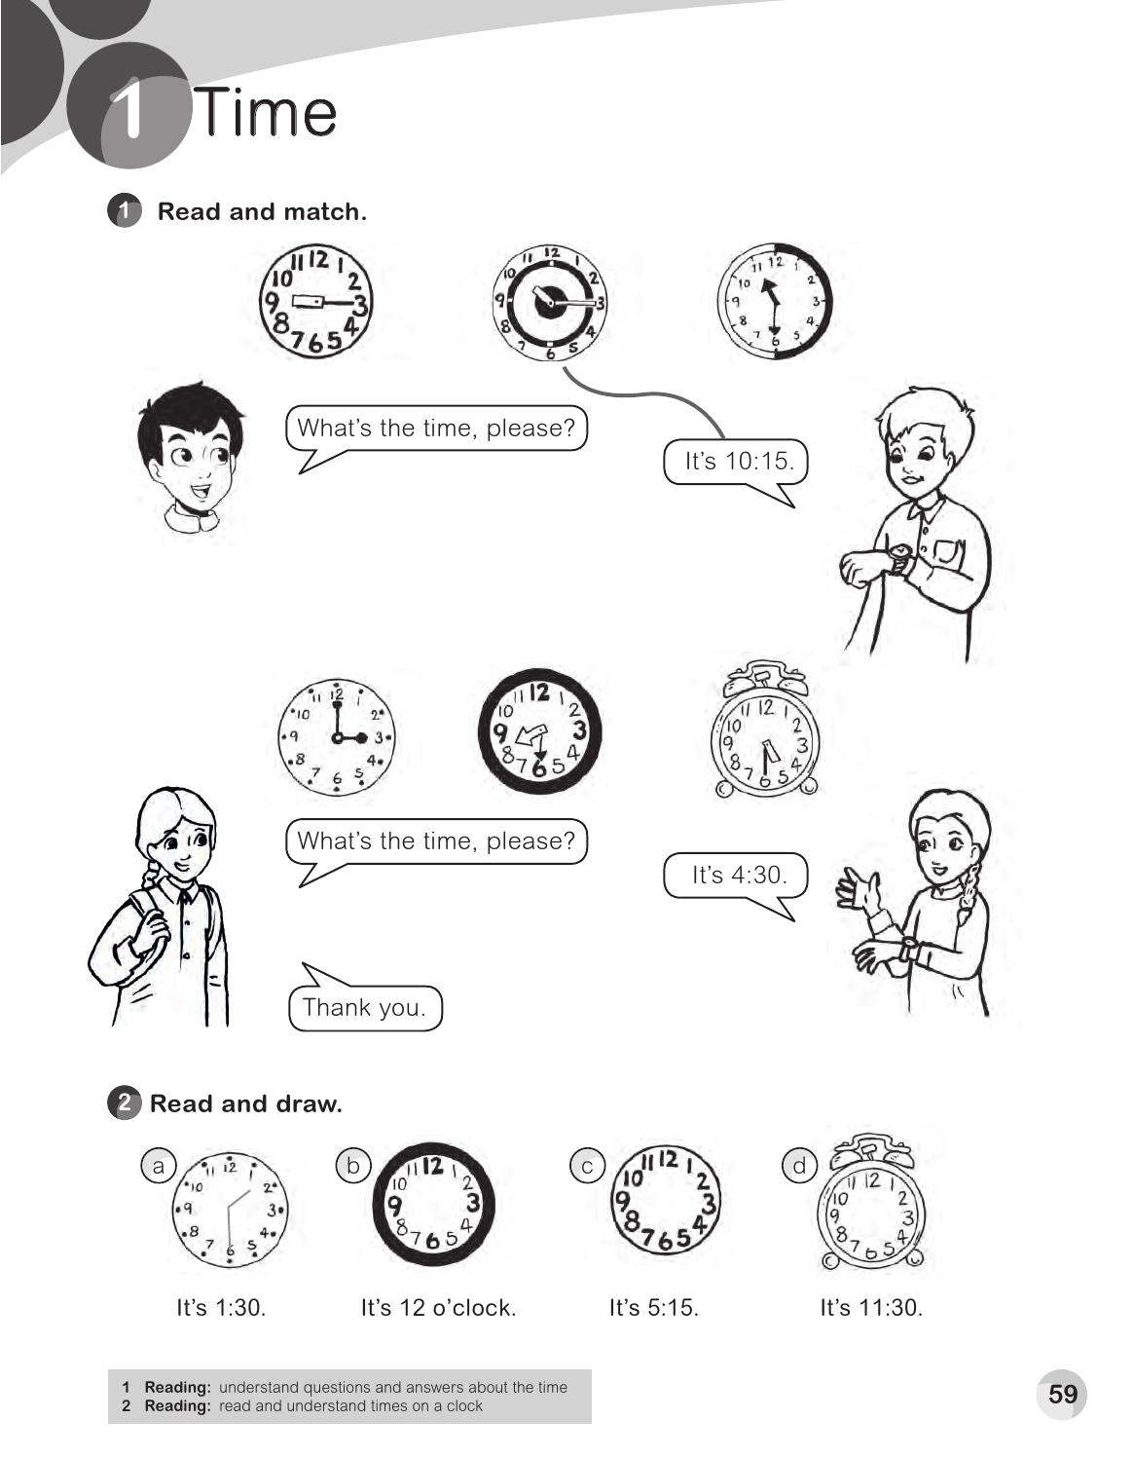

Slide 3
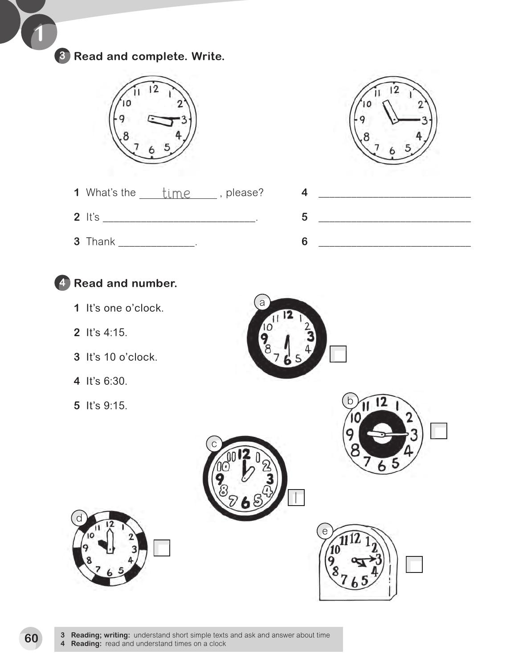
What`s the time , please?
3 : 15
It`s 11 : 15
you
Thank you .
4
5
3
2

Slide 4
two
o'clock
sorry
late
You`re
ealy

Slide 5
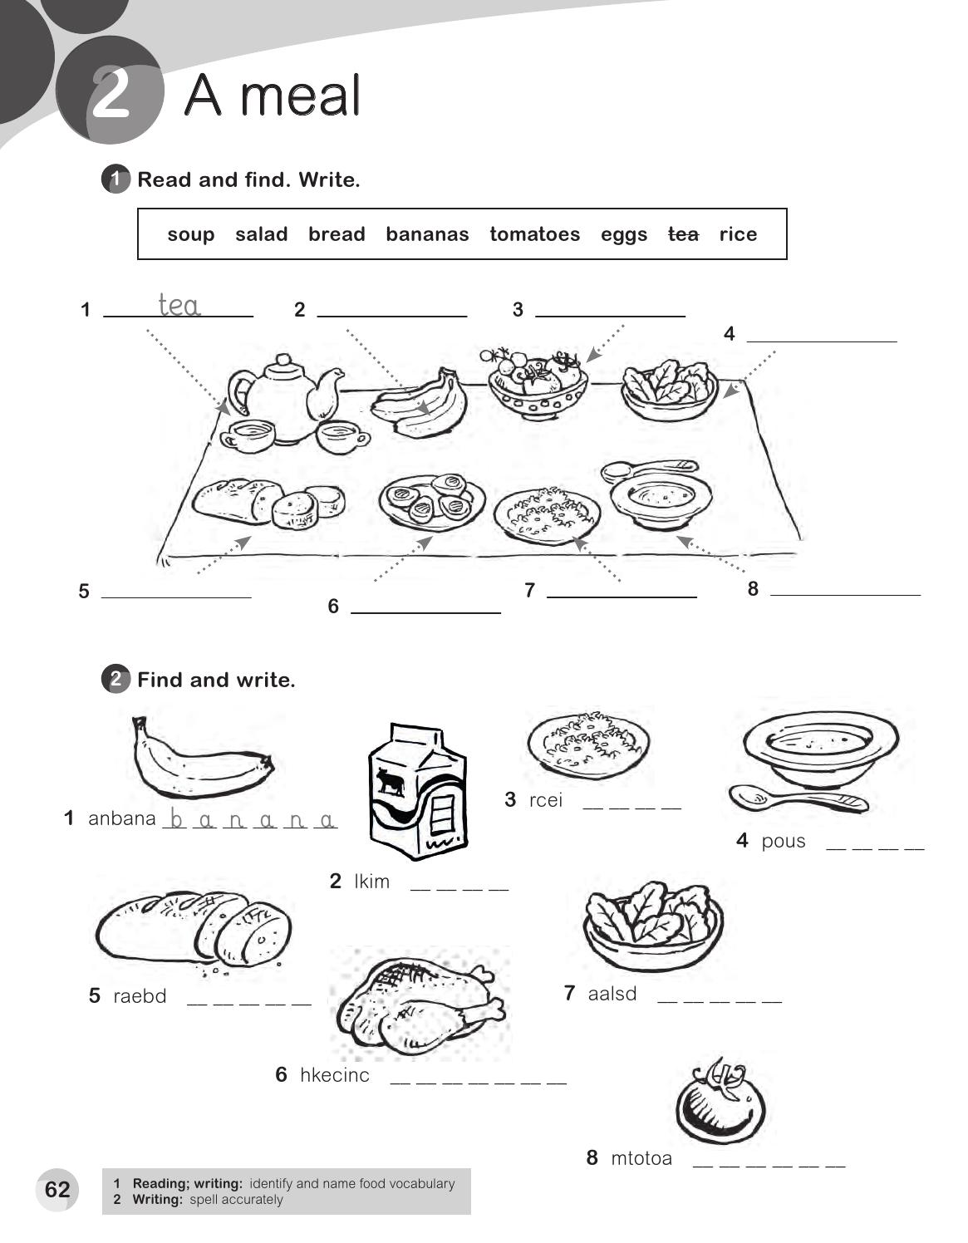
bananas
tomatoes
salad
bread
rice
soup
eggs
r i c e
s o u p
m i l k
b r e a d
s a l a d
c h i c k e n
t o m a t o

Slide 6
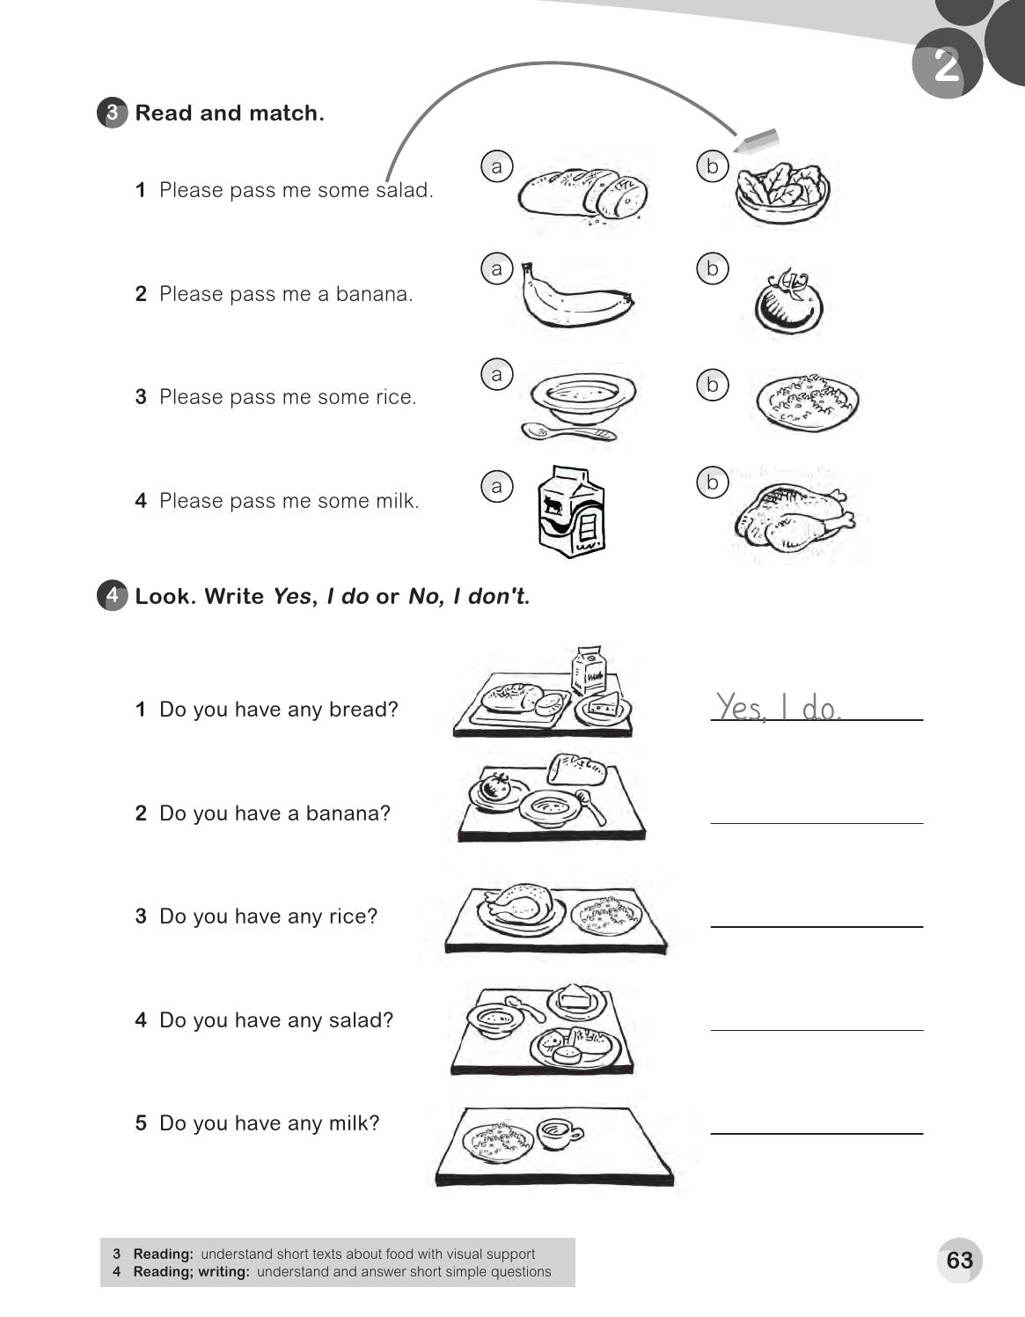
No , I don`t
Yes , I do
No , I don`t
No , I don`t

Slide 7
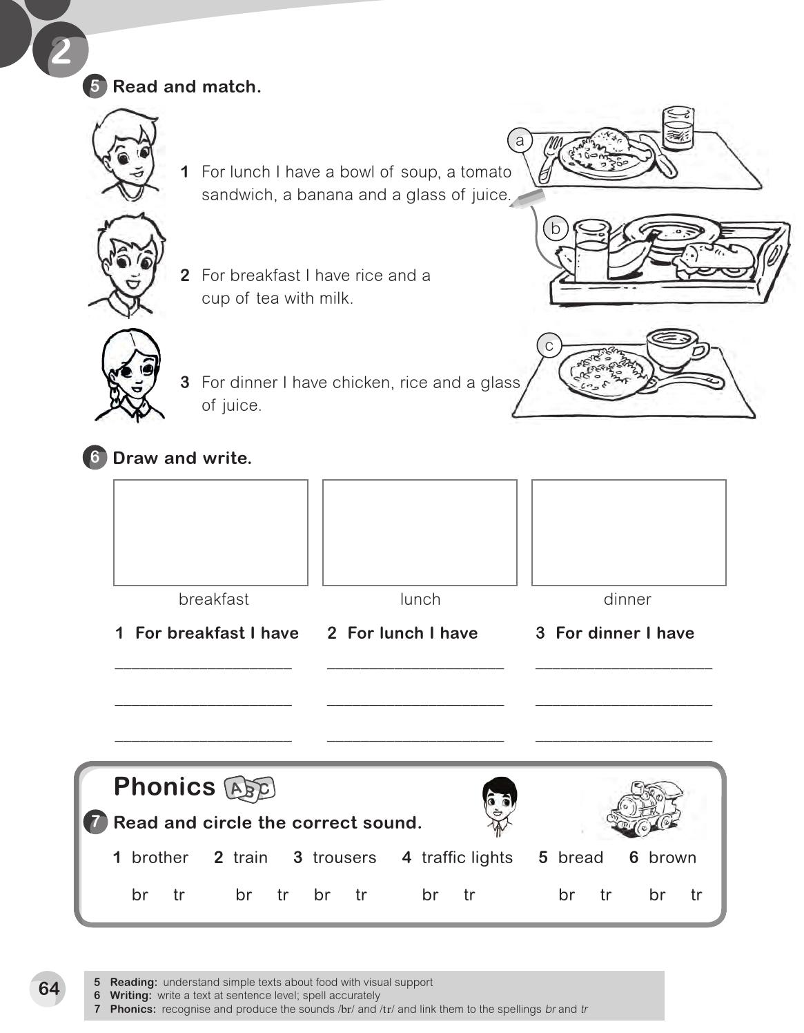
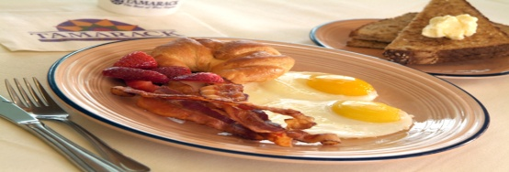
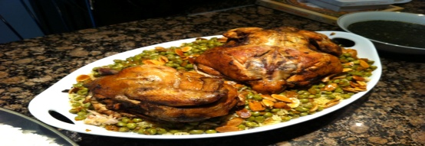
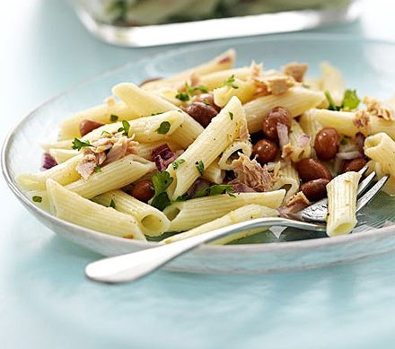
For breakfast I have a bread and Egg dish .
For lunch I have a rice and chicken .
Pasta dish . For dinner I have a

Slide 8
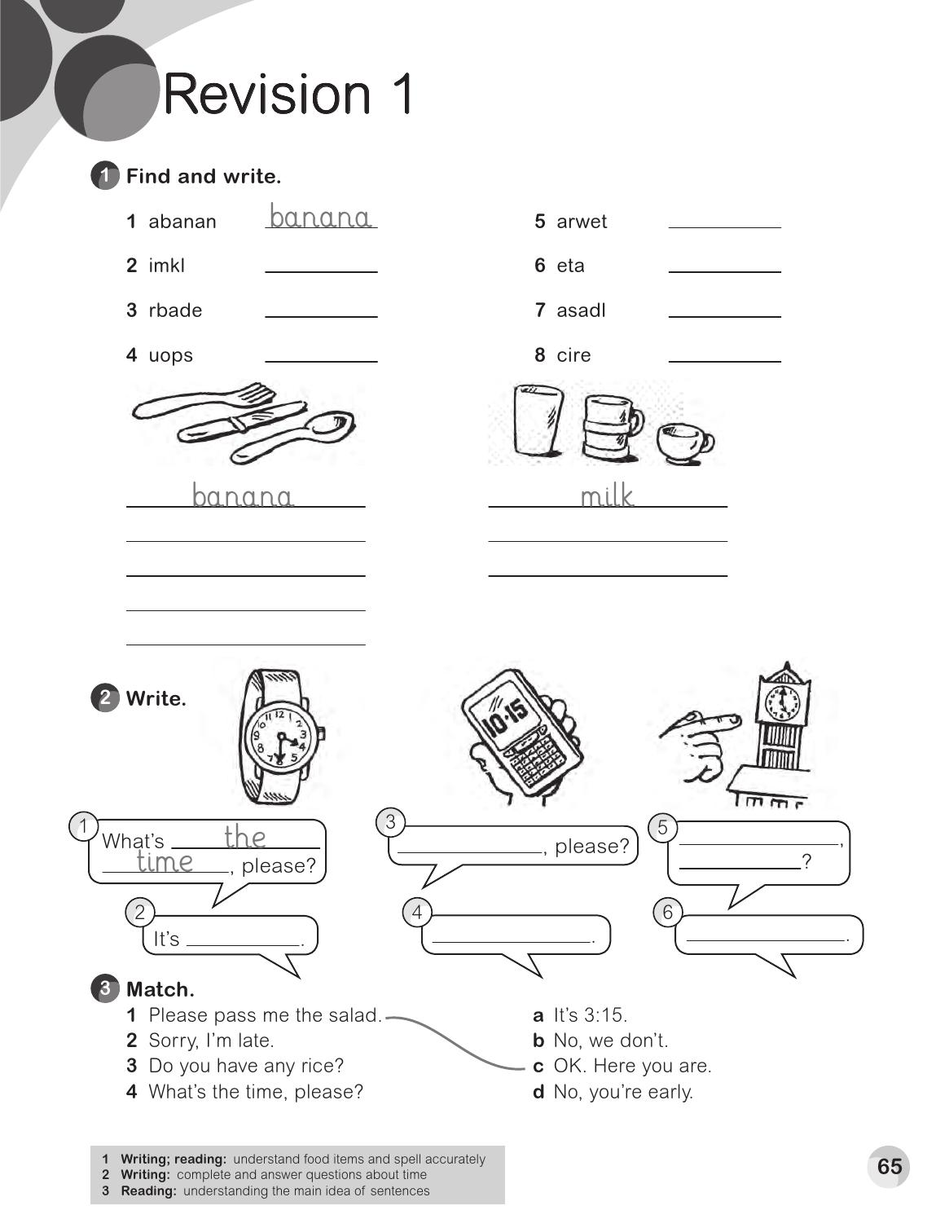
water
milk
tea
bread
salad
soup
rice
bread
water
rice
tea
salad
soup
What`s the time
What`s the time please ?
4 : 30
10: 15
5 o`clock

Slide 9
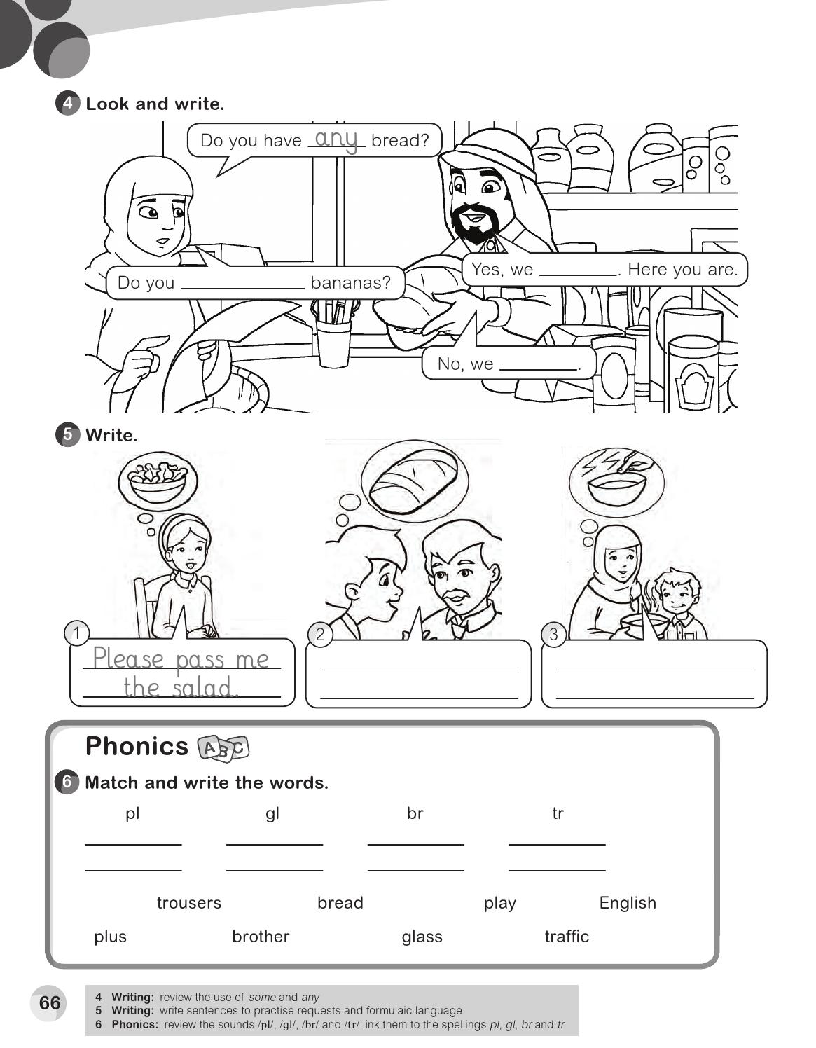
do
have any
don`t
Please pass me some bread
Be careful. It`s hot .
play
English
bread
trousers
plus
glass
brother
traffic

Slide 10
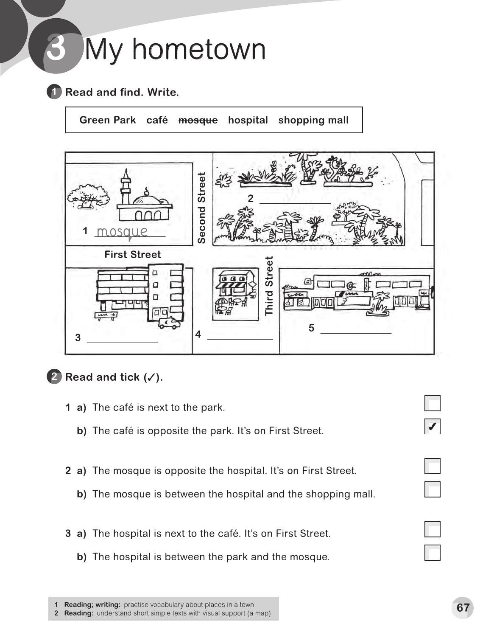
Green park
hospital
Café
Shopping mall
✓
✓

Slide 11
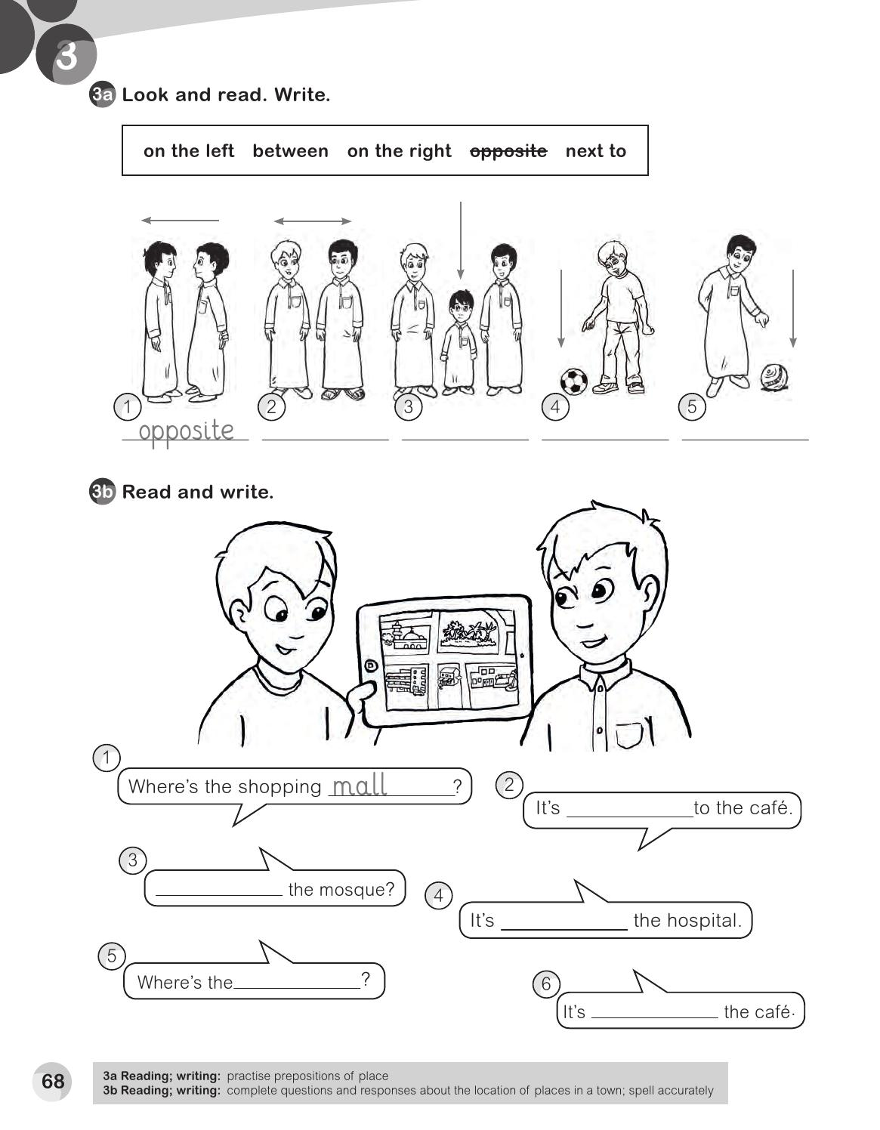
next to
between
on the left
on the right
next
Where`s
opposite
hospital
next to

Slide 13
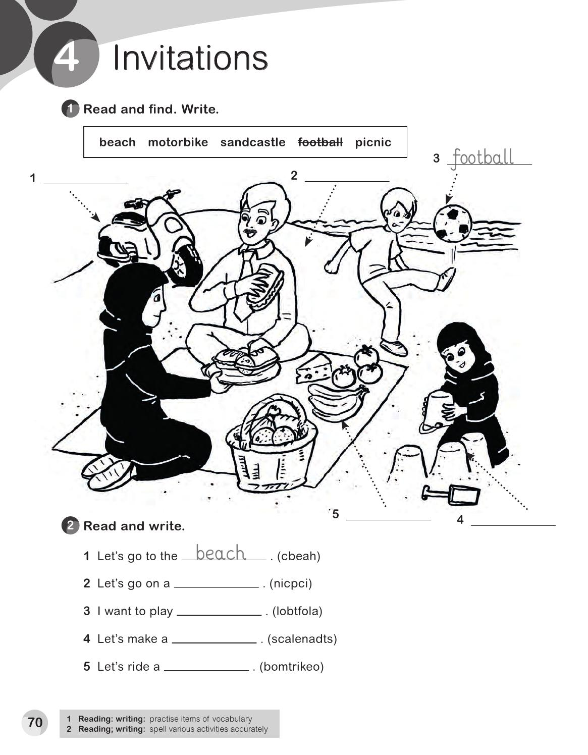
motorbike
beach
picnic
sandcastle
picnic
football
sandcastle
motorbike

Slide 14
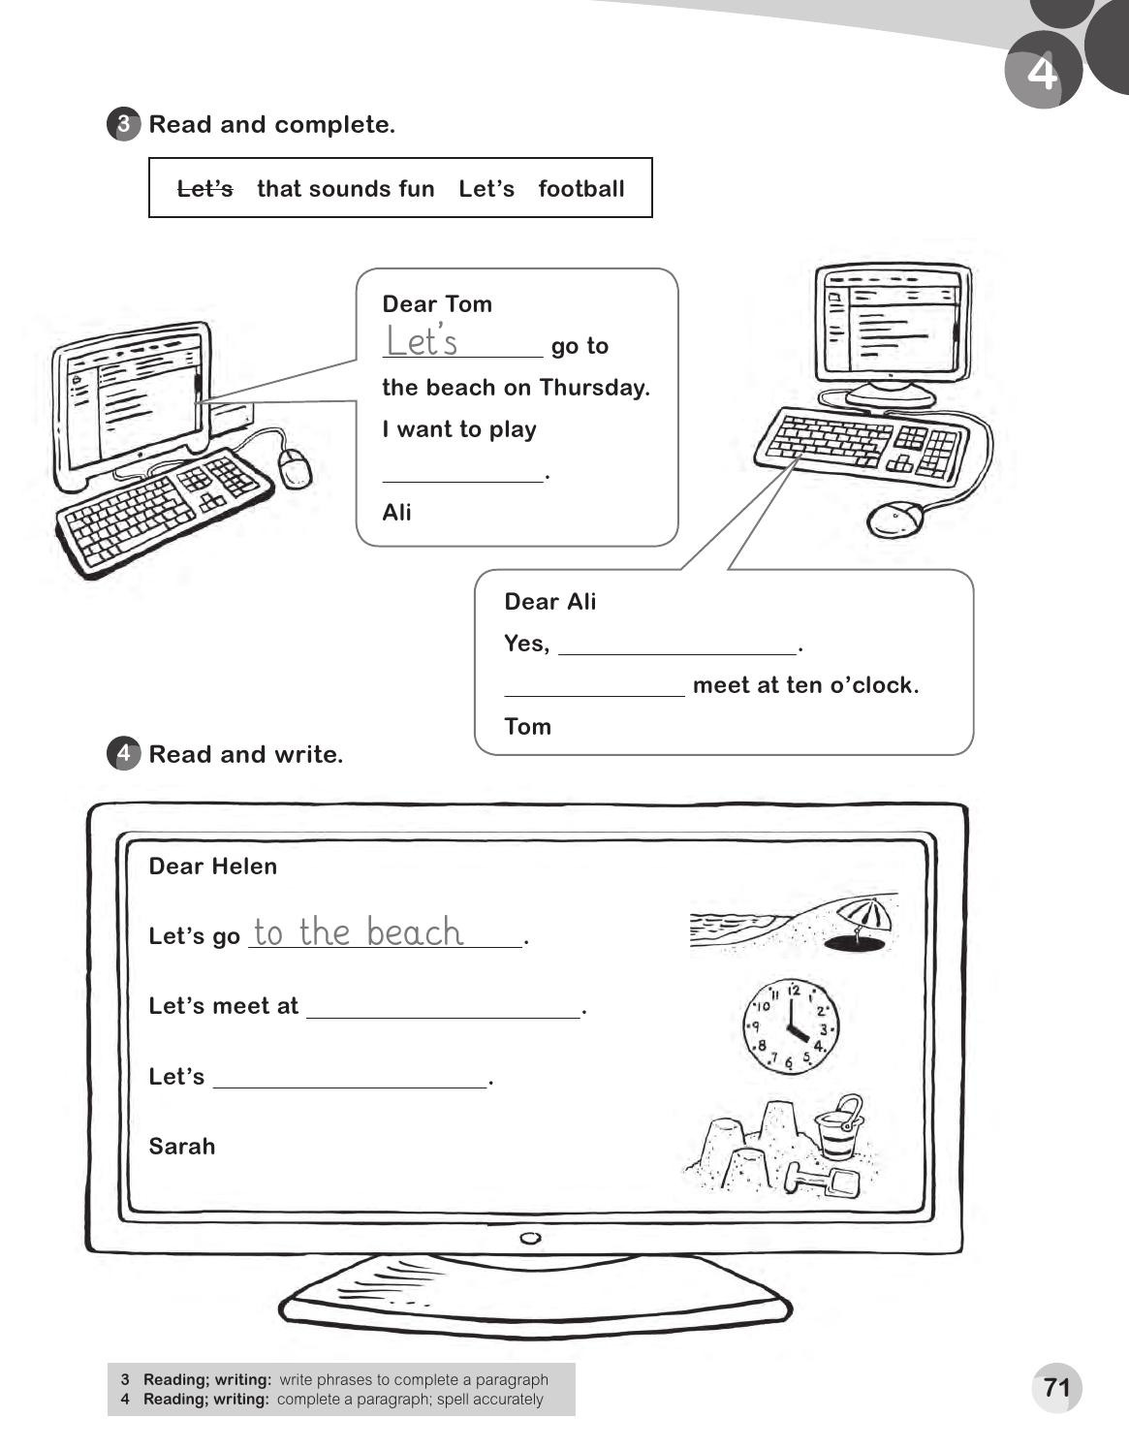
football
that sounds fun
Let`s
four o`clock
make a sandcastle

Slide 15
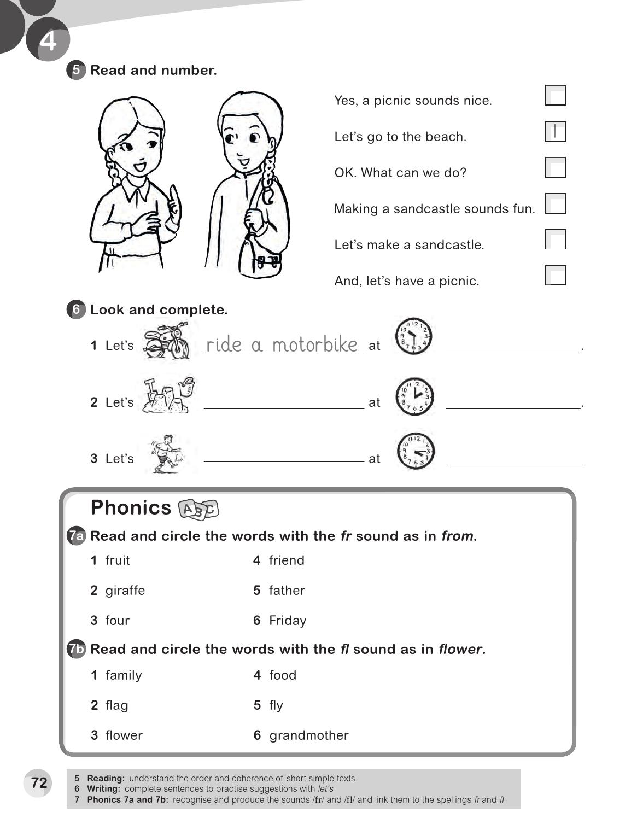
6
2
4
3
5
10:30
make a sandcastle
2 : 00
Play football
4:15

Slide 16
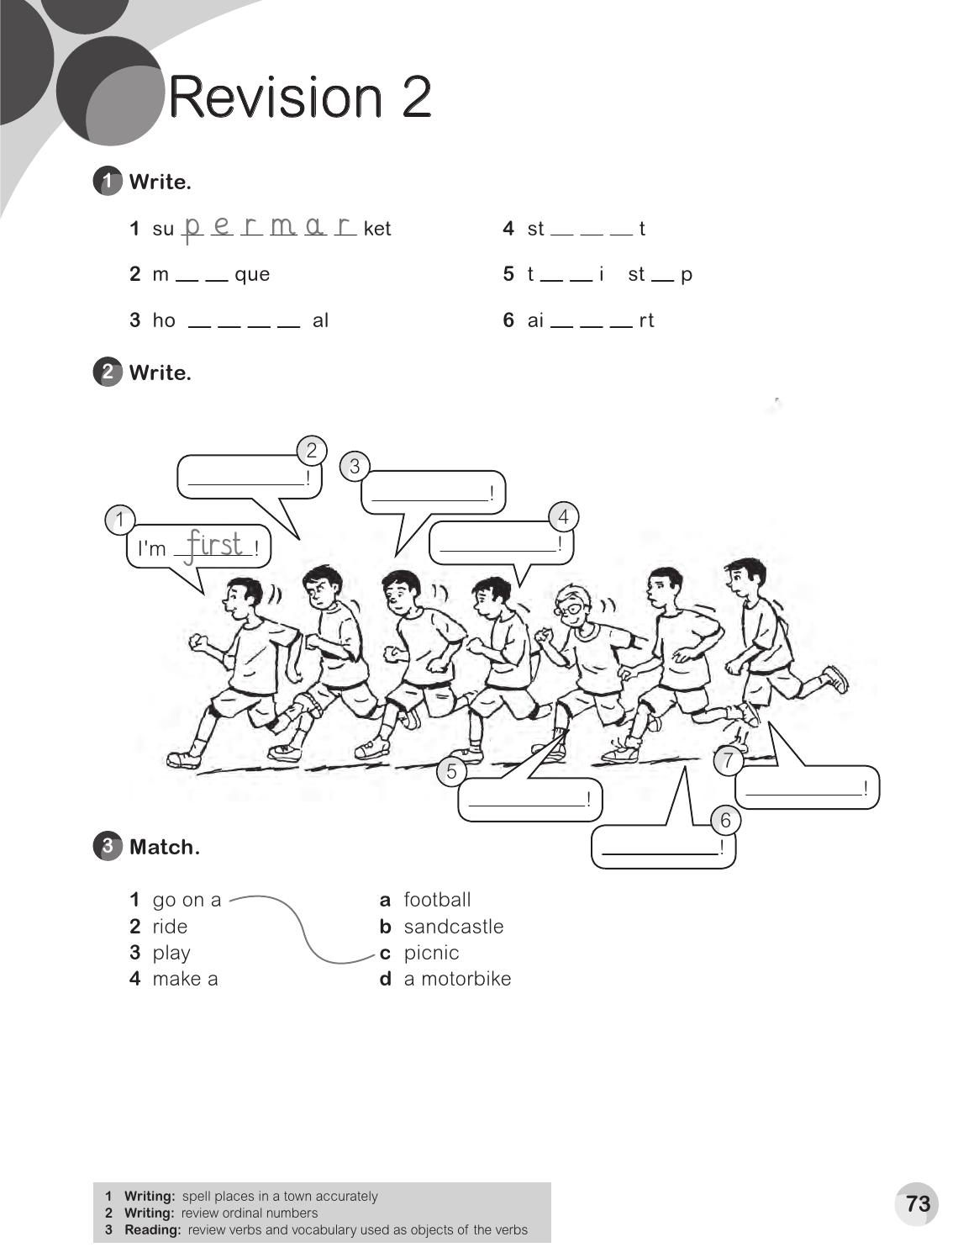
r e e
o s
a x
o
s p i t
r p o
I'm first
I'm second
I'm third
I'm fourth
I'm seventh
I'm sixth

Slide 17
Is there a cafe` ?
Yes , there is
Is there bus stop ?
Yes , there is
Is there an airport ?
No , there isn`t
books
numbers
houses
fruit
fly
maps
keys
blouses
friend
flag

Slide 18
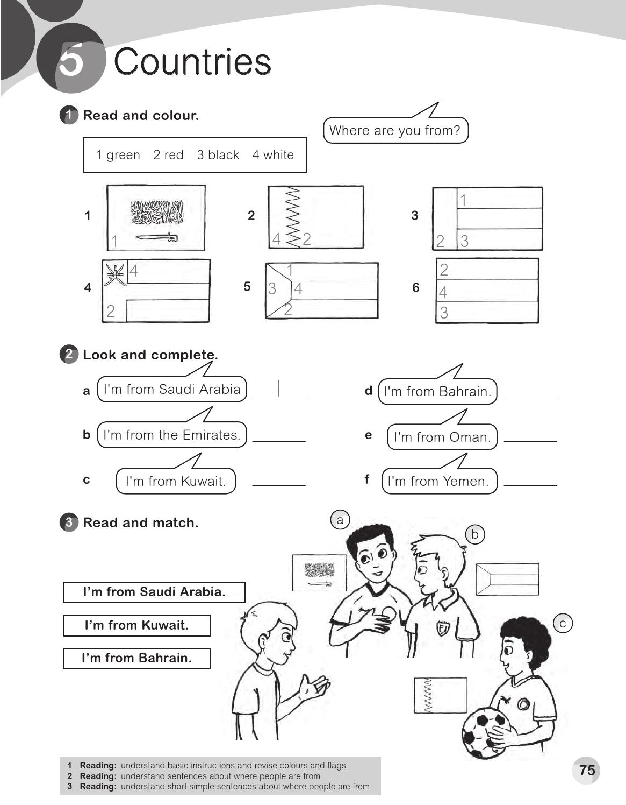
2
3
4
5
6

Slide 19
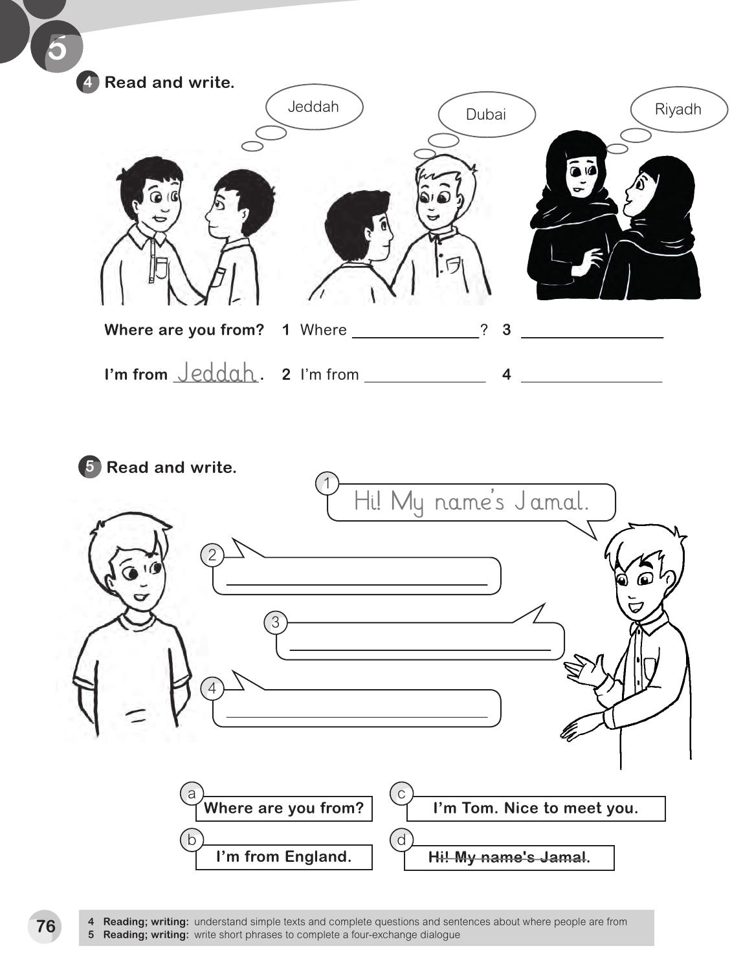
are you from
Where are you from ?
Dubai
I'm from Riyadh
I`m Tom . Nice to meet you .
Where are you from?
I`m from England .

Slide 20
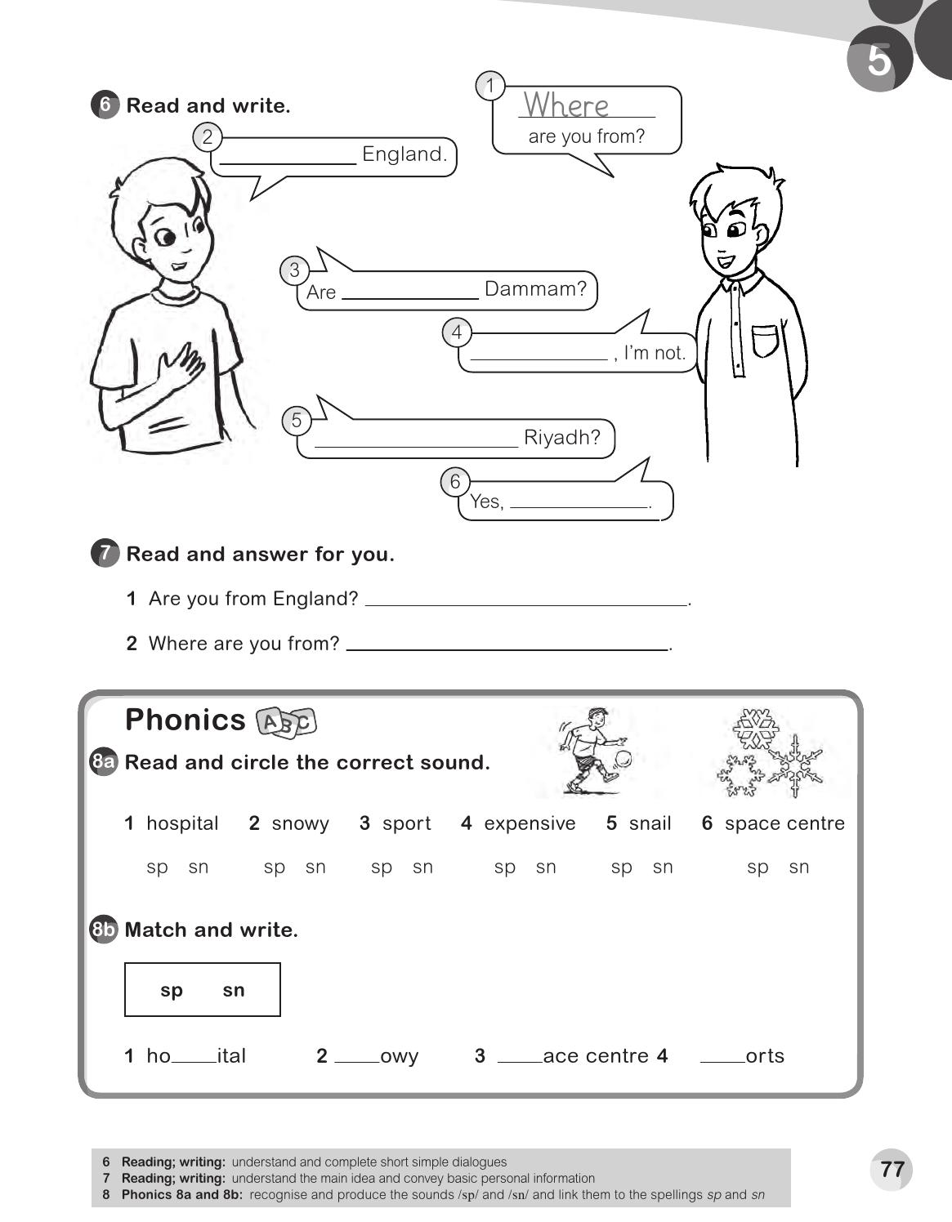
I`m from .
you from
No
Are you from
I am
No , I'm not
I`m from Medina.
sp
sn
sp
sp

Slide 21
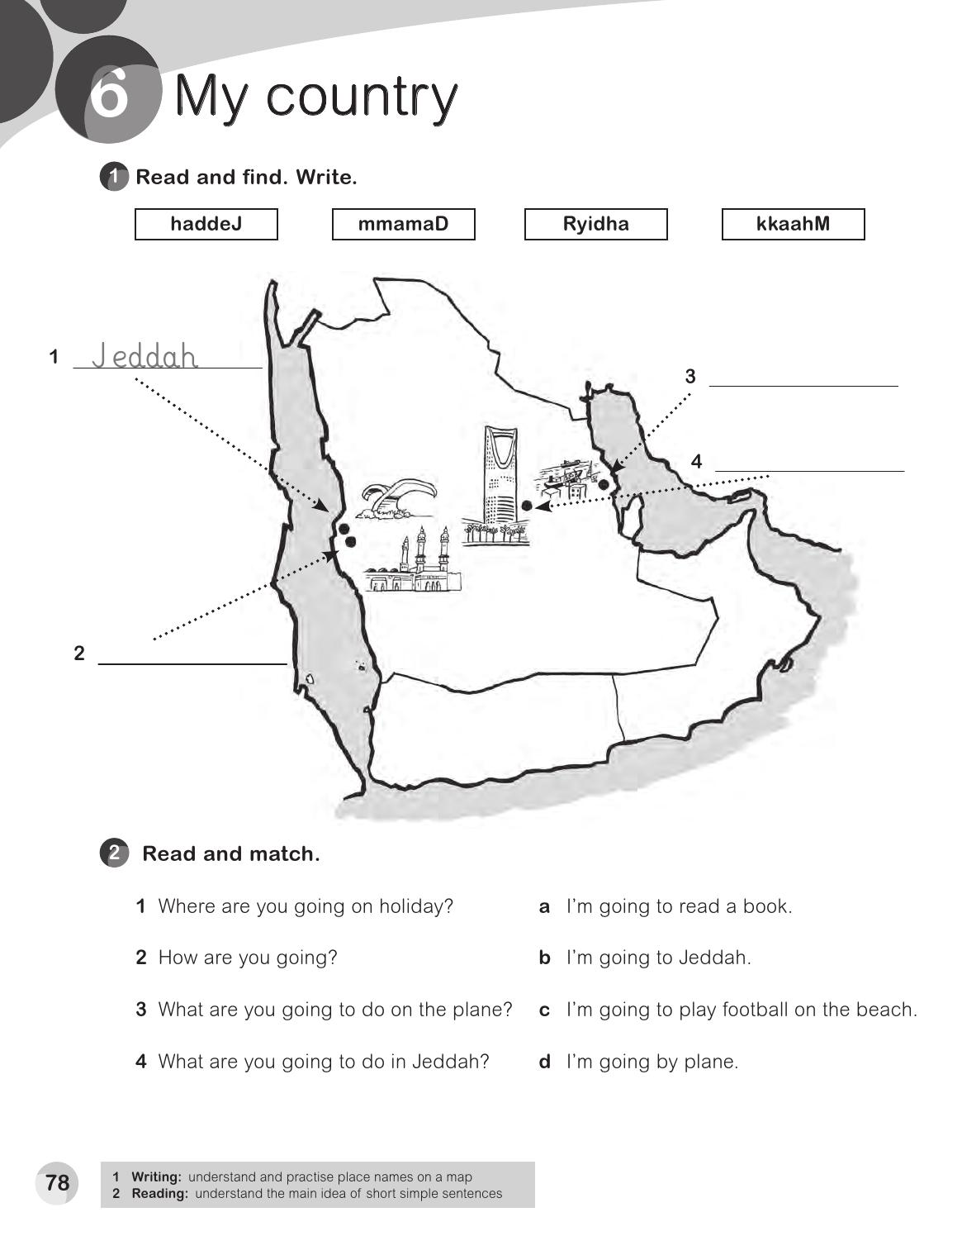
Dammam
Riyadh
Makkah

Slide 22
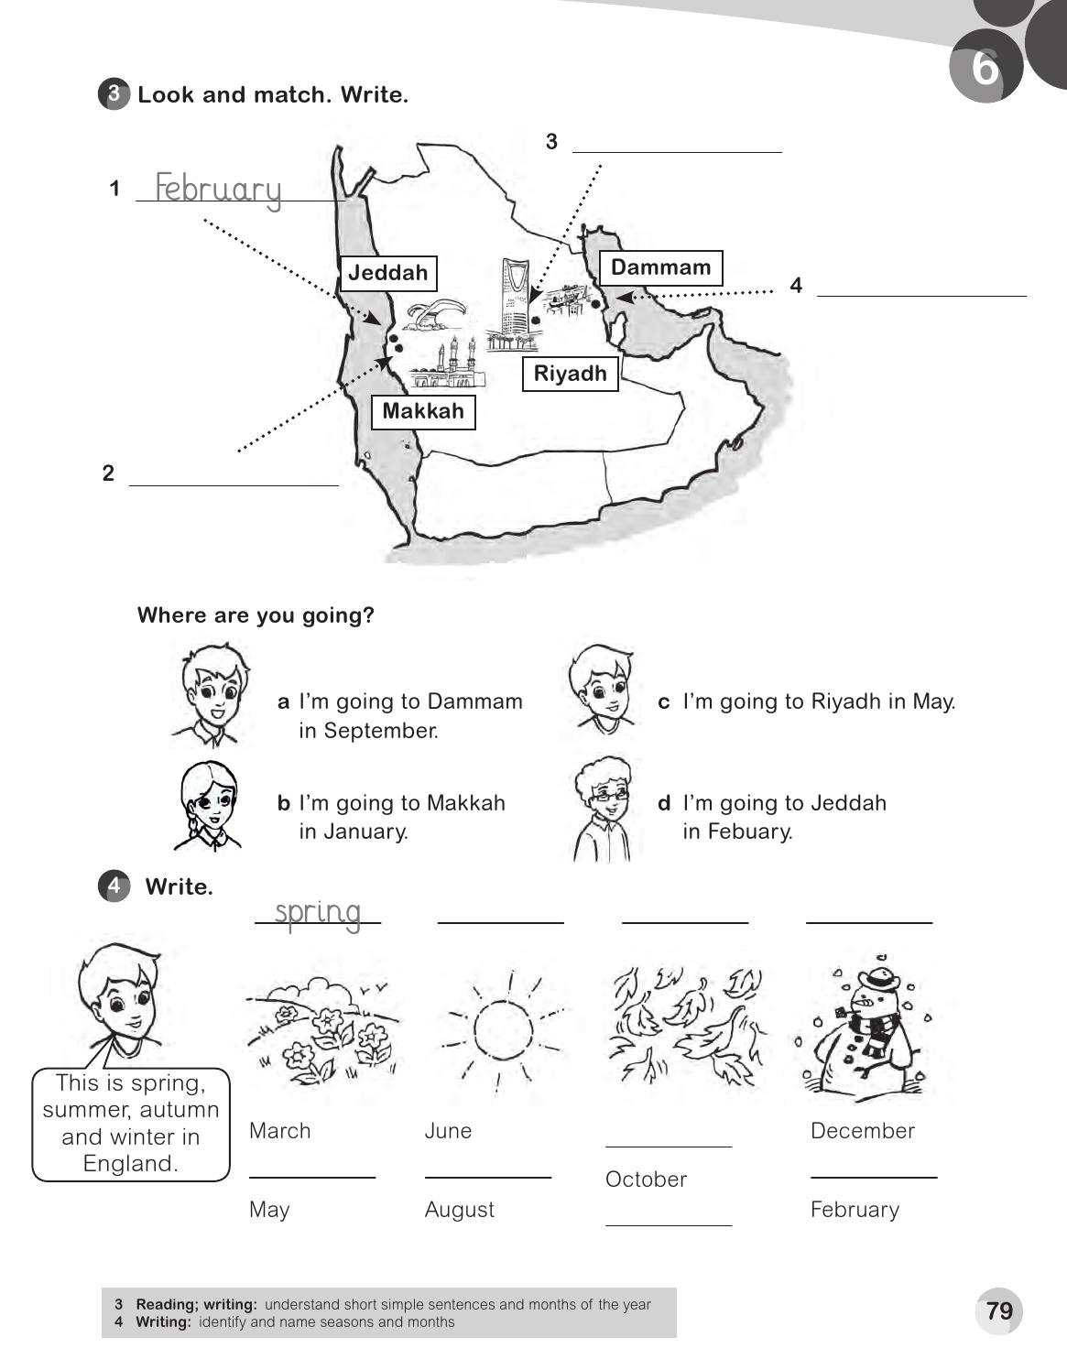
May
September
January
March
April
May
August
Summer
June
September
Autumn

Slide 23
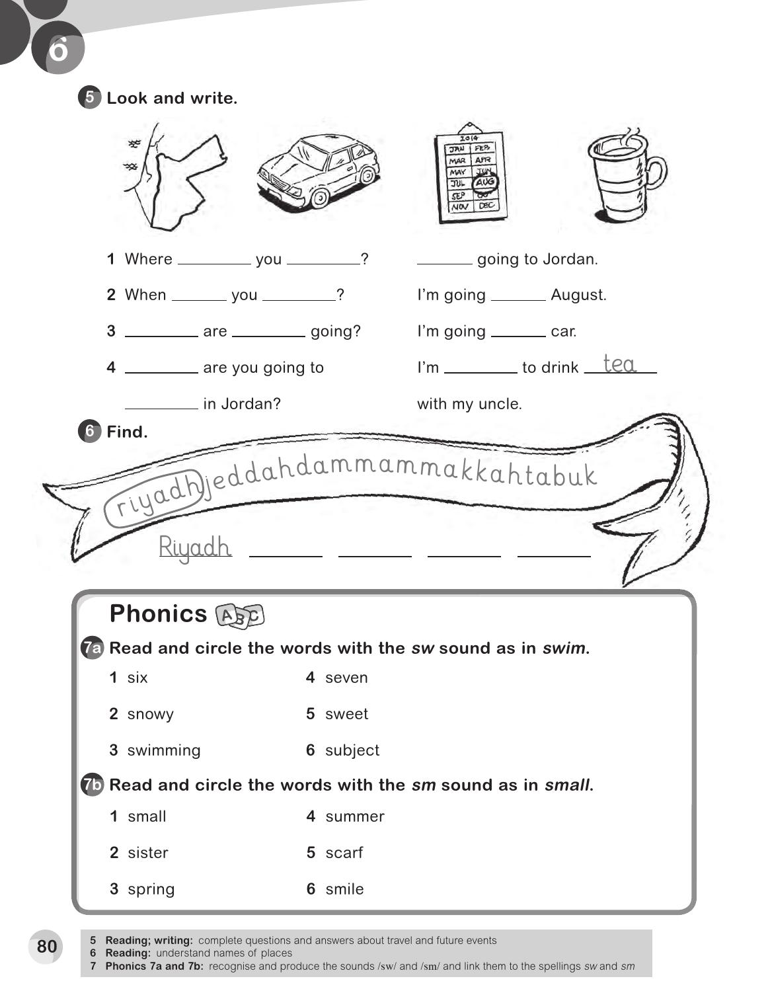
are
going
I'm
are
going
in
How
you
by
What
going
do
Jeddah
Dammam
Makkah
Tabuk

Slide 24
F
b
A p r i l
M
u
M
a
j a n u a r y
r
r
J u l y
c
h
Jala
Isma`il
Emirates
Yemen
Where
he
from
He`s

Slide 25
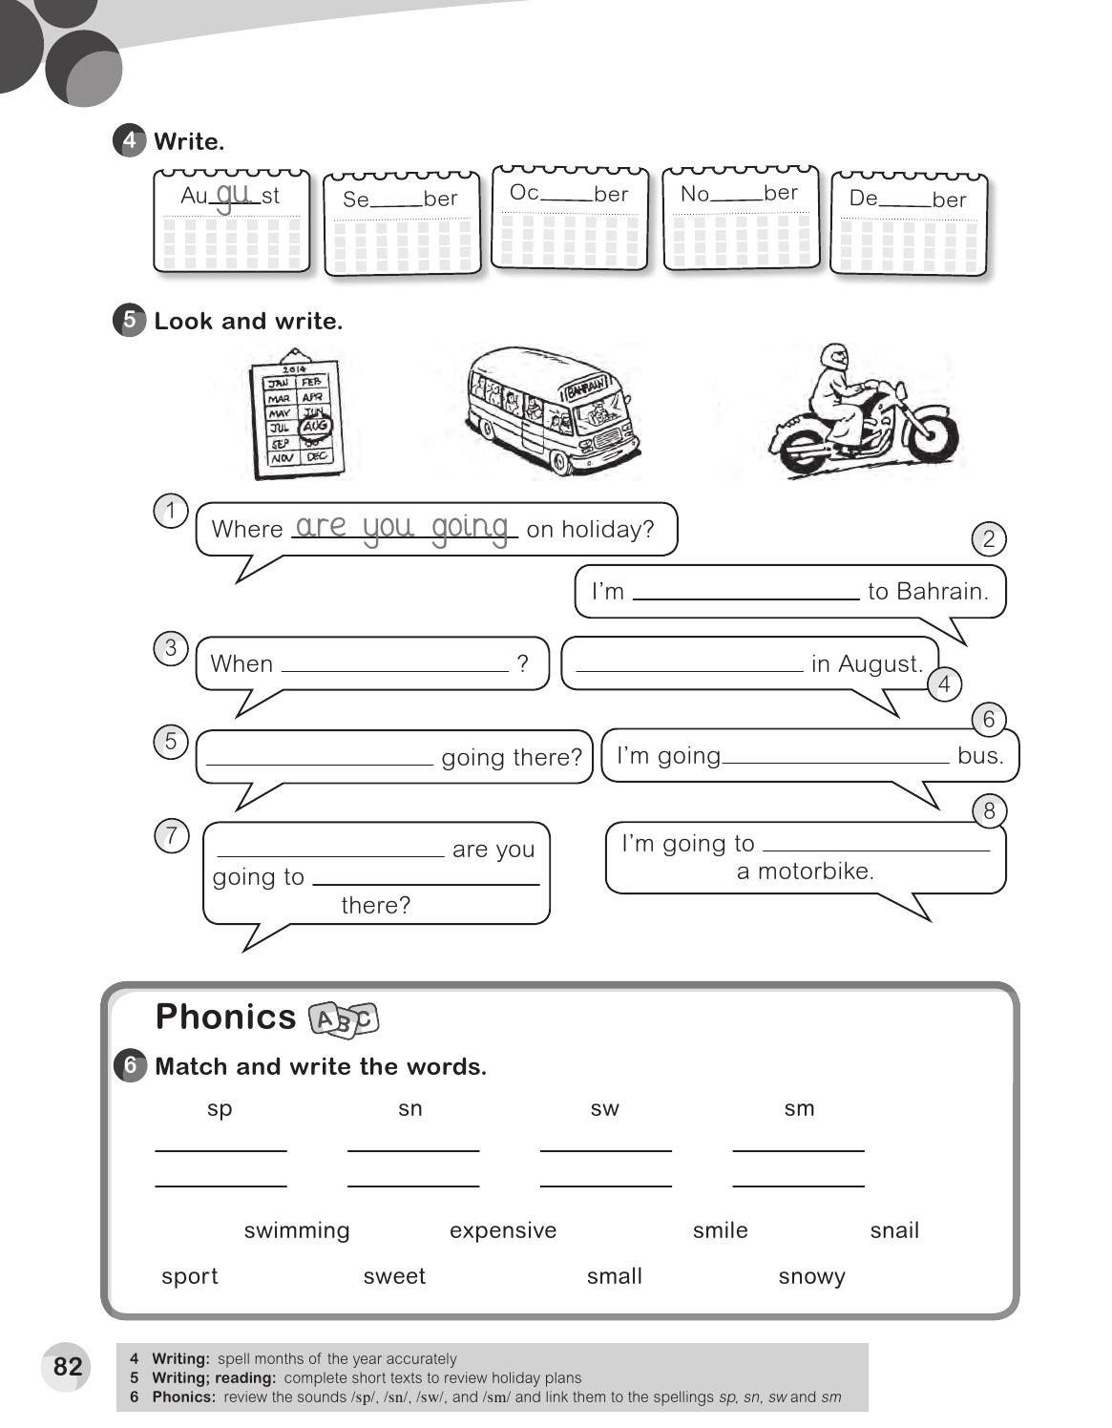
ptem
to
vem
cem
going
are you going
I'm going
How are you
by
What
ride
do
sport
snail
swimming
small
expensive
snowy
sweet
smile

Slide 26
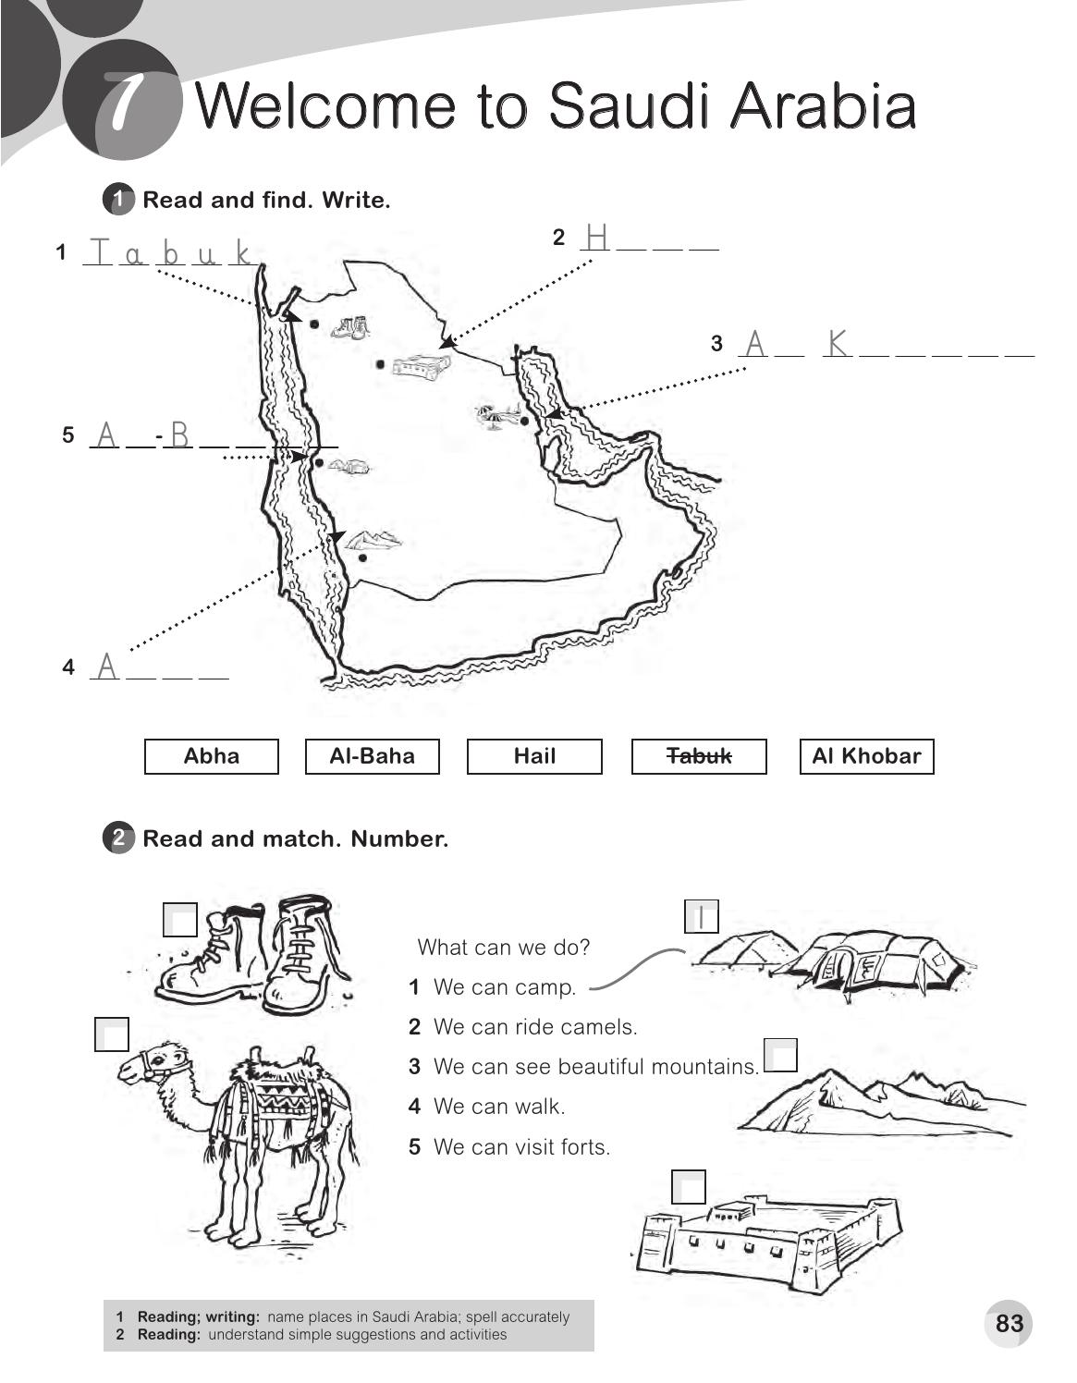
a i l
h o b a r
l
a h a
b h a
4
2
3
5

Slide 27
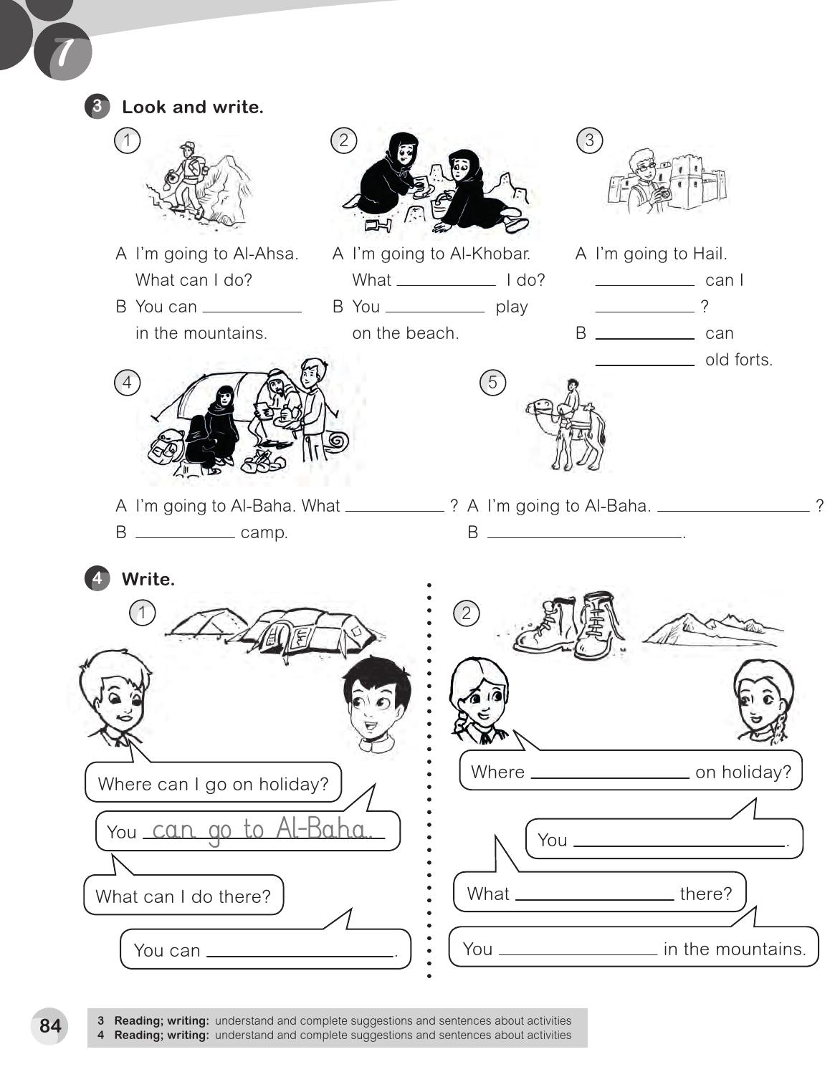
can
What
walk
can
do
you
visit
can I do
What can I do
You can
You can ride camels .
can I go
can go to Abha
can I do
camp
can walk

Slide 28
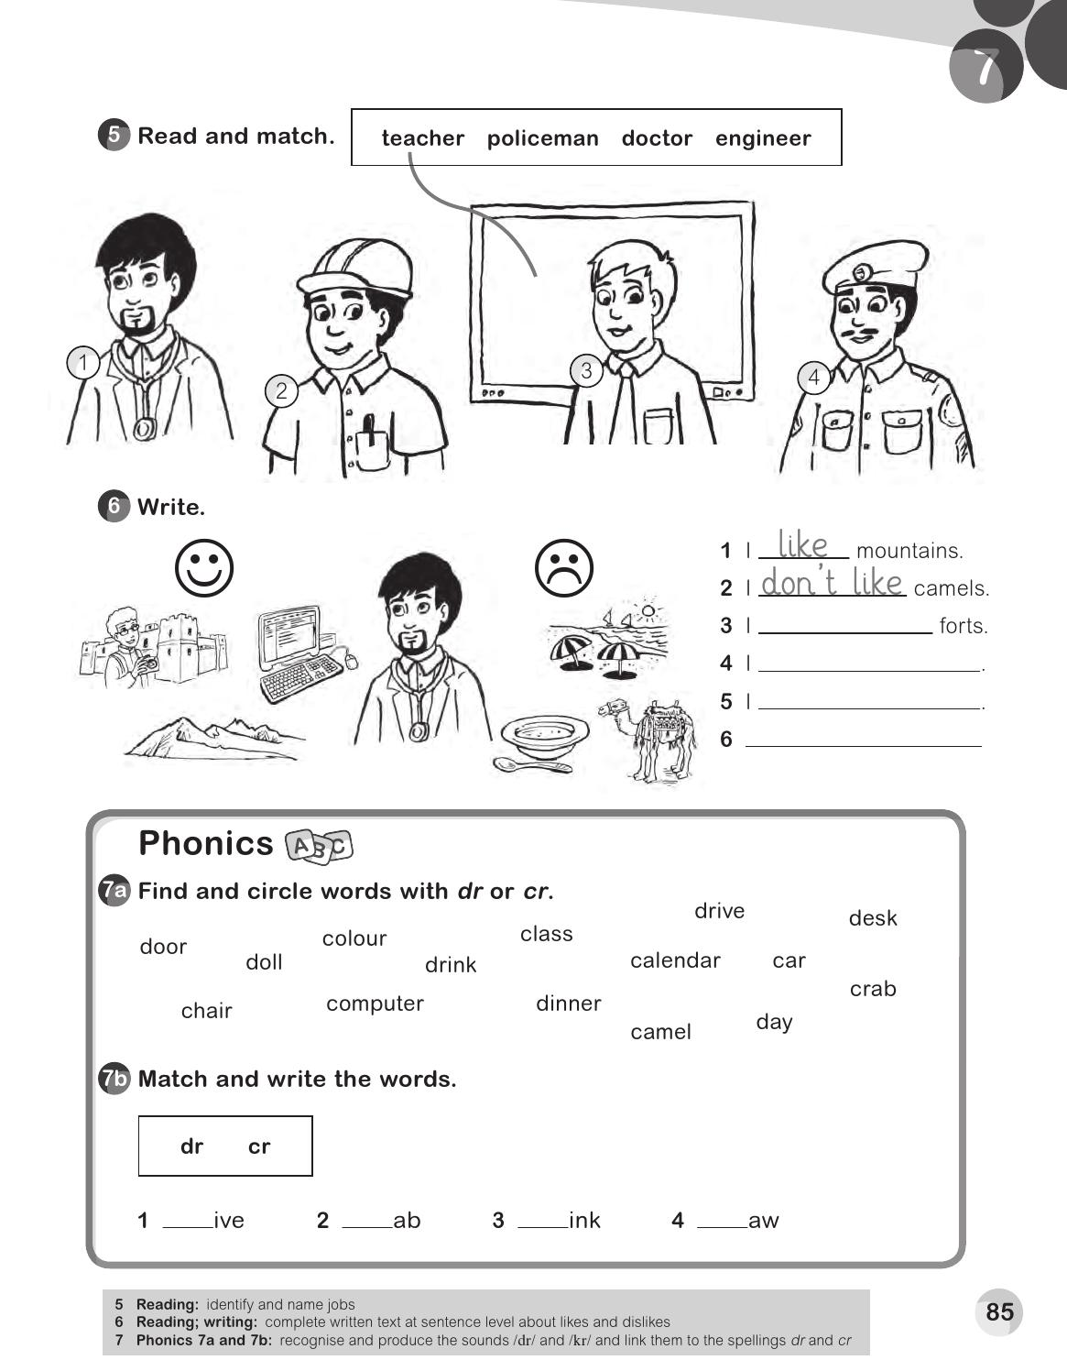
like
like computers
Don`t like beaches
Don`t like soup
dr
cr
dr
dr

Slide 29
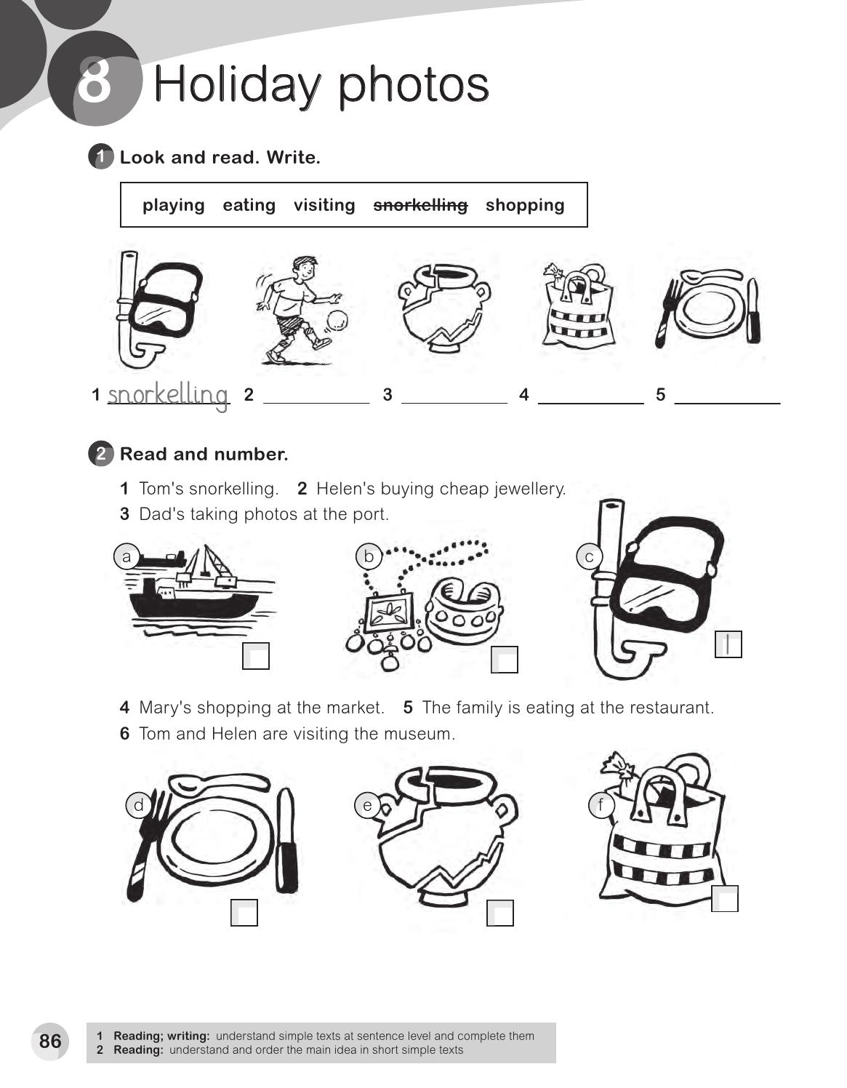
playing
visiting
shopping
eating
3
2
5
6
4

Slide 30
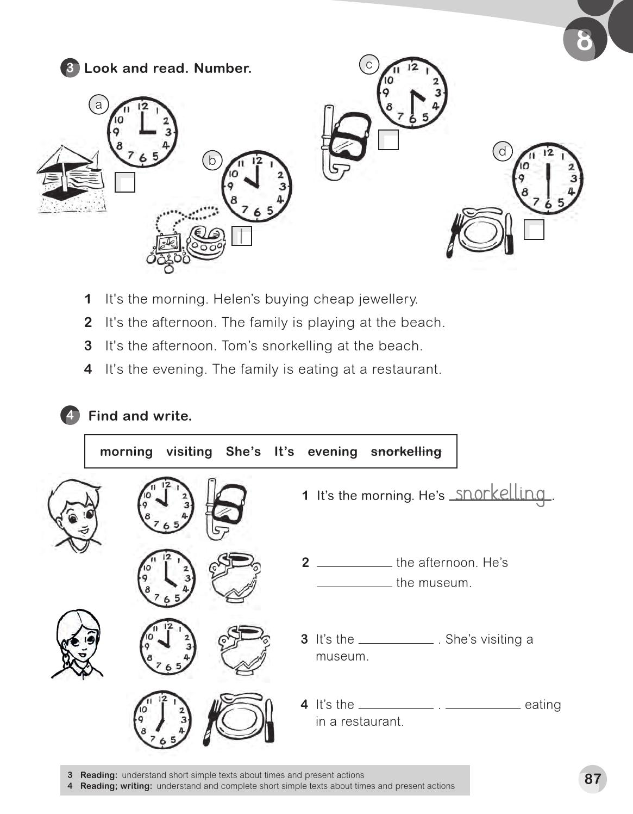
3
2
4
It`s
visiting
morning
evening
She`s

Slide 31
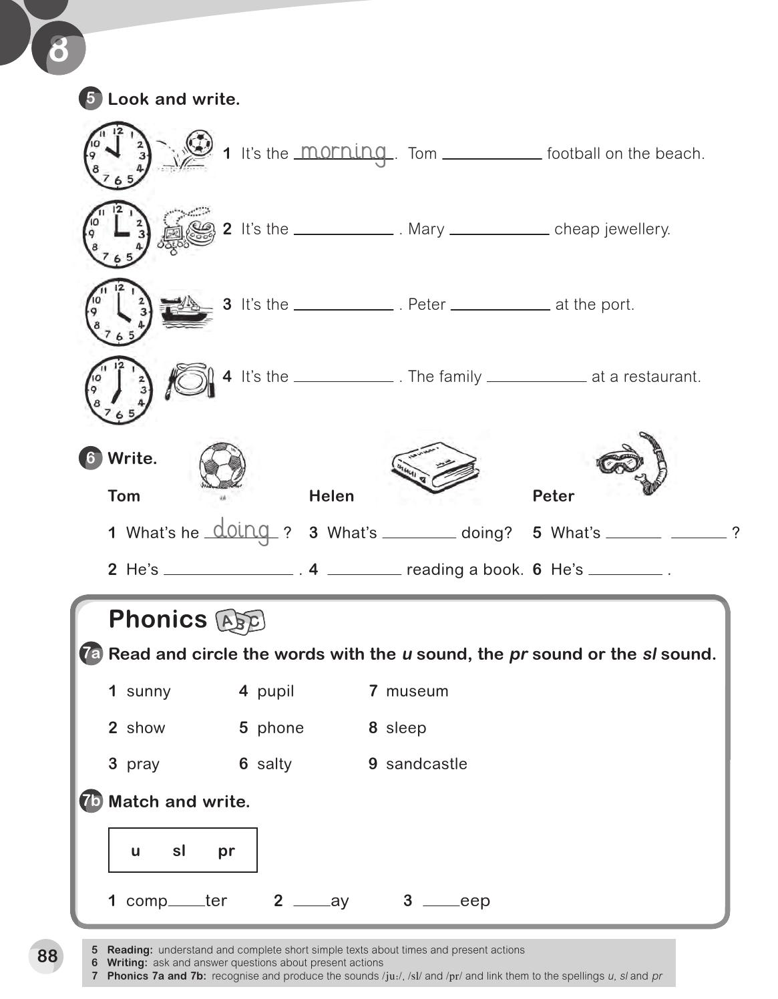
playing
afternoon
is buying
afternoon
is taking photos
evening
is eating
she
he doing
playing football
She`s
snorkelling
u
p
sl

Slide 32
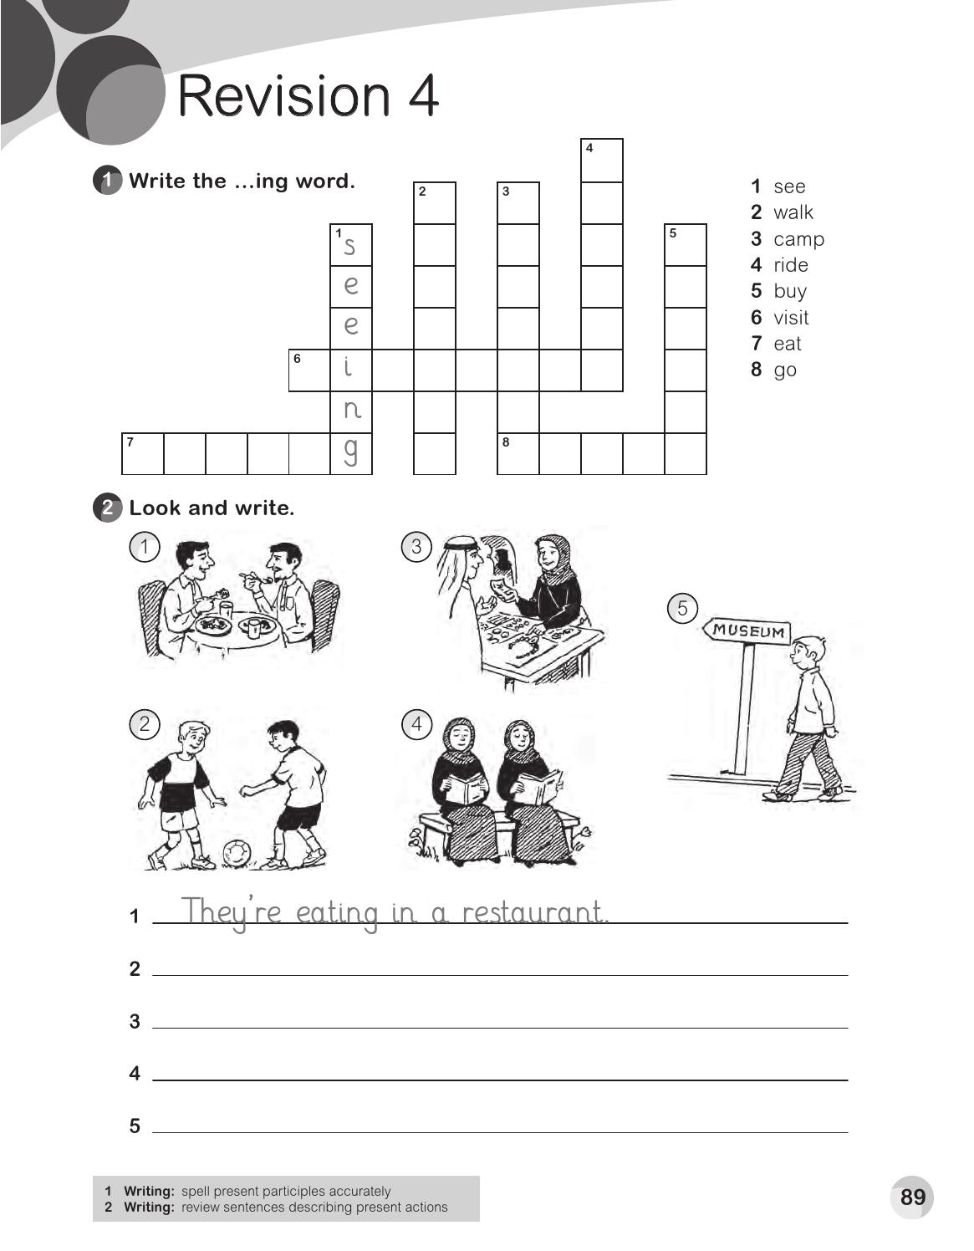
r
w
c
i
a
a
d
b
l
m
i
u
k
p
n
y
s i t i n g
v
i
n
n
n
e a t i n
g o i n g
g
They`re playing football .
She`s buying jewellery .
They`re reading booking

Slide 33
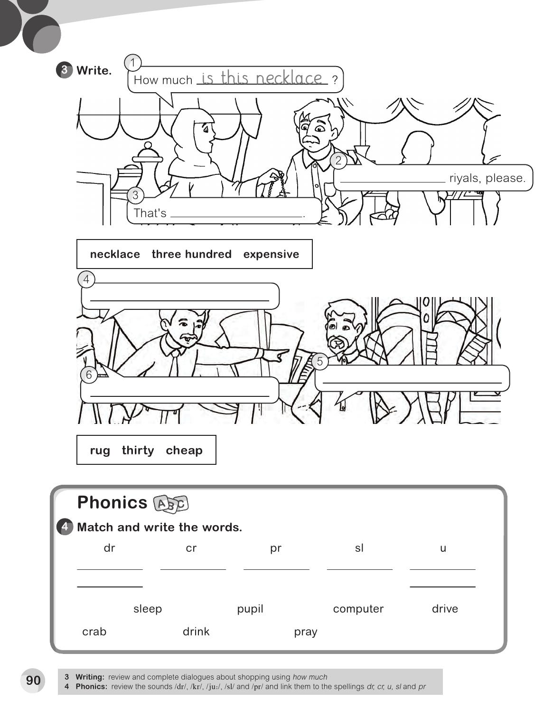
Three hundred
expensive
How much is that rug
Thirty riyals , please .
That`s cheap .
drive
crab
pray
sleep
pupil
drink
computer

