Slide 1
Thin

Slide 2
Thick

Slide 3
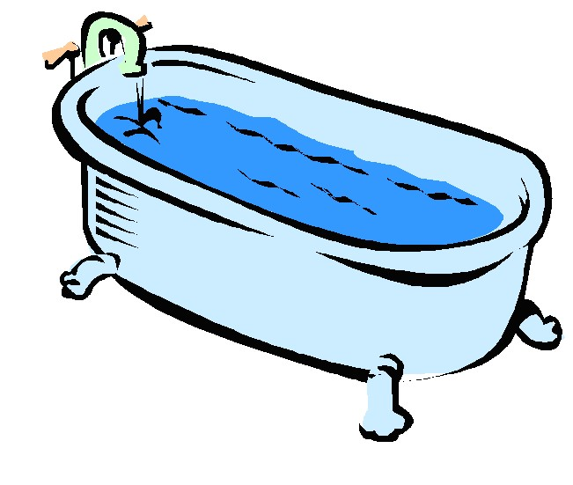
Bath

Slide 4
Math

Slide 5
Thumb

Slide 6
Thanks

Slide 7
Father

Slide 8
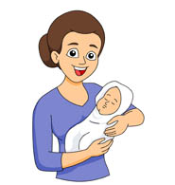
Mother

Slide 9
This

