Slide 1
Q1:Do you like banana?

Slide 2
Q:Do you like cheese?

Slide 3
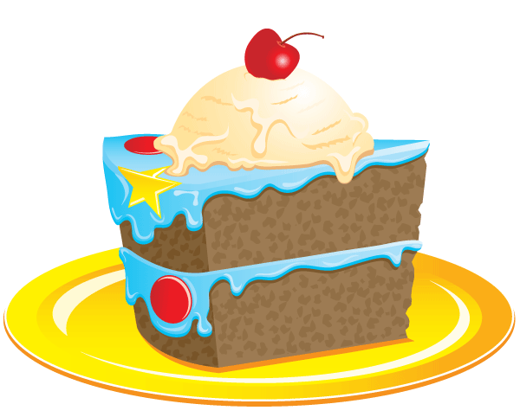
Q:Do you like cake?

Slide 4
Q:Do you like bread?

