Slide 1
Unit 2 lesson 1
How ill am I ?

Slide 2
New Vocabulary

Slide 3
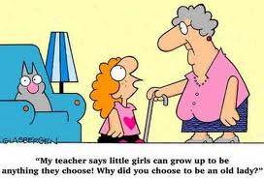
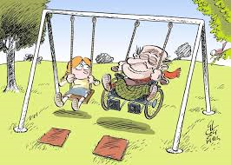
Age

Slide 4
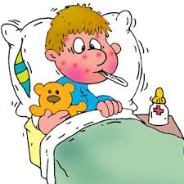
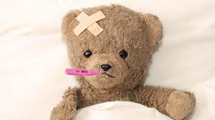
ill

Slide 5
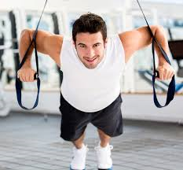
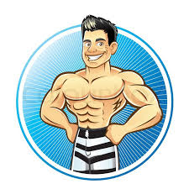
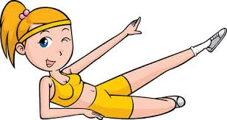
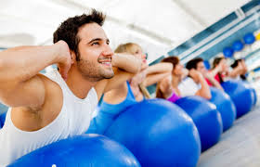
Fit / fitness

Slide 6
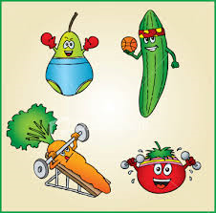
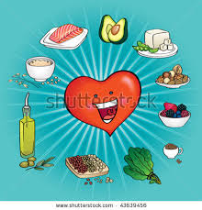

Health / healthy

Slide 7
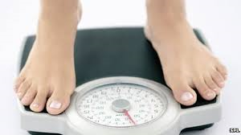
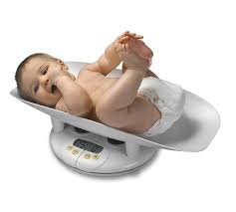
Weigh / weight

Slide 8
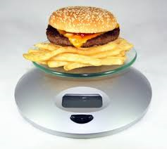
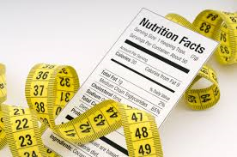
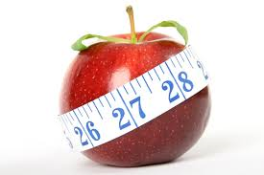
calorie

Slide 9
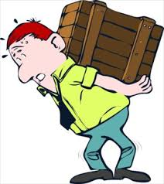
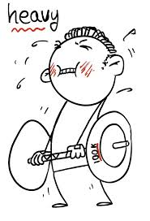
heavy

Slide 10
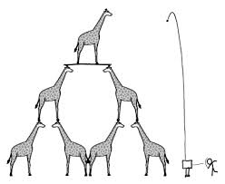
height

Slide 11
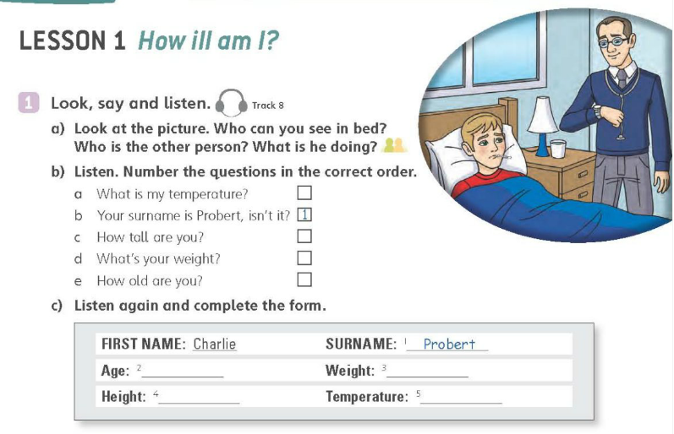
LISTEN
5
3
4
2
14
54 KILOS
1 METRE 55
38 DEGREES

Slide 12
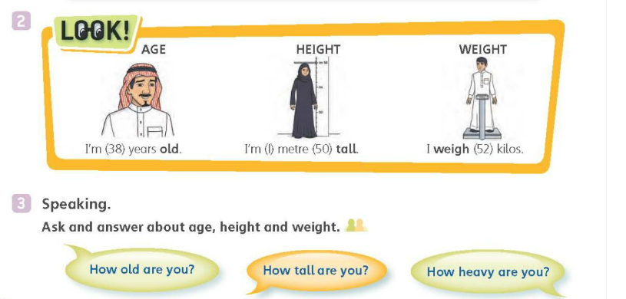

Slide 13
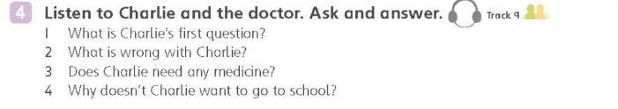
LISTEN
How ill am I doctor ?
He has a headache and a cold
No
He has a maths test

Slide 14
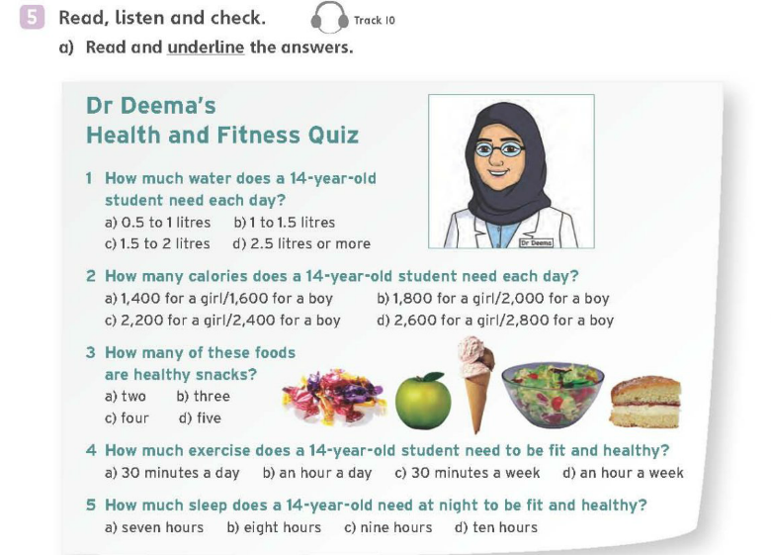
LISTEN

Slide 15
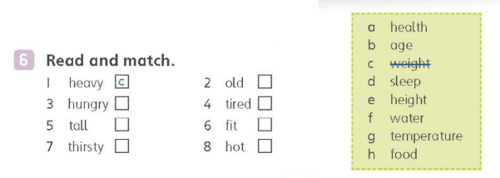
READ
b
h
d
e
a
f
g

Slide 16

HOME WORK

Slide 17
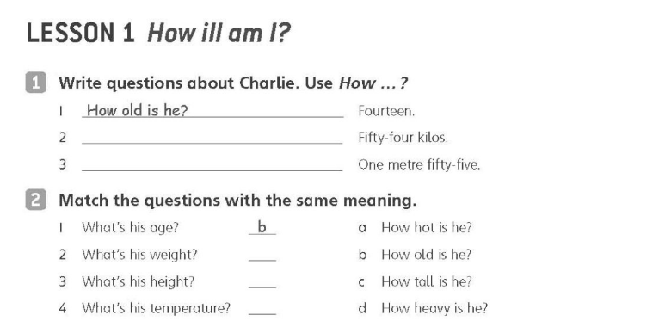
How heavy is he?
How tall is he ?
d
c
a

Slide 18
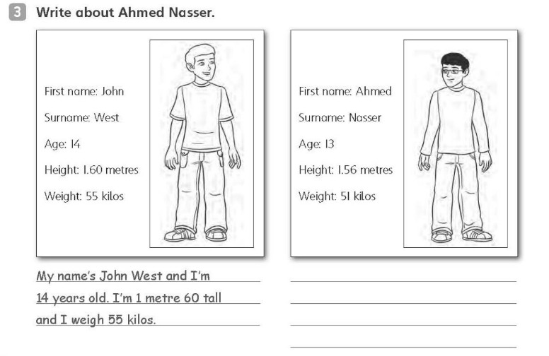
My name`s Ahmad Nasser and i`m 13years old .i`m 1 metre 56 and I wiegh 51 kilos

Slide 19
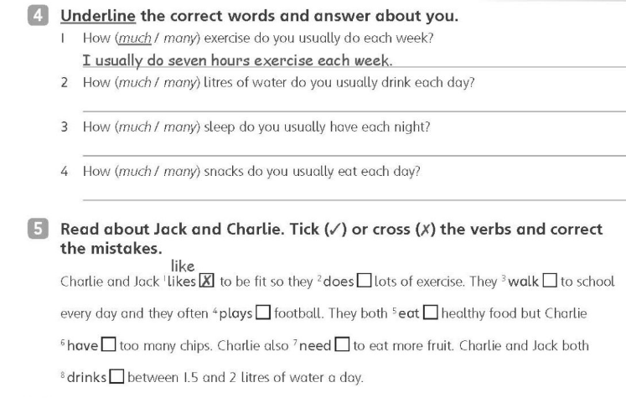
❒ do
✓
play
✓
has
needs
drink

Slide 20
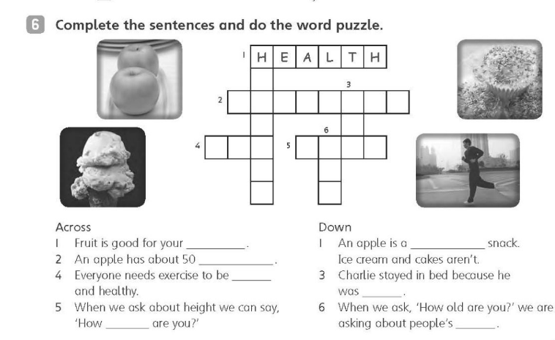
healthy
calories
fit
ill
tall
age

Slide 21
W.B Answers :
Q.S (1) :
(1): 2 - How heavy is he?
3- How tall is he?
*******************************
Q.S (1) :
3- My name’s Ahmed Nasser and I’m 13 years old. I’m 1 metre 56 tall
and I weigh 51 kilos.

Slide 22
Q.S 4:
2- many 3- much
4- many

