Slide 1
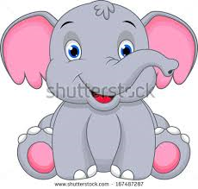
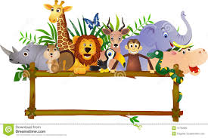
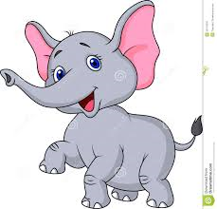
Unit 2 lesson 2
How heavy are elephant ?

Slide 2
New Vocabulary

Slide 3
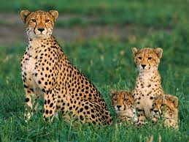
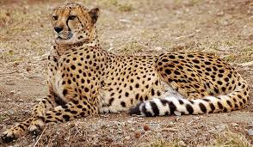
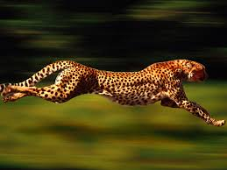
Cheetah

Slide 4
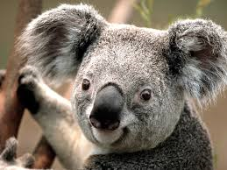
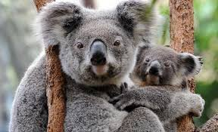
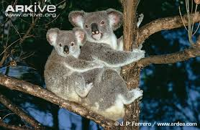
koala

Slide 5
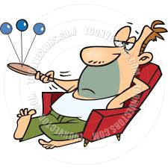
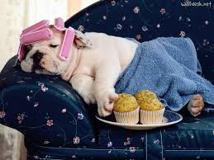
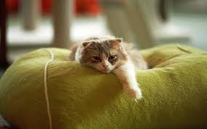
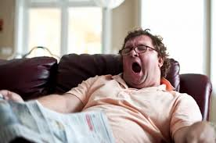
lazy

Slide 6
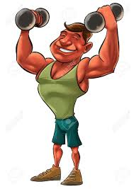
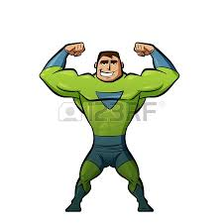
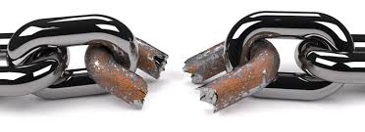
Strong

Slide 7
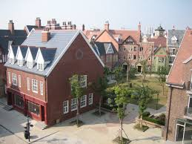
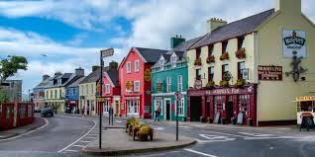
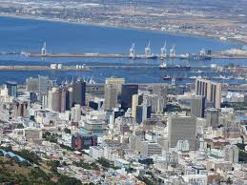
town

Slide 8
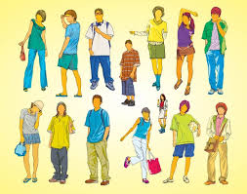


young

Slide 9
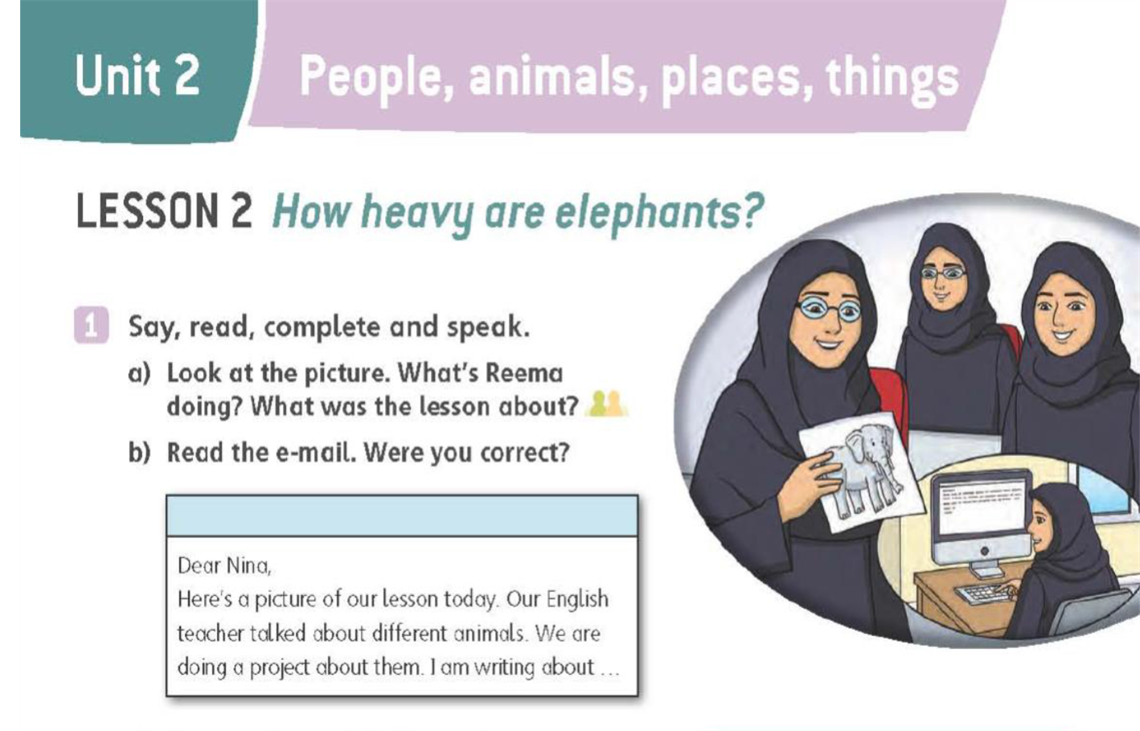

Slide 10
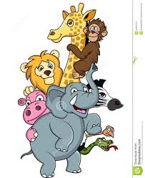

Slide 11
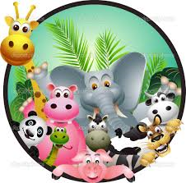
Reading
tallest
Fastest
laziest

Slide 12



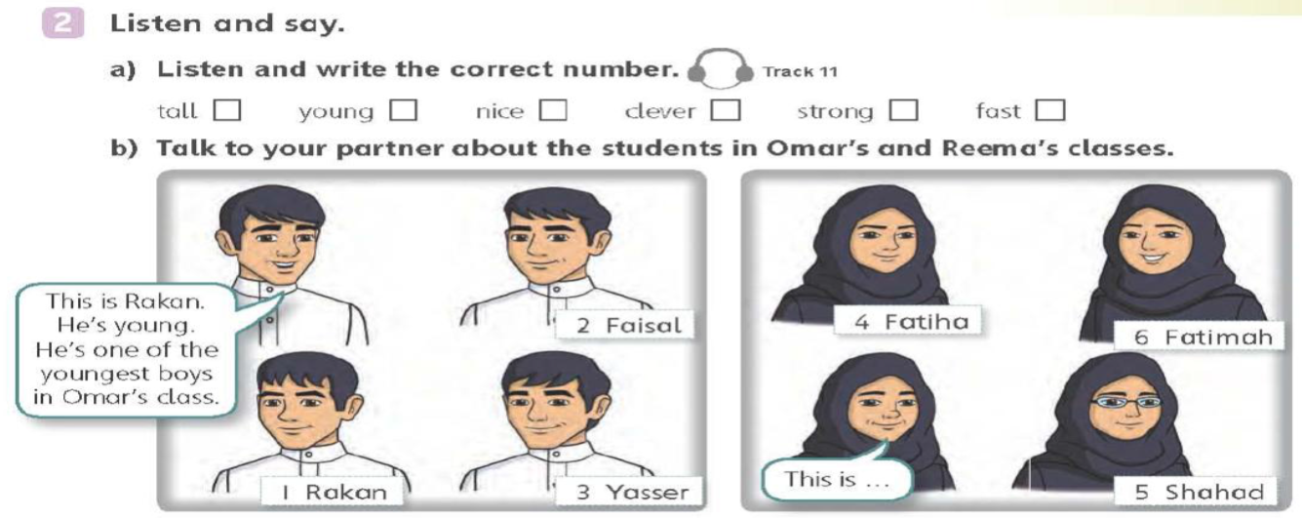
LISTEN
4
1
6
5
3
2

Slide 13
Writing :

Slide 14
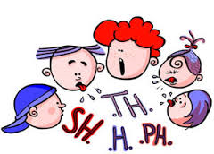
asks
weighs
uses
sleeps
runs
watches
likes
goes
Catches

Slide 15
W.B answers :
Q.S 1 :
2- cheetahs C 3- elephants D 4- koala bears A
********************************************
Q.S 2 :
2-They run at 80 kilometres an hour or more. C
3-They weigh 3 tonnes or more. D
4-They are 3 metres tall or more. B

Slide 16
W.B answers :
Q.S 3 :
2- How high is Mount Everest?
Very high. It’s 8,844 metres high or more.
3- How fast did he walk?
Very fast. He walked at 5 kilometres an
hour or more.
4- How heavy are hippos?
Very heavy. They weigh 2 tonnes or more .

Slide 17
W.B answers :
Q.S 5 :
2 - It is one of the oldest libraries in Europe.
3- He is one of the tallest teachers in (the) school.
4- It is one of the strongest animals in the world.
5- It is one of the coldest places in the world.
6- He is one of the youngest boys in the class.

Slide 18


