Slide 1
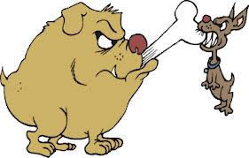
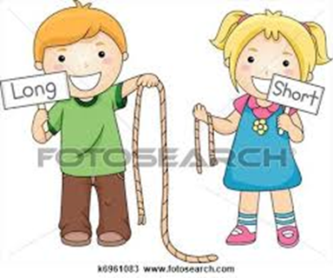

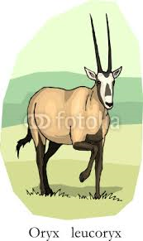
Unit 2 lesson 3
They are even bigger

Slide 2
New Vocabulary

Slide 3
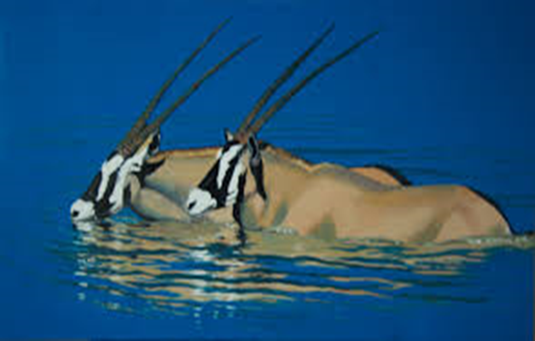
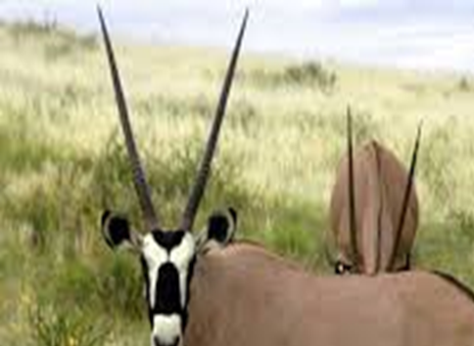
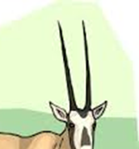
Horn

Slide 4
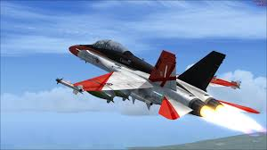
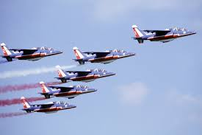
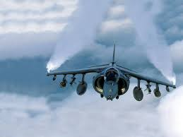
Jet

Slide 5
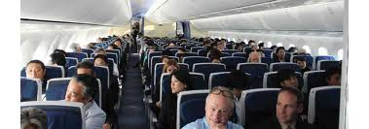
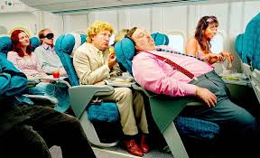
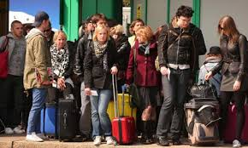
Passenger

Slide 6
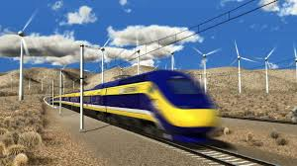

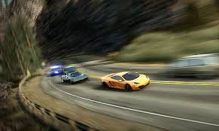
Speed

Slide 7



Call

Slide 8

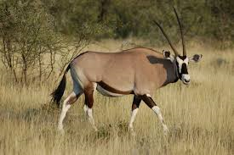

Oryx

Slide 9
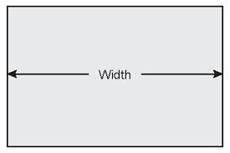
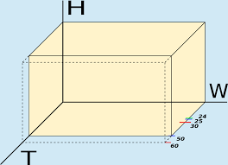
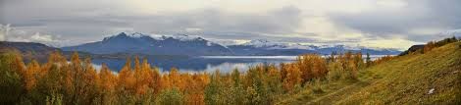
Wide / Width

Slide 10
To write a project about flying.

Slide 11
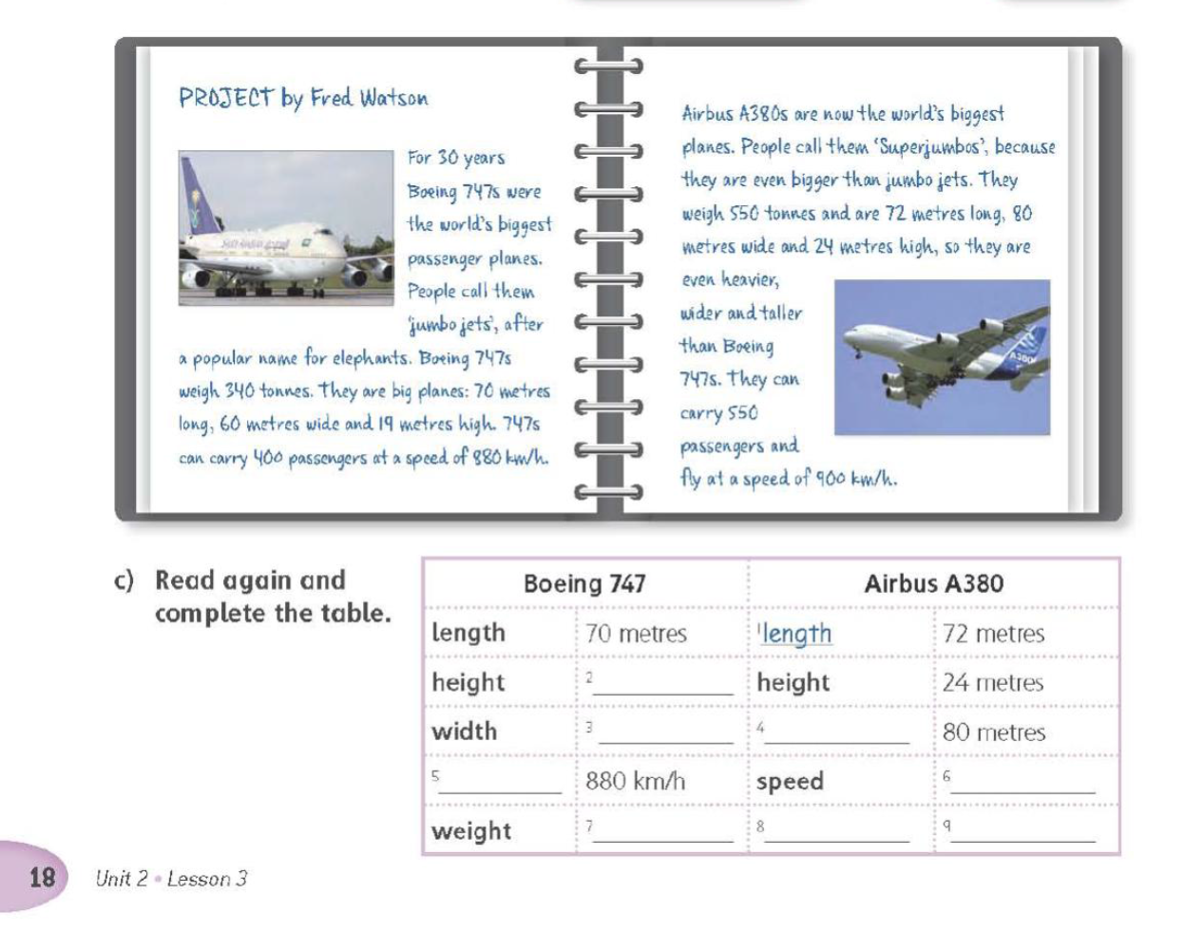
Reading

Slide 12
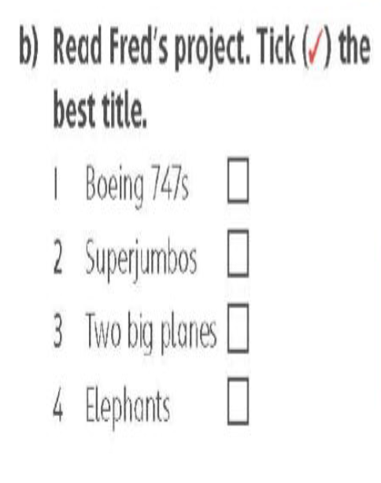

Reading
19 metres
60 metres
width
speed
900 km/h
340 tonnes
weight
550 tonnes

Slide 13
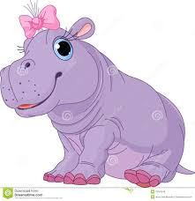



Slide 14

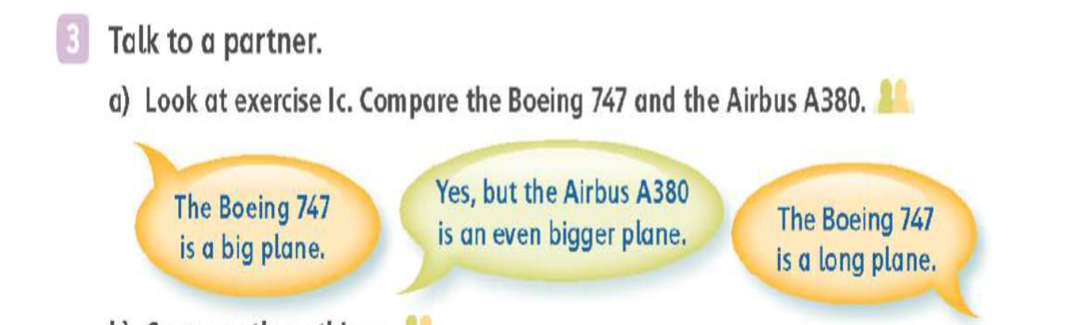
Speaking
..
2 The Boeing 747 is a long plane. Yes, but the Airbus A380 is an even longer plane .
3 The Boeing 747 is a tall plane. Yes, but the Airbus A380 is an even taller plane
4 The Boeing 747 is a wide plane. Yes, but the Airbus A380 is an even wider plane.
5 The Boeing 747 is a fast plane. Yes, but the Airbus A380 is an even faster plane.
6 The Boeing 747 is a heavy plane. Yes, but the Airbus A380 is an even heavier plane

Slide 15
Speaking
..
1. Horses are fast animals . Yes but cheetahs are even faster animals .
2. Hail is a big city . Yes, but Tabuk is an even bigger city .
3. Cats are lazy animal . Yes, Koala bears are even lazier animals .
4. Jabal Zar is a high mountain . Yes, but Jabal Dakah is an even higher mountain.
6. Camels are tall animals . Yes, but giraffes are even taller animals .

Slide 16


white
about 50 centimetres
about a metre or more
the Arabian desert
grass
about 70 kilos

Slide 17
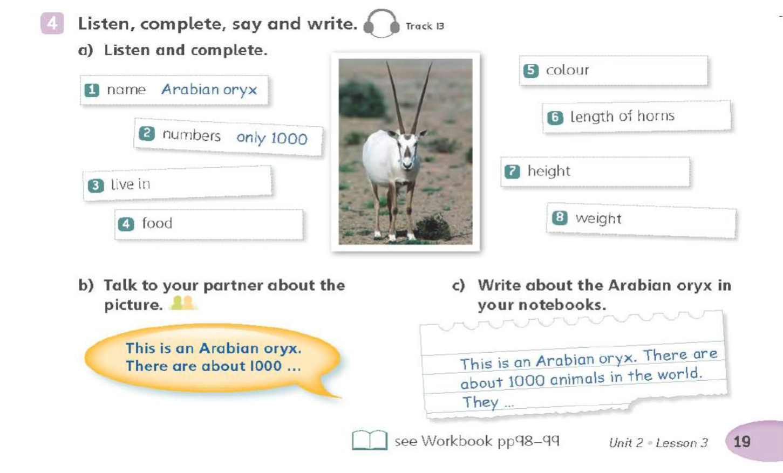

Slide 18
W.B answers :
Q.S1 :
1- Height 2- Width 3- Length
*****************************
Q.S 2 :
a) 2- 4.5m 3- 1.7m 4- 1.5 tonnes 5 180 km/h
b) Height: 1.5m, Length: 4.5m, Width: 1.7m

Slide 19
W.B answers :
Q.S4 :
2- A is a tall building but the B is even taller.
3- A is a cold place but B is even colder.
4- TVs are heavy things but cars are even heavier.
5- A is a wide road but B is an even wider road. *****************************

