Slide 1
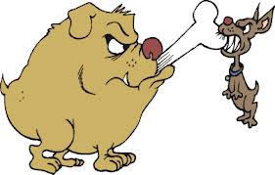
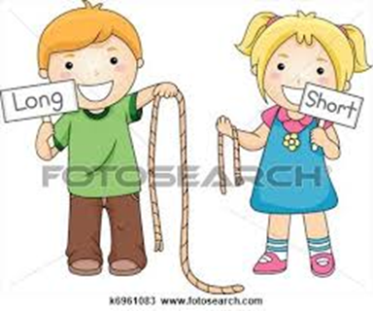
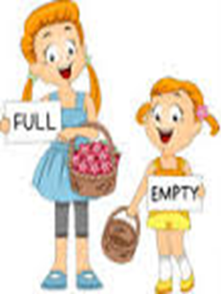
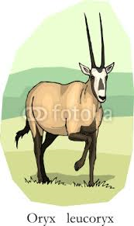
Unit 2 lesson 4
Review Unit 2

Slide 2


Slide 3
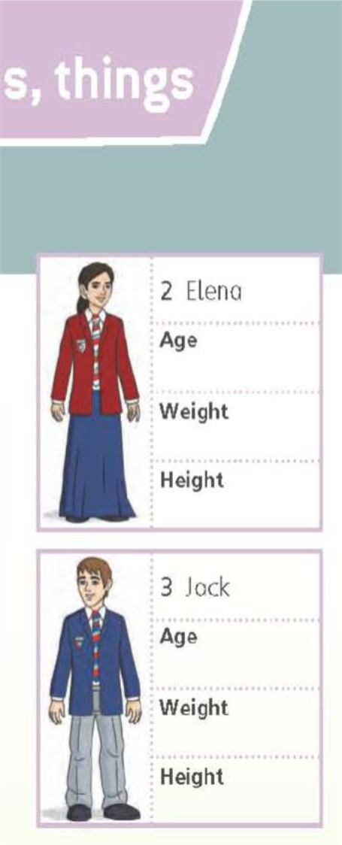
13
54 kilos
46 kilos
1.55m
1.53 m
14
56 kilos
1.57m

Slide 4
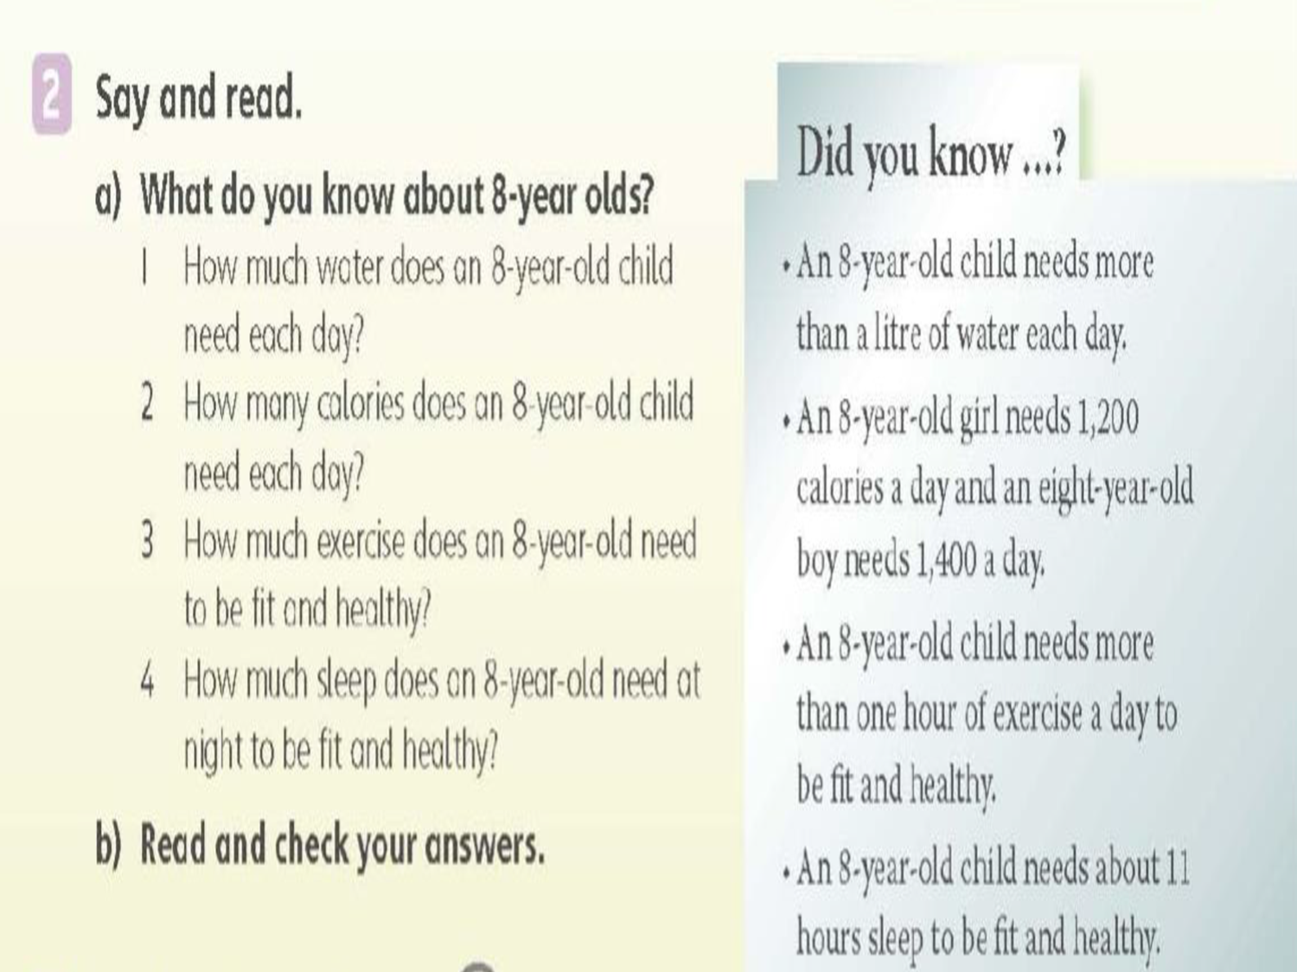
Reading
1 More than one litre.
1,200 calories for a girl and 1,400 for a boy.
More than one hour a day.
About 11 hours.

Slide 7
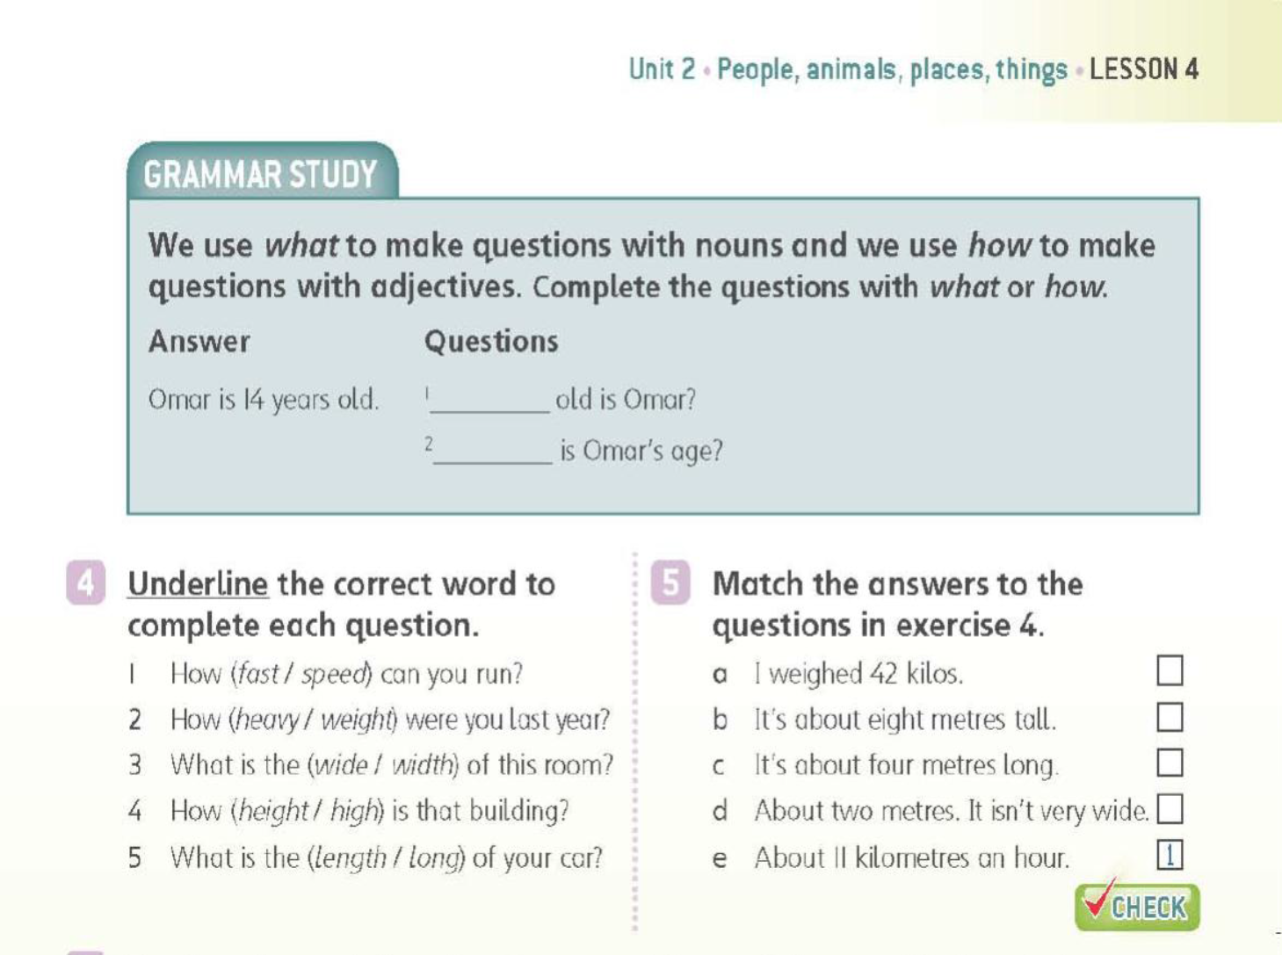
2
4
5
3

Slide 8
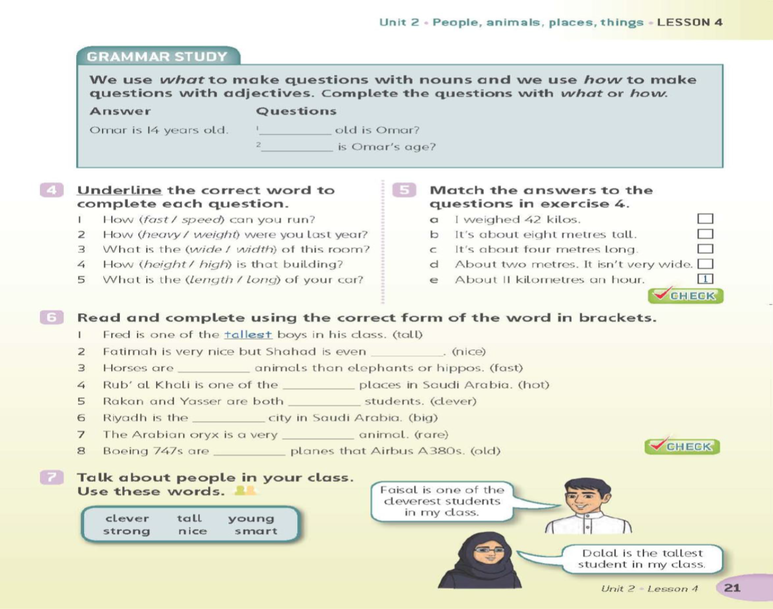
nicer
faster
hottest
clever
biggest
rare
older

