Slide 1
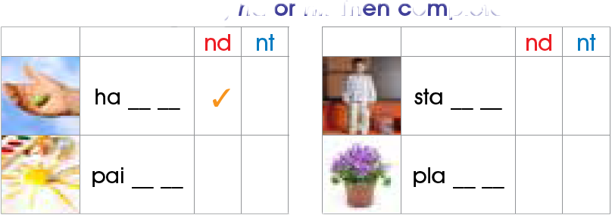
lesson
4
Phonics
1. Listen , read and practice .
2. Listen , and check ( √ ) nd or nt , then complete the words .
n d
n d
√
n t
√
n t
√

Slide 2
2. Listen and circle the words ending in nd and nt then chant

Slide 3
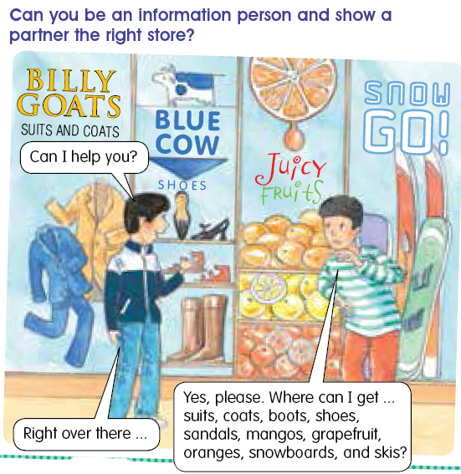
4. In the shopping mall .
Can you be an information person and show a partner the right store

