Slide 1
lesson
3
Reading and writing

Slide 2
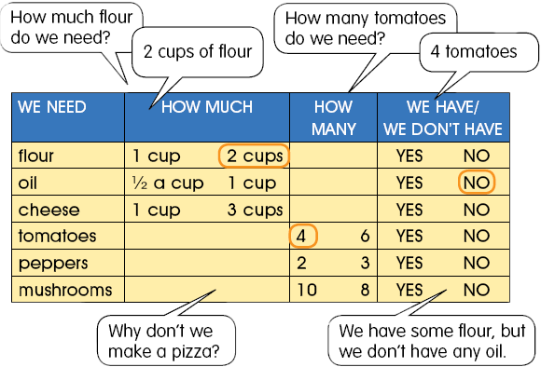
1. Listen and read , circle the answers in the chart .

Slide 3
2. Listen and circle Yes , No , in the chart , practice in pairs .
3. Write two sentences with some , any ,and but .

Slide 4
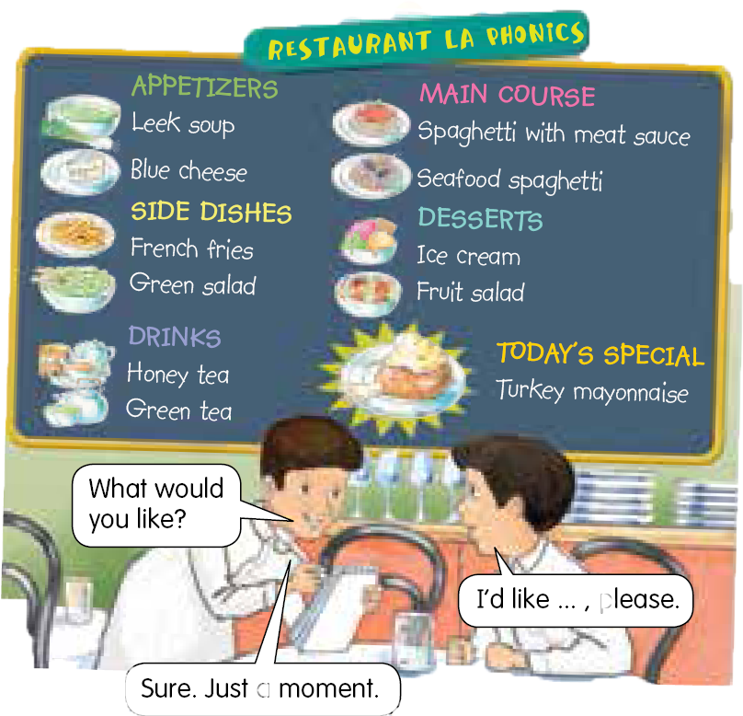
4. Ordering in restaurant .
Can you be a waiter or a waitress and take an order from a partner

